Slide 1
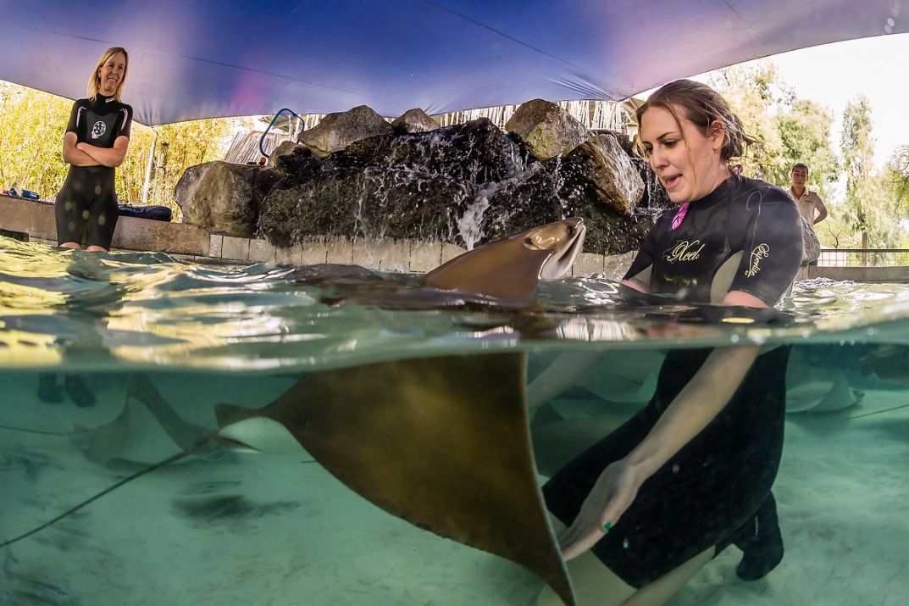
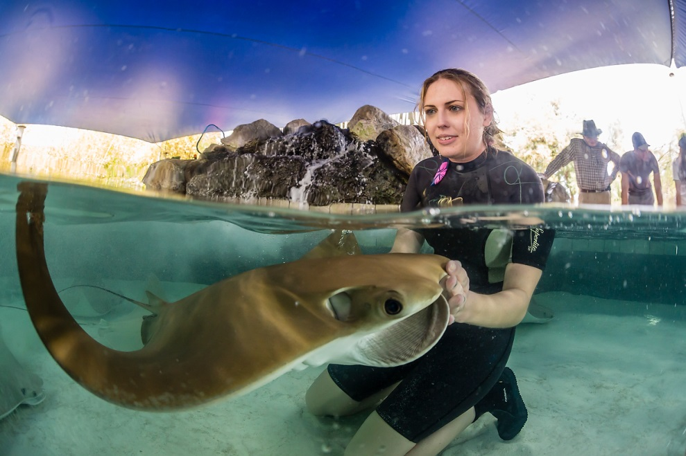
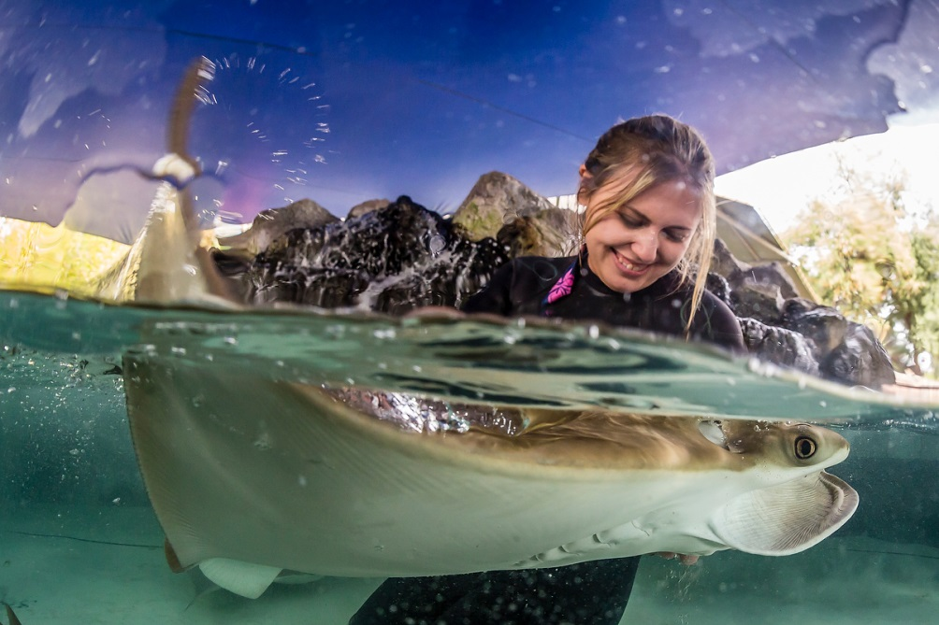
Improving the Lives of “Touch Tank” Elasmobranchs Through Enrichment and Training
Lindsey McLaurin and Hilda Tresz
Phoenix Zoo

Slide 2
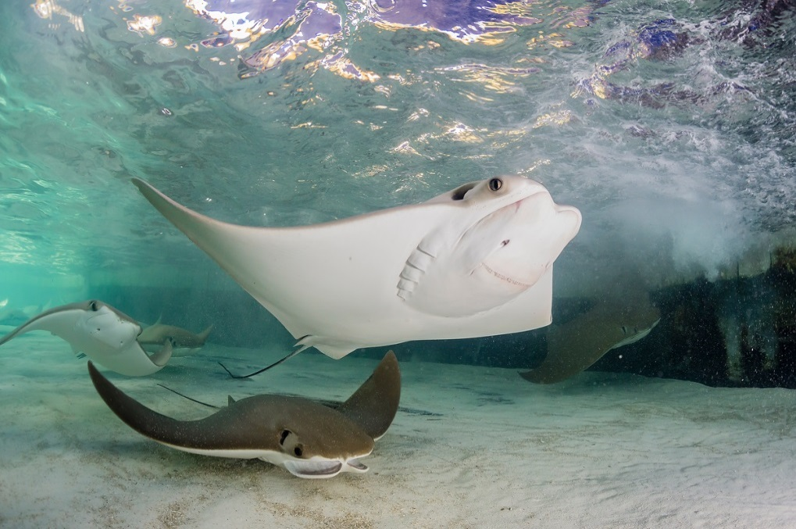
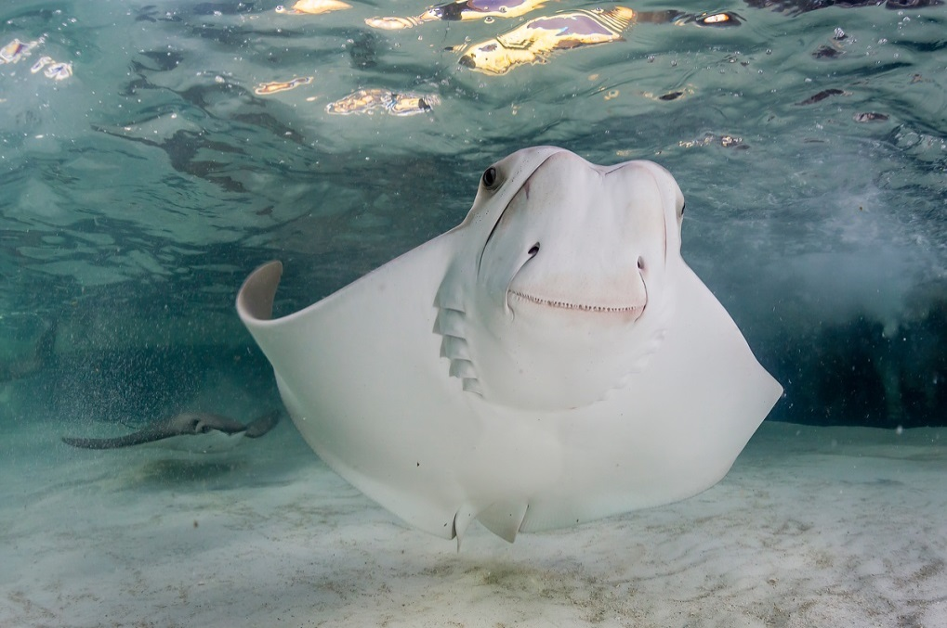
Phoenix Zoo Goal
Create a new, more complex enrichment program to:
Improve welfare and cognitive ability
Educate guests
Generate more interest for a paid exhibit
Raise the bar on available enrichment information
Demonstrate that these animals are more intelligent than generally believed
Notes:
-There are not a lot of enrichment ideas for stingrays that are well communicated. Our goal was to create new, more complex enrichment devices that can be easily replicated. Our goal is to share these ideas so that hopefully other touch tanks will easily be able to provide more stimulation for these animals.
-A lot of guests that visit a touch tank do not know much about stingrays, so there is a great chance to educate the public. Many guests who see the training sessions or see these animals operating new enrichment devices have left with the new belief that these animals are “more than just a fish” and are actually capable of learning/problem solving.
-As we will discuss shortly, enrichment and training have recently been proven to positively affect the cognitive ability in fish. We plan to use these new enrichment ideas to help the animals improve their cognitive ability while also educating the public in an exciting way, which in turn helps promote an exhibit that creates revenue for the zoo.

Slide 3
The Goal of Enrichment
To promote species-appropriate behaviors by offering animals a sense of control of their environment by allowing them to make choices.
Behavior: anything an animal does (loosely)
Species-typical behavior: anything an animal does in the wild
Species-appropriate behavior: any species-typical behavior that an animal is allowed to do in captivity (Example: harmful aggression, infanticide is not allowed)
Notes:
In passing the Animal Welfare Act , Congress did not intend such extremes to be promoted in the maintenance of captive primates. Therefore, the term species-appropriate behavior has been adopted instead of the more common term, species-typical behavior.

Slide 4
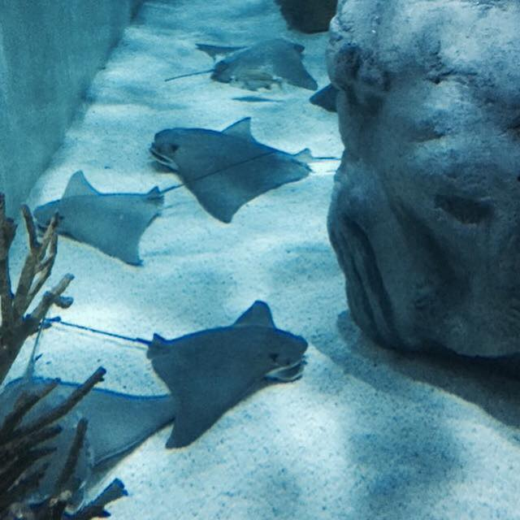
The Effect of Enrichment on Fish
Environmental enrichment promotes neural plasticity and cognitive ability in fish (Salvanes et. al, 2013)
Enriched fish were more likely to succeed at problem solving in a maze –they previously learned through a trial an error process
Completed it faster
Made less mistakes
Increased learning ability
Enriched fish have been shown to have
More adaptive foraging abilities
Decreased aggression
Faster recovery from stressful situations
Improved social learning skills
More flexible shoaling responses
Notes:
A recent study done on captive juvenile salmon showed a correlation between enrichment and learning ability. They also found that fish exposed to enrichment made less mistakes in working their way through a maze than those in the control group. The enriched fish were able to improve upon their accuracy with each trial through the maze and were therefore exiting the maze faster each trial. The control group did not increase their time exiting the maze with each trial like the enriched.
There have been similar studies in fish rearing that have concluded that fish exposed to enrichment have decreased aggression, are able to recover faster from stressful situations, improve their social learning skills, and have more flexible schooling responses.
Based on the findings in the cognitive ability study, keepers at the Phoenix Zoo began to evaluate the types of stimulation that the cownose rays were exposed to in the touch tank.

Slide 5
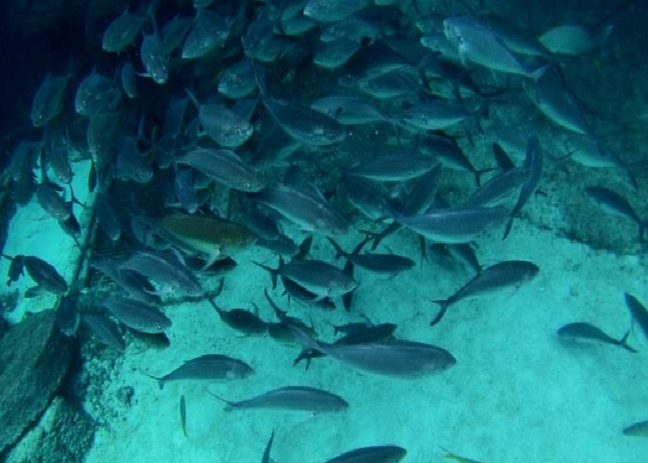
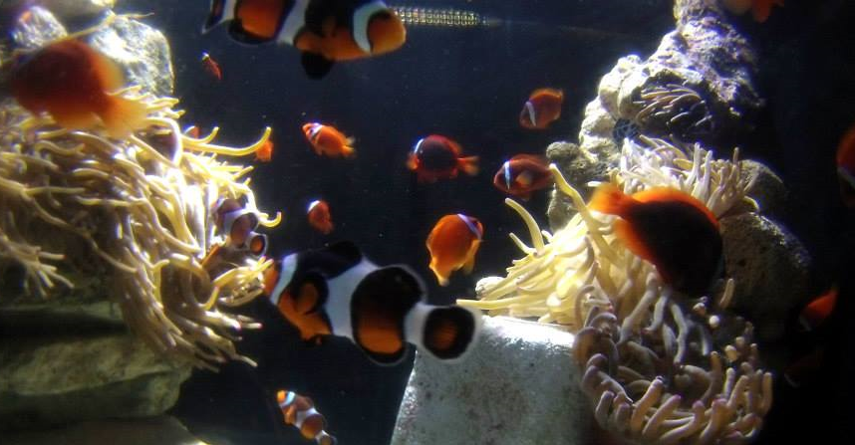
Schooling Schoaling
Synchronized group, facing same direction
Confuses predator
Minimizes chances of individual being eaten by larger fish
Buddy systems, exhibiting individual behaviors , following a general direction, join or leave shoals
Groups stay together for more social reasons
Finding mates
Foraging success
Detection of predators
Common behavior in the wild but not in aquariums
Aquariums lack predators and have abundance of food/resources for animals
(Aparna, 2011)
Notes:
Fish schooling and fish shoaling are two different behaviors.
Schooling behavior is when fish are swimming together in a very tight formation and in a very synchronized manner. If you have at least seen the movie Finding Nemo then you have seen an example of schooling fish. The fish move together quickly in the same direction and synchronized patterns to confuse predators and to minimize their chances of being eaten by larger fish. They are also more likely to find the resources that they need when they are together.
Shoaling is a more social behavior in fish. Fish showing a shoaling behavior will swim together following a general direction, but do not always stick closely together like the schooling fish. Individuals of a shoal are more likely to show individual behaviors and do as they please like foraging at different times, resting in sand, etc. Shoals are known to create more of a social benefit to the animals of the group by being an easy way to find mates, forage together as a group (therefore making foraging easier), and to easily detect predators. Fish can choose to switch shoals based on finding more individuals that resemble them. (shoalmates) Shoaling is a behavior that is very common in the wild but is also a behavior that we tend to not see as much in captivity. Animals prone to shoaling in the wild will be less likely to interact and shoal together because they have an abundance of resources and a lack of predators. Without these two stimulants we would be less likely to see these behaviors in captivity. The study from the previous slide mentions that fish exposed to enrichment have more flexible shoaling responses. This means that enrichment could be used to bring out these natural behaviors in fish in captivity.
Shoaling fish often find “shoalmates”, which are fish that they consistently follow that have a similar appearance (size, color). We have noticed within our own population of cownose stingrays that Phil began to closely follow Annie. Both of these animals have incredibly similar physical features. The following behavior began during training sessions as he tried to get to the food that Annie had access to. These two animals are often seen swimming together and will follow each other when the keeper is in the tank. This would support the idea that the training enrichment has encouraged a shoaling behavior between these two animals in particular.
Picture credit:http://blogs.disney.com/oh-my-disney/2013/09/30/how-well-do-you-know-finding-nemo/
Picture credit: http://disney.wikia.com/wiki/Moonfish
Picture credit: http://www.natureworldnews.com/articles/303/20121108/sounds-fishy-clownfish-make-calls-show-status.htm

Slide 6
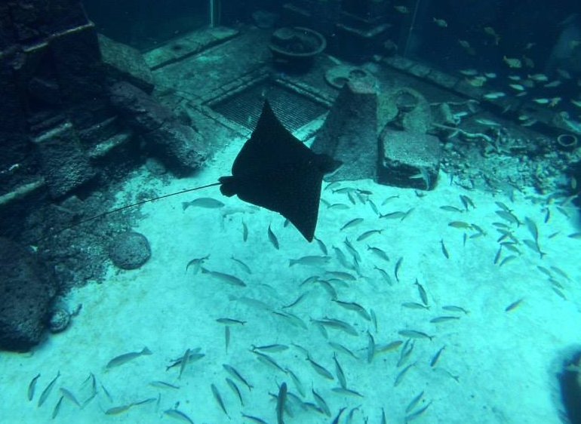
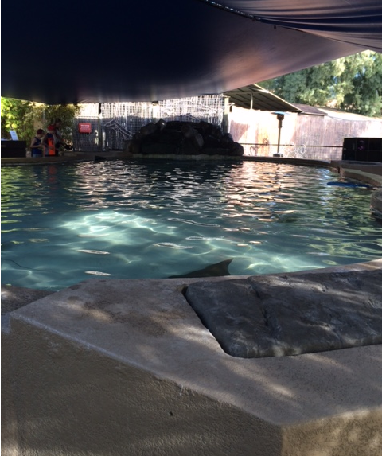
Influence of Exhibit Design on Captive Elasmobranchs
Exhibit design often considers species’ needs (e.g., Pelagic, benthic, semi-pelagic, etc.)
Natural environments
Aesthetic
Natural looking
No direct human contact
Touch tanks often monotone & not natural looking
Lacking detailed exhibit design
Human contact greatly effects behavior
Making stereotypic behaviors even more possible
Notes:
Exhibits can be designed for elasmobranch species based off of a few different concepts:
-What does each species need? Pelagic, benthic, semi-pelagic, and other species of elasmobranchs have specialized needs that are
taken into account when designing exhibits.
- There are many exhibits that are designed to mimic a natural environment for these species and promote natural behaviors. But captivity gives us certain limitations on creating a natural environment, making it very difficult or almost impossible to have an exact replication.
-There are many touch tanks with the same appearance like the one in this picture from the Phoenix Zoo. Touch tanks are undeniably a great interaction experience for guests and a great source of revenue for many facilities, but it is not impossible for the designs of these exhibits to have an affect on the behavior of the animals living in them.
-For example: Pelagic animals are accustomed to shallow water, being touched, and surface or hand feeding multiple times a
day. It is doubtful that a cownose ray would be used to hand feeding and constant human interaction in the open ocean.
There has been some research on rearing and domestication of fish and how this has affected brain development. When researching more about the affect that an environment can have on fish, we learned that there have been comparative studies on closely related species of cichlids in the African Rift Valley lakes have been revealed that environmental factors cause a rapid change in the sensory processing structures of the fish brain.
While there has not been a lot of documentation on stingray behavior specifically in a touch tank environment, the elasmobranch husbandry manual states:
Providing enrichment for elasmobranchs and achieving or increasing the incidence of natural behaviors can be a challenge. What precisely
constitutes natural behavior for elasmobranchs is often subjective and open to debate.
So with the promotion of natural behavior already being a challenge in captivity and there also being a challenge of determining typical elasmobranch behavior, what can we learn from touch tank elasmobranch behavior and how can it be influenced by different stimulants?
Photo credit: http://www.dailyherald.com/storyimage/DA/20130322/entlife/703229992/EP/1/6/EP-703229992.jpg&updated=201303212251&MaxW=800&maxH=800&updated=201303212251&noborder

Slide 7
So….
Can touch tanks elicit natural behaviors?
Elasmobranch Husbandry Manual:
The exact definition of natural behavior for elasmobranchs is subjective.
(Smith et. al, 2004)

Slide 8
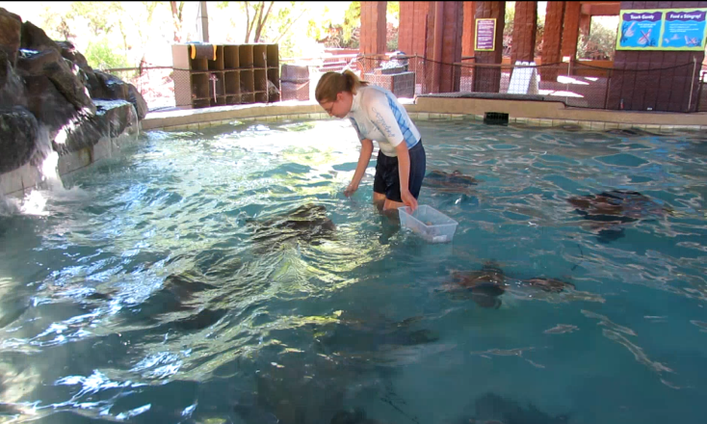
Creating an Ethogram
Environment doesn’t replicate the natural habitat
Same depth, constant touch, no option to migrate, hand fed
Lack of sufficient information on stingray behavior
Referencing manta ray ethograms did not depict behaviors seen in our cownose rays (Georgia Aquarium, 2011)
feeding, breaching
Lack of sufficient enrichment information
Questions we wanted to answer
How do these animals react to new enrichment?
Do they prefer certain enrichment?
Does enrichment influence their behavior?
If yes, how?
What behaviors do they exhibit and what are the definitions of these behaviors?
Notes:
Finding information about captive elasmobranch behavior, particularly cownose ray behavior, can be challenging. There either have not been sufficient studies done to evaluate their behavior in touch tanks or this information is not easily accessible for caretakers.
-There are some ethograms that have been created for shark species and also for manta rays. Keepers reviewed various shark and manta ray ethograms but realized that these ethograms did not help evaluate the behaviors seen in our population of cownose rays.
-Based on a lack of information for the questions that we wanted to answer, we decided to create our own ethogram.
-The ethogram that was created was based on specific behaviors seen in the population of cownose rays inhabiting the touch tank at the Phoenix Zoo.

Slide 9
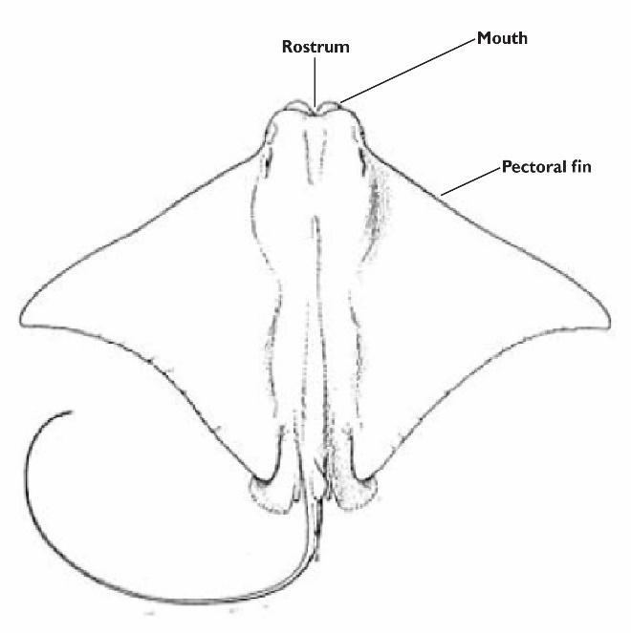
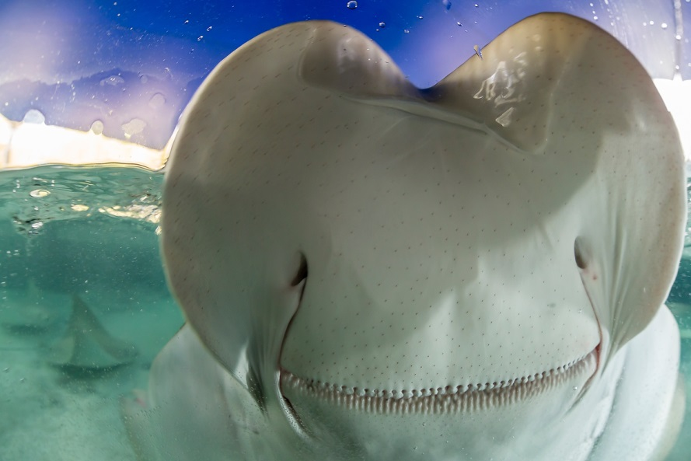
Main Behaviors to Be Enriched
Nineteen behaviors were defined
Foraging- Animal is searching with mouth for food.
Inspection- Animal slowly approaches object to close proximity, sometimes bumping or touching object with pectoral fins or rostrum, then swims away.
Oral Inspection- Animal swims over top of object or positions head and mouth over or near object being inspected. The lobes that surround the mouth are protruding and moving around the object being inspected.
Favored Use- Animal changes usual (circular) swim pattern to use specific enrichment item or an animal uses an item and then immediately turns around to reuse the item.
Notes:
The following behaviors are an excerpt from the ethogram designed for the population of cownose rays at the Phoenix Zoo.
Out of the behaviors that we have seen with our population of rays, these are some that we see consistently during enrichment.
The behaviors that you see listed here are behaviors that we began to pick up on after videotaping their behavior. We noticed that they would inspect new objects primarily by bumping with their rostrums or brushing/touching with their pectoral fins. Some individuals that seemed to spend more time with certain objects would begin to very slowly inspect with their mouths; we would see the lobes protrude and move slowly around the object, especially when no food was involved.
We also noticed a correlation between animals exhibiting this oral inspection behavior and figuring out how to use the object. They were not only more likely to figure out how to properly use the object, they were more likely to interact with the object repeatedly as described in our ‘favored use’ behavior.
Based on the consistency in these correlations we have seen between interaction with enrichment and these particular behaviors, keepers decided that these are the most desired behaviors to enrich in our population of cownose rays.

Slide 10
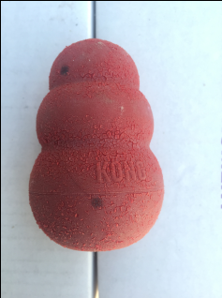
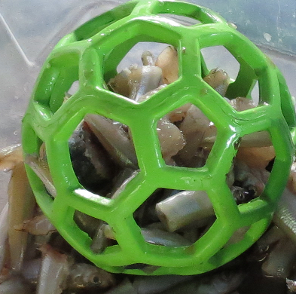
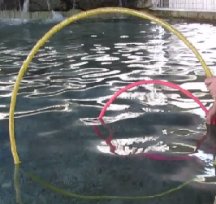
Commonly Practiced Enrichment vs. Phoenix Zoo Enrichment
Elasmobranch Husbandry Manual
Different temperature gradients
Moving underwater structures
Hiding food in exhibit
Changing water flow
Live prey
(Smith et. al, 2004)
Artificial looking environment and enrichment promoting natural behaviors
Food balls
Kong toys
Feeder Tubes
Hula Hoops
PVC pipes
Etc.
Notes:
In the left hand column there is a list of enrichment ideas from the elasmobranch husbandry manual. In the right column there is a list of the more common artificial enrichment items that we started working with and eventually developed more ideas from. We have found that PVC pipes are a great source for creating new enrichment structures and are also cost efficient.

Slide 11
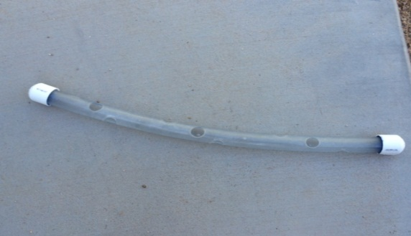
Forage Balls

Slide 12
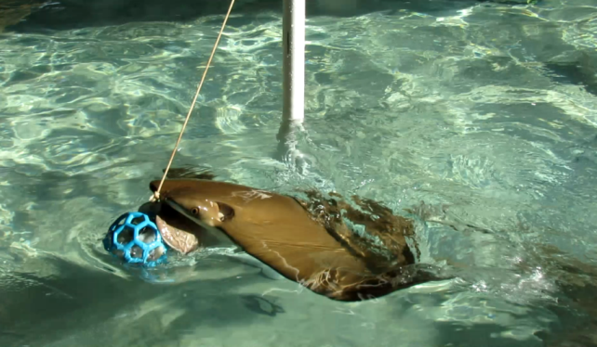
Tetherball Set
A new way to use foraging balls
Increases level of difficulty
Different set of skills
Different set of muscles
Notes:
Keepers recorded the amount of time taken to get food out of the normal foraging ball at an average of 39.85 seconds (.664 min). When this foraging ball is attached to the tetherball set the amount of time taken to get all of the food out averages at 2.88 mins. This is a significant increase in foraging time, showing that this item creates a more challenging way for the animals to use a familiar enrichment item.

Slide 13
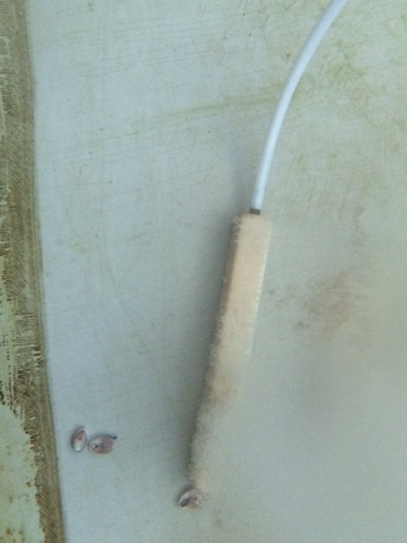
Using Behavioral Observation to Create New Enrichment
Animals were consistently changing their swim pattern to interact with airline tubing connected to the airstones. They liked dragging the airstones.
They also change their swim patterns to swim through hula hoops
Notes:
In the summer of 2014 our exhibit shut down for maintenance. All animals were moved to temporary holding behind the scenes. Being temporary, this holding tank was circular and did not provide much stimulation.
-Keepers would enter this tank twice a day for cleaning. After a while we began to notice that the animals were choosing to interact with any object that they could, which was mostly the airstones that were connected to the airline tubing. They would swim into the
airline tubing and would position it in the center of their rostrum, then swim in various directions-which in turn would drag and move the airstones around.
- Some afternoons keepers would weigh down hula hoops while they were in the tank cleaning. Every animal in the tank would
participate in swimming through these hula hoops.
It was the observation of these two behaviors that gave keepers the idea to design a new enrichment device for the animals that combined the experience of interacting with the air line tubing and swimming through the hula hoops.

Slide 14
Stingray “Carwash” Enrichment
Combines the experience of swimming through hula hoops and airline tubing
Notes:
So far this is the most successful piece of enrichment that has been introduced. This item is safe enough to be placed in the exhibit in the morning and left while keepers proceed with their daily tasks. The animals use this item repeatedly throughout the day and also move it around their exhibit.

Slide 15
From Hula Hoops to Problem Solving?
The animals started to mouth, push, pull and carry the hula hoops
Large-small hoops
Yellow, blue, pink
Notes:
Annie- chose pink
Carried it away
Try to hide it under
Ladder
Color preferences could
be studied further
Notes:
-As previously mentioned, the stingrays would show a lot of interest in swimming through the hula hoops. While reviewing some of the enrichment footage one day we noticed that one particular stingray interacted with the hula hoops very differently than the others, especially the hot pink hula hoop. She would approach the hoop, turn while inside of it, and inspect it with her mouth. After a few seconds of inspection we saw her secure the hoop to her rostrum, pick it up, and carry it away.
-What was not captured on camera was that she swam away from the rest of the stingrays with the hoop and tried to take the hoop under the ladder that the keepers would use for entry to the isolation tank. She did not try this with the yellow or blue hula hoops, she would only do this with the hot pink hoop.
After seeing the behavior of this stingray with the hula hoop, we began to wonder if her interest could lead to new training and learning tactics, so we began to train her to retrieve the hula hoop on command.

Slide 16
Training as Enrichment-Retrieving
# 11615 (Annie) was then trained to retrieve
The retrieval behavior was consistent and she has developed different ways (i.e. angles and pushing methods) to deliver the hula hoop.
Thirty days could pass between training sessions and she did not regress to any steps in the training plan.
After awhile other stingrays began to follow and mimic the behavior, trying to steal the hula hoop from the animal being trained.
She repeated it with similar items as well such a dive rings.
Notes:
What we found out was that not only could we train her (“Annie”) to bring consistently retrieve the hula hoop, we could actually introduce similar items for her to retrieve. So far we have only used the hot pink hula hoop and the smaller dive rings because they are the easiest for her to manipulate and carry long distances.
After awhile of consistent training a male stingray began to follow Annie during sessions. He began to interfere with sessions and would mimic her behavior. He actually began to steal the hula hoop mid session before she could deliver it to the keeper, but he did not bring the hoop to the keeper. Instead we had to spend time trying to take the hula hoop away from him. While he was never taught to bring the hula hoop on command, keepers do suspect that he was able to associate the hula hoop with reinforcement.
To keep this male from intervening in further training sessions with Annie, we developed a separate training program for him. He would not be reinforced for any interference during Annie’s training session, but he could hover nearby and would be reinforced when his target was placed in the water after the session was over. He eventually was able to progress to more advanced training to weave his way through an agility set.

Slide 17
Problem Solving (Without Keepers)
Notes:
Annie was given access to her training hula hoop one morning for some enrichment. A few minutes later I walked into the bay and saw that she started to bring her hula hoop to the guests at the side of the exhibit. She was able to make the connection of bringing her hula hoop to the people at the side of the tank-something we have never practiced-for a reward. When she did not get a reward from the guests she took her hula hoop back to the middle of the exhibit. I gave her the hand signal to bring it back and she brought it to the side of the tank again for a reward. We will be working on this more often now to see if it can become consistent. This is a good example of how enrichment can stimulate

Slide 18
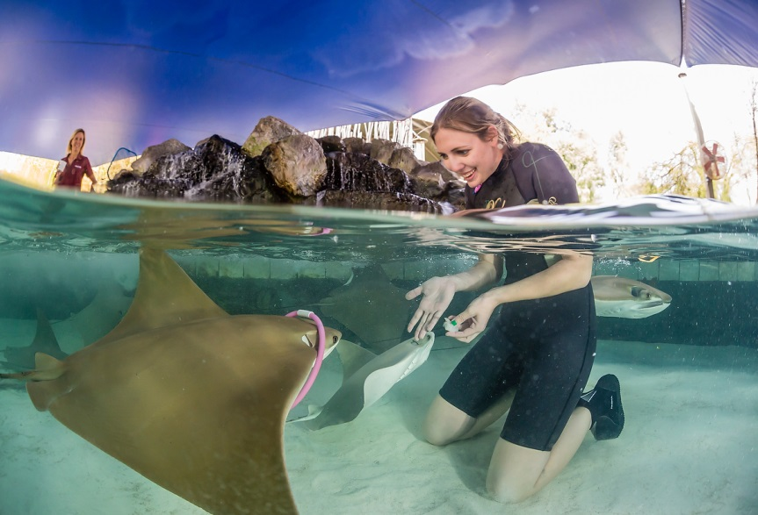
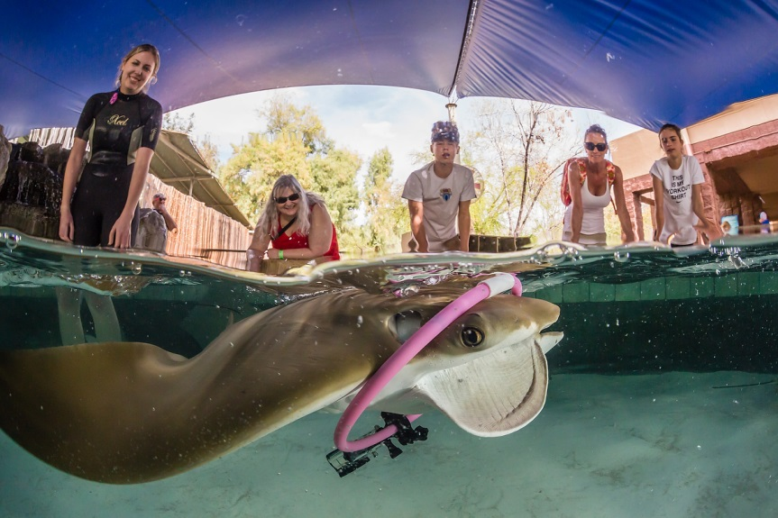
GoPro Training
Keepers attached a GoPro camera to the dive ring that Annie is trained to retrieve.
Annie picks up the ring and camera from the keeper on cue and carries it around the tank until the cue is given to return the camera.
Notes:
Annie was already comfortable swimming to the keeper to pick up the dive ring and follow the keeper with it. Keepers decided to take her training to the next level and attached an underwater camera to the ring. The camera was harnessed to the ring with string.
During the first training session, the camera was off. The keeper was waiting to gauge the animal’s reaction to the additional shape and weight to an item that she was used to carrying. Annie approached the ring and camera without slowing down or hesitating, slid her rostrum through the middle, and followed the keeper. The camera was turned on for the second attempt, and Annie behaved the same way and followed her trainer. By the third attempt, Annie picked up the camera-but instead of following the trainer she calmly turned away and swam around the tank. The keeper gave the cue to return after the first loop, and Annie returned the camera to receive her reward. By the fourth attempt, Annie was leisurely swimming multiple loops around the tank for minutes at a time while carrying the camera.
Two other stingrays (Phil and another female named Ellie) have followed Annie during these sessions and have also learned to wear this camera. The other female is more comfortable with it than the male and even follows the exact same cues that Annie is given during sessions. This other female-named Ellie-had never been taught retrieval before, everything she has picked up has been from watching Annie.

Slide 19
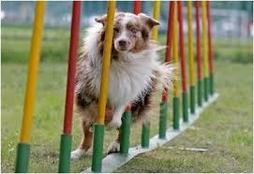
Stingray Agility Set
Animals trained to weave through the poles.
The goal is to help influence a change in routine; to discourage the monotonous circular swim pattern.
Hoping to influence coordination, mental alert, quick thinking, confidence, following and stronger bond with keeper.
Notes:
With no furniture in our touch tank, our stingrays would spend all of their time swimming in one large circle. We decided to build something that would encourage them to explore their space differently. The agility set was introduced with the intent to encourage the stingrays to swim through at different angles to break up their monotonous swim pattern.
This concept was taken a step further after seeing the success of training with Annie and Phil, the interfering male mentioned from before. When the keeper first introduced the agility set to the tank she walked through the poles in the same pattern as the dog in this picture to demonstrate the concept of the device to viewers. When she turned around she realized that the two stingrays from training sessions were weaving through with her and following her. While Annie’s training sessions are still focusing on retrieval, she was also able to successfully learn to use the agility set. Phil, the male, has also been successfully trained to use the agility set.

Slide 20
Stingray Painting- Creating Possible Revenue
Using tips from the Saint Louis Zoo, keepers constructed a push paddle painting machine that stingrays operated.
Materials:
PVC piping material
Milk Crate to shield paint splatter
HolEE-roller food ball
Painting supplies
Notes:
We decided that creating a painting machine would be a type of foraging enrichment that could also be used to promote the exhibit. The food is placed into the forage ball at the end of the machine. When the animals try to get food out of this foraging ball they push on the PVC pipe, which in turn moves the brush that is above the water. This is an activity that guests love to watch.

Slide 21
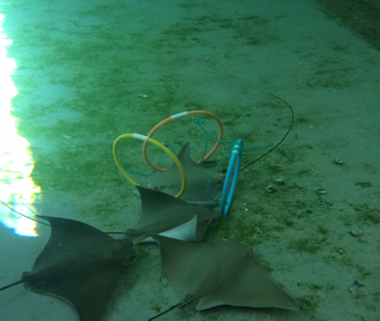
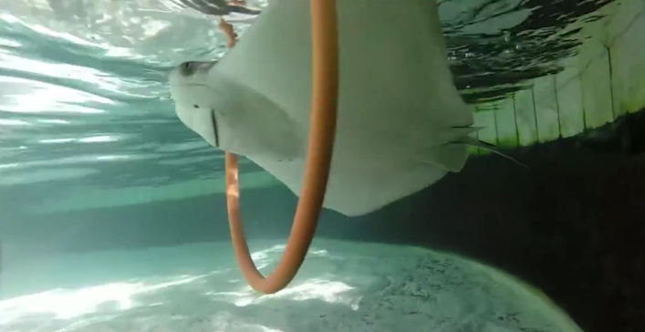
Pup Enrichment 2014-2015
Pup Enrichment 2014
Sixteen pups were born between 12/2014-4-2015
Behavioral observations:
Pups were given access to enrichment in the holding tank behind the scenes
Burying behavior not seen due to lack of substrate in holding tank
Hand feeding began within 1-2 months after birth
Aside from a few social pups, most avoided keeper interaction until after hand feeding was consistent
Spyhopping behavior very prevalent in 3 stingray pups (to the extent of injury)
Pup Enrichment 2015
Fifteen pups were born between 9/2015-11/2015
Pups had access to enrichment every day starting at birth in a nursery on exhibit
Hoops, Kongs, feeder balls
Keeper taught pups how to use hoops
Behavioral observations:
Burying behavior was seen immediately after birth
Pups born in 2015 were more social with keeper
Approached during cleanings and interacted with keeper
Allowed keeper to place hands on them and around the rostrum/mouth
Pups started handfeeding consistently at four days old
Spyhopping behavior seen occasionally in one pup, no injuries recorded
Notes:
Before the enrichment and training program started at the Zoo, the average birth rate was around 5 pups per year. In 2014 we had our first season with 16 births, and in 2015 we had our second successful season of 15 births.
Having to consecutive years with almost the same number of pups allowed us to observe a lot of behavioral differences during the rearing process. In 2014 we housed the 16 pups in a 10,000 gallon isolation tank behind the scenes. This tank allowed the pups to have a lot of space to move around in away from the adults and made it easy to monitor the amount of food being eaten by each pup. The isolation tank did not have any substrate or furniture, so foraging behavior was limited and burying behavior was not a possibility. Pups were given access to dive rings as hula hoop enrichment but were not taught how to use them. Keepers left food around the hoops so that the pups would become used to them and learn to use them on their own. Keepers also began to regularly socialize and train the pups to hand feed about a month after birth, and pups were becoming consistent at hand feeding around 3 months of age. Most pups being housed in the isolation tank were skittish around keepers, which is what made teaching to hand feed a longer process.
-Most importantly in this pup season, there were a few pups that exhibited a spyhopping behavior. They would move up and down the sides of the tank just at the water surface and would repeat this behavior throughout the day. This caused the animals to rub their ventral sides on the walls of the tank and to get abrasions. When inspecting the water quality and life support system we could find nothing wrong, and since a small number of the population was exhibiting this behavior we began to believe that this was an abnormal or stress behavior. One case became severe enough that a pup seemed to have open sores on his ventral side (but he would not stop the behavior). We came up with a solution to this case,
which I will mention on the next slide.
So in 2015 we tried something different with our second largest population of pups. We set up a nursery on exhibit so the pups were separate from the adults but still had a substrate to bury in. All pups placed in the nursery immediately after birth spent the entire first day burying in the substrate-except for the one part of the day where the keeper would socialize with them. Socializing began on the first day. Keepers would enter the nursery and held the dive rings similar to the hula hoops for the adults, and taught the pups how to use them. At first the pups were nervous about using the rings, but after a few turns they learned to curl their wings up and swim through. This was a positive learning experience for the animal and a stress free way to begin to socialize with keepers. With this new method keepers also decided to see what would happen if food was offered by hand right away. Pups began hand feeding and approaching keepers for food regularly as early as four days old. The spyhopping behavior seen in the previous year’s population of pups had been completely eliminated, and all pups were very consistent and comfortable with being hand fed and touched before being send to their next facility.

Slide 22
Social Enrichment
2014 Pups were taught to socialize and hand feed

Slide 23
Social and Hula Hoop Enrichment
2015 Pups were taught how to use dive rings and interact with keeper the day they were born

Slide 24
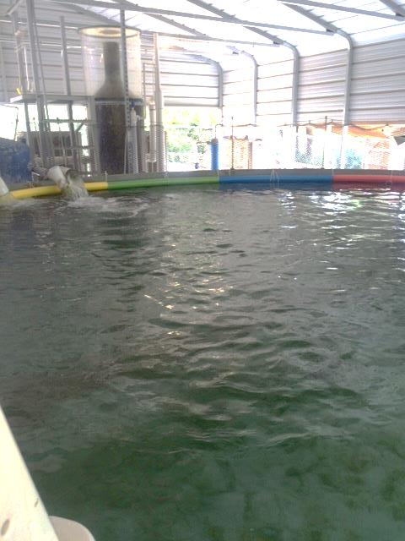
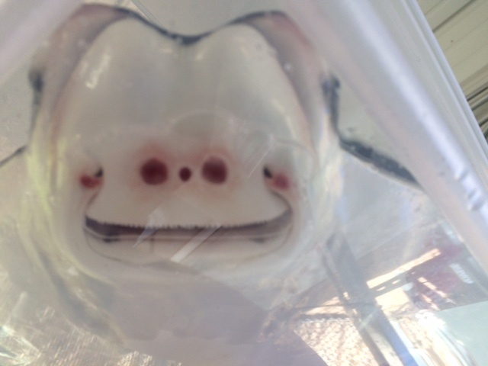
Possible Solution for “Spyhopping” Pup Behavior
Notes:
This year we had 16 pups born on exhibit. When the pups are born we acclimate them to our isolation tank behind the scenes. We have noticed that a few of our pups will occasionally “spyhop” along the walls of the tank; an up and down motion against the wall where the animal also ends up rubbing its ventral side. The result of this behavior can be ventral redness and abrasions. Pups that exhibit this behavior the most are likely to have more severe injuries like seen in the picture on the right. This particular pup had the worst abrasions that we have seen so far.
After testing water quality on a regular basis we could not find any scientific evidence that could be causing this behavior. Speculating that this may be a developed stereotypic behavior, we decided to try lining the tank with pool noodles. These pool noodles rest at the surface of the water where the pup would normally have access to this spyhopping behavior against the wall. The noodles are a soft surface that physically block the pup from being able to further injure himself by rubbing vertically on the sides of the tank.
When we first placed the noodles against the walls of the tank, the pup was trying to search for an open place on the wall where he could do this spyhopping behavior. After awhile of bumping his rostrum on the soft noodles and knowing he could not accomplish this behavior he began to resume a normal stingray swimming behavior and rested on the bottom of the tank for awhile (a behavior commonly seen in young pups). We have yet to see this behavior since the noodles have been in place, so we believe that this has been a successful deterrent for the spyhopping behavior.

Slide 25
Interesting Observations
The two stingrays with the most advanced training (agility set and retrieval)
Developed the most social behaviors with guests and with keepers
First to approach new enrichment devices
First to figure out the correct way to operate new enrichment..
Most likely to return to the enrichment repeatedly
Breeding influences?
Year before enrichment program was initiated: 5 pups born
First year of program-16 pups born
Second year of program-15 pups born
Decrease in the number of ‘spyhopping’ behaviors, no injuries
Rest of the rays in general:
When enrichment was given on crowded days:
Decreased
Tight schooling (swimming very closely and fast together to avoid danger to any directions)
Spiraling (more individual based, in the middle of the tank, away from animals and guests (row boat with only one paddle, circling in one spot, but not going anywhere)
Notes:
These are some observations that we have consistently noticed within our population as the new enrichment has been introduced.
Phil and Annie, the two animals who have had exposure to the most training are the first animals to approach all new enrichment in the tank, even if the first approach is just an inspection behavior.
-These same two animals are also the most likely to return to enrichment devices repeatedly, and are always first to figure out how to operate the new enrichment correctly.
-They are also the two most talked about animals in the population of cownose rays, as their behaviors have become increasingly
social with guests over the span of the year where they have received this training. Guests are excited to recognize and interact with
them, keep track of them, return to the exhibit to see them again, and ask our exhibit guides about them.
-The stingrays have been able to go over 30 days without training and not forget any of the steps in their sessions.
-On holidays, spring breaks, and other busy times our exhibit can have multiple days in a row where it is at capacity with a constant long line. This constant exposure to guests and touch can cause the animals to form a tight schooling behavior in the middle of the tank, away from the guests’ hands. Some animals exhibit abnormal behaviors like spiraling in the middle of the tank away from animals and guests. Keepers have observed that when the new enrichment items are placed into the exhibit (particularly the carwash), there is an almost instant decrease in this stress based behavior. The animals spend time interacting with the enrichment and eventually resume normal behavior, while periodically returning to interact with the enrichment again.
Keepers are currently developing a training program for the entire population of stingrays to reduce stress in barb trims and other medical procedures.

Slide 26
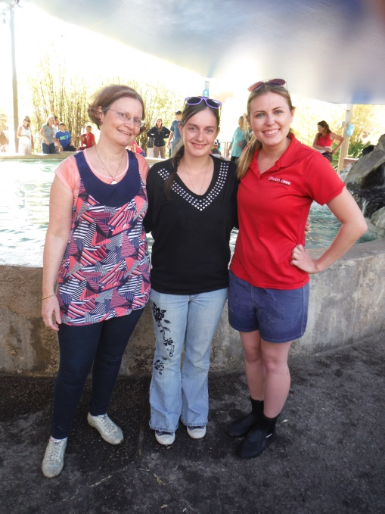
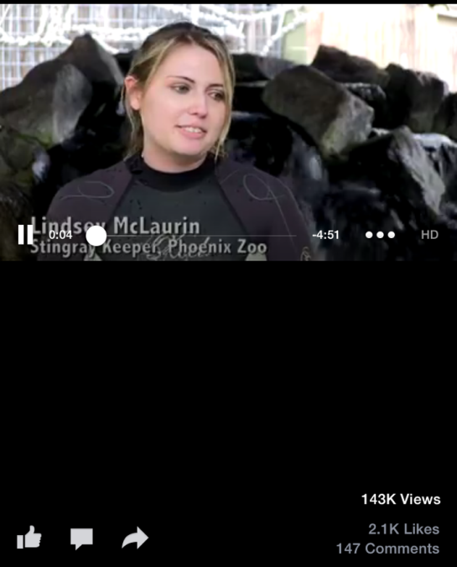
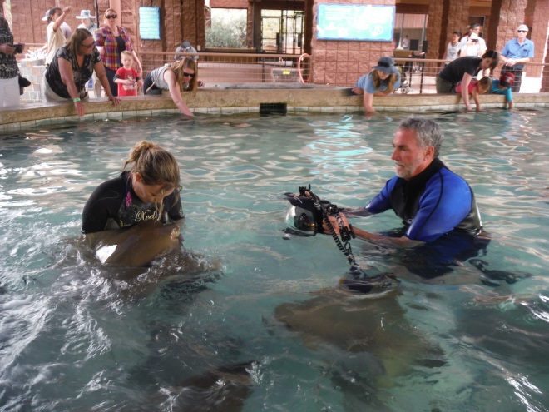
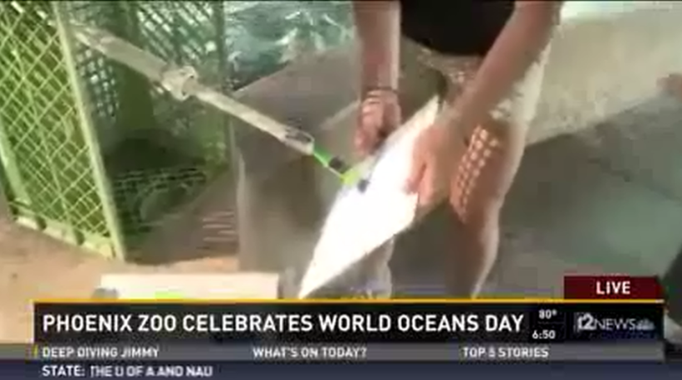
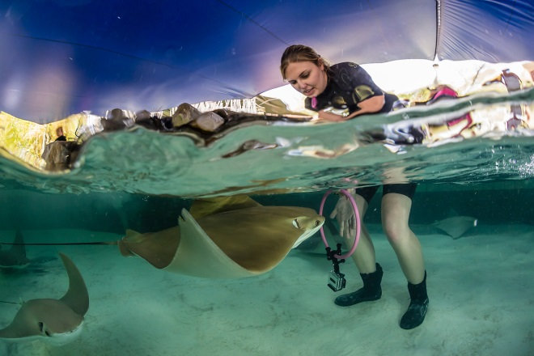
Enrichment and Media
Stingray Bay is the highest paid for exhibit at the zoo.
The enrichment at the bay has received a lot of attention from guests and from fellow zoo employees.
Promotional activities with the media
Increasing revenue for paid exhibit
Superbowl prediction, World Ocean Day
Publication in Drum and Croaker
Facebook training video
Over 140,000 views
Guests want to meet Annie
Visitors from around the world
National Geographic
Notes:
We have a lot of new and exciting enrichment devices for the stingrays, and we have noticed that guests have enjoyed seeing them when they are interacting with the animals. Since this is a paid experience for guests and we have had such a positive response with our enrichment we have used this for the media
We released footage of our training GoPro training sessions with Annie to the Phoenix Zoo’s Facebook page. This video has had over 140,000 views and has been share all over the world. Institutions are beginning to contact us for advice on training elasmobranchs and for advice on enrichment. We have also been contacted for help by institutions who have behavioral or animal welfare issues with their elasmobranchs. Our goal is to show the world that these animals are more intelligent than they are given credit for and to promote the idea that they require more stimulation in captivity, and we are starting to reach people around the world.

Slide 27
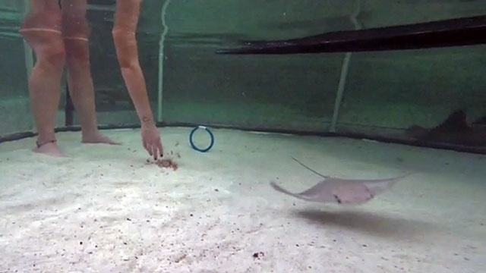
Spreading the Word
Jacksonville Zoo and Gardens, FL
Notes:
The Jacksonville Zoo and Gardens recently had its first stingray pup. When contacting our aquarists for information on pup rearing, we mentioned the enrichment that we have done so far with our pups and that the animals are having success in the interactions with the new enrichment. The Jacksonville Zoo is planning on implementing some of our pup enrichment with their newborn pup. This is an excerpt from a press release. We are hopeful that touch tank enrichment will become more common.
Aquariums from around the world are now contacting us on enrichment, training, and pup rearing. Our goal is to spread the message that these animals deserve more stimulation in captivity and that they are capable of more than we realize. If we do this then we can improve animal welfare as a whole and we can change the public’s perception of these misunderstood animals.

Slide 28
Acknowledgements
Special thanks to the Phoenix Zoo Management for supporting behavioral enrichment and for all keepers who take time to provide proper enrichment for their animals on a daily basis.

Slide 29
References
Aparna, Bhaduri (2011) Mockingbird Tales: Readings in Animal Behavior OpenStax College.
Georgia Aquarium Manta Ray Behavior Chart. (2011). http://www.docstoc.com/docs/83950647/Manta-Ethogram-3
Mari Belko Photography
Salvanes AGV, Moberg O, Ebbesson LOE, Nilsen TO, Jensen KH, Braithwaite VA. 2013 Environmental enrichment promotes neural plasticity and cognitive ability in fish. Proc R Soc B 280: 20131331. http://dx.doi.org/10.1098/rspb.2013.1331
Smith, M., Warmolts, D., & Thoney, D. (2004). Elasmobranch Husbanndry Manual: Captive Care of Sharks, Rays, and their Relatives (R. Hueter, Ed.). 170-170. https://sites.google.com/site/elasmobranchhusbandry/manual
Stingray artwork at St. Louis Zoo. (2010). https://www.youtube.com/watch?v=k0CdSGV5wf8
Michael S. Nolan Wildlife Images 4812 N. Avenida Largo Tucson, AZ 85745

Slide 30
Appendix
Ethogram for Rhinoptera bonasus
For further questions please contact Lindsey McLaurin at lmclaurin@phoenixzoo.org

Slide 31
Ethogram for Rhinoptera bonasus
By: Lindsey McLaurin
Solitary behaviors
Foraging: Animal is searching with mouth looking for food.
Bury: Animal lays flat on the sand and moves sand onto its back using mouth or body; animal lays still on the floor of the tank with sand on the back. No food is present.
Retreat: Animal has been startled and swims away very quickly from a guest, object, another animal, or sometimes nothing visually noticeable. Animal will sometimes splash during retreat. In rare or serious circumstances animal may try to breach (jump out of water).
Pattern: Animals are swimming in their normal, calm, circular motion around the tank.
Social behaviors
Guest: Animal approaches guest against wall of exhibit and allows guest to touch when no food is present.
Keeper: Animal approaches keeper, follows keeper, or investigates keeper’s activity. Keeper can be in or out of the water, no food is present.
Feeding: Animal chooses to interact with human (guest, keeper, guide) when food is present.
Tight Schooling: Multiple or all animals are swimming quickly and very close together. This is commonly seen when keeper is in the water trying to catch animals.
Notes:
Due to the number of animals in our tank, the ethogram is used in a scan sampling method. After taking observations and defining key behaviors, keepers will begin to use this to evaluate animal behavior with enrichment exposure.

Slide 32
Ethogram for Rhinoptera bonasus
By: Lindsey McLaurin
Social Breeding
Breeding Chase: One or more males following a female closely and quickly while trying to bite on her pectoral fin.
Breeding flip: Male successfully bites onto the pectoral fins of the female and successfully flips her onto her back.
Copulation: Successful contact between the male’s claspers and the female’s cloacae. This can be difficult to see, but occurs almost immediately after breeding flip.
Social Aggression
Block: Animal uses body to prevent other animal(s) from gaining access to item/food. Animal will either push/swim into another or swim higher/over top of another animal. Animal receiving block behavior is not able to access food/item.
Submission: An animal specifically receives blocking behavior from another and swims away, giving up the chance to have access to the desired object, food, or interaction.

Slide 33
Ethogram for Rhinoptera bonasus
By: Lindsey McLaurin
Manipulation
Inspection: Animal slowly approaches object and gets close to object, then swims away. During inspection they will sometimes bump their rostrum or brush pectoral fins against object before swimming away.
Oral Inspection: Animal swims over top of object or positions head and mouth over or near object being inspected. The lobes that surround the mouth are protruding and moving around the object being inspected. If food is involved then that is foraging , not oral inspection.
Favored Use: Animal changes usual (circular) swim pattern to use specific enrichment item or an animal uses item and then immediately turns around to reuse item. This would not apply if keeper puts item within the normal circular swim pattern in which the stingrays swim in.
Possible Abnormal Behaviors
Spiraling: Animal is seen swimming in very tight (small), repetitive circles with no obvious direction or gain to the animal. This does not include swimming in their normal circles around the tank or turning to change direction.
Spyhopping: Animal is vertical in the water and moving in an up and down motion with the head bobbing in and out of the water. Animal can be doing this against the wall of the tank and can injure its ventral side.

