Slide 1
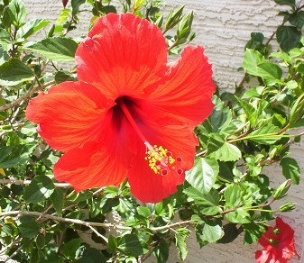
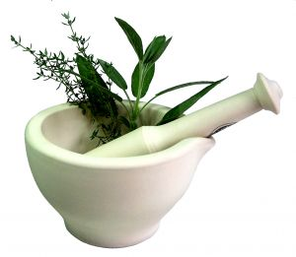
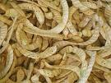
Beneficial Browse
有用的动物园植物
The start of a browse program at the Phoenix Zoo
凤凰城动物园植物项目的开始
Hassena Kassim,
Tracy Montgomery
Hilda Tresz

Slide 2
Empty cages / Empty environments空笼/空旷的环境
Many animals are exhibited in enclosures without vegetation or other stimulation.
很多动物都被关在没有任何植物或者其他刺激物的笼舍里

Slide 3
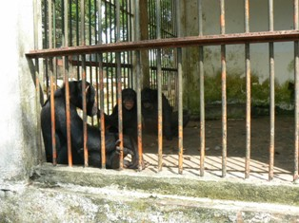
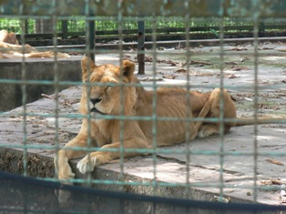
Lack of vegetation can have negative effects on an animals physical and psychological well being.
缺乏植被可能会对动物的身心都会产生负面影响

Slide 4
Vegetation and browse = Healthy, Stimulated
草木加上自由取食=健康、刺激

Slide 5
From Desert to Eden从荒漠到伊甸园
Providing browse is not impossible, not even in a desert environment
提供一个有植被并自由取食的环境并不是不可能，
即使是在沙漠都是有可能的
The Phoenix Zoo is located in the Sonoran desert
凤凰城动物园位于索诺兰沙漠
Desert climate with temperature ranging from 28F to 125F
沙漠性气候、温度28-125华氏度（2.2-51.7摄氏度）
Lack of reliable water supply with 10 inches or less of annual rainfall
年降雨量少于254毫米，缺乏水资源
Dust storms沙尘暴
Heat Island Effect due to urban environment
城市热岛效应

Slide 6
Desert landscape in the past
历史沙漠景观

Slide 7
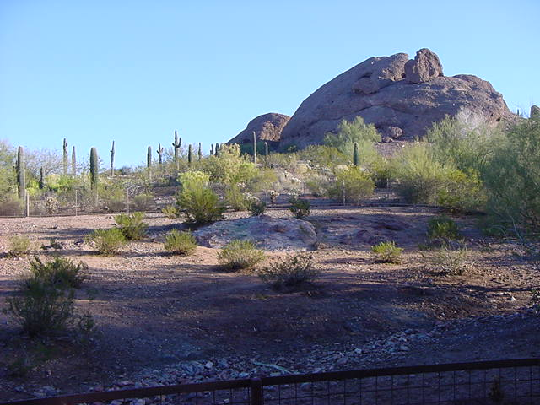
Sections of zoo still native Sonoran vegetation
动物园有些部分仍然生长索诺兰沙漠本土植物
Desert Lives
沙漠生物

Slide 8
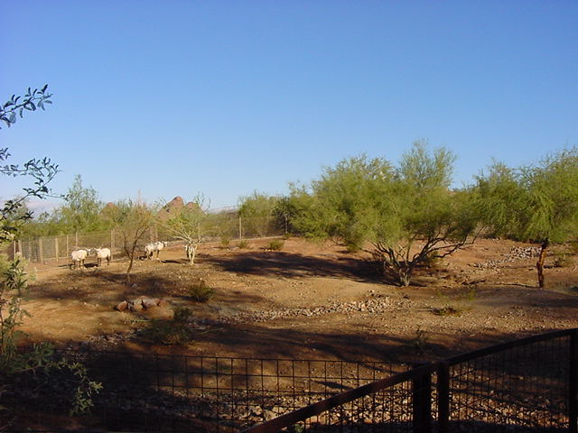
Desert Lives
沙漠生物

Slide 9
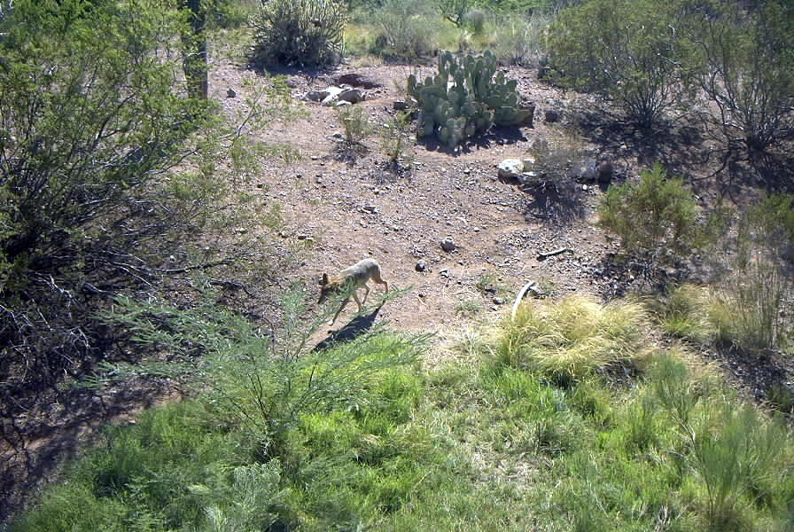
Arizona Trail
亚利桑那步道

Slide 10
Naturally, in the past, the zoo’s plant collection
due to:
过去，动物园植物能生长，是因为：
Desire for an aesthetic, comfortable environment为了环境舒适美观
The need for shade for our guests and the animal collection为游客和动物提供阴凉
Supplying browse for the animals为动物提供自由采食的机会
Developing geographically divided, themed areas 开发不同地理环境、不同主题的区域
grew

Slide 11
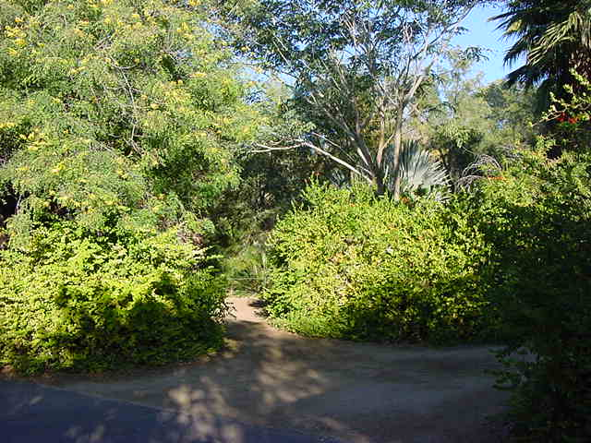
Current landscape 2011
2011年景观

Slide 12
Current landscape 2011
2011年景观

Slide 13
Current landscape 2011
2011年景观

Slide 14
Current landscape 2011
2011年景观

Slide 15
Current landscape 2011
2011年景观

Slide 16
The benefits of browse
自由取食的好处
Nutritional supplement营养补充
Hydration supplement水化补充
Behavioral enrichment行为丰容
Husbandry enhancement饲养丰容
Medicinal aid医学辅助
Naturalistic exhibits自然化的展区
Temperature control温度控制

Slide 17
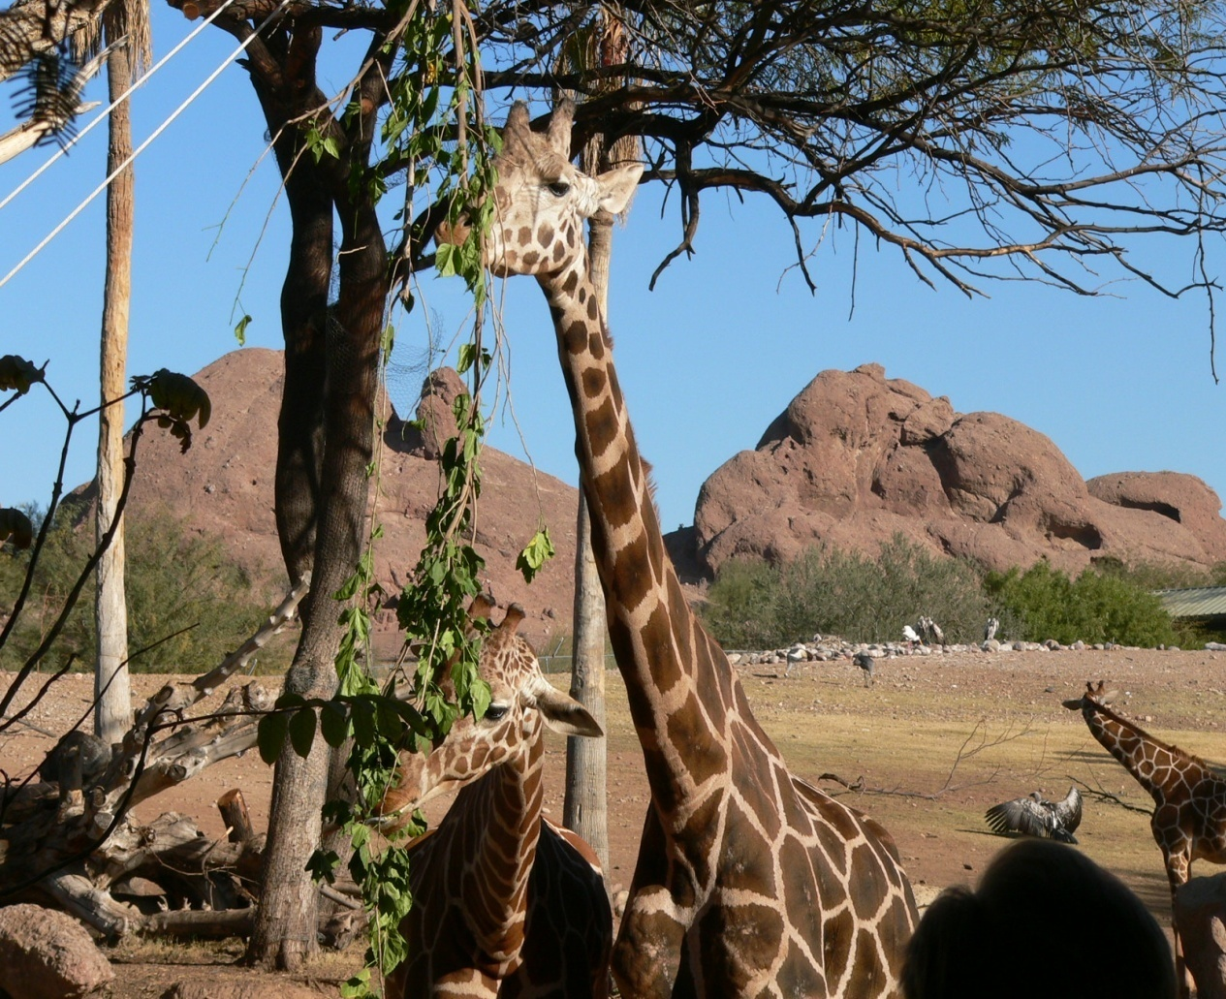
Nutritional Supplement营养补充
Healthy caloric intake摄入健康的热量
Extra fiber额外的纤维
Natural vitamin
and mineral
天然维生素和矿物质
Some Populus (Cottonwood) species contain vitamin C
某些杨树（如三角叶杨）富含维生素C

Slide 18
Hydration supplement 补充水分
Providing moisture for desert species为沙漠物种提供水分

Slide 19
Foraging Enrichment觅食丰容

Slide 20
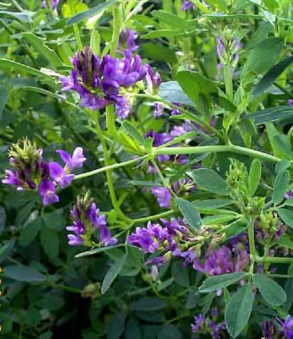
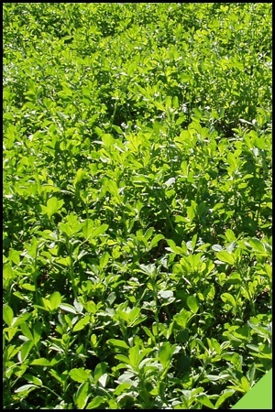
Replacement plants for browse
Lucerne (fresh alfalfa)
代替紫花苜蓿的植物（苜蓿鲜草）
http://www.foxforages.co.uk/images/nav/field.jpg
http://www.greenharvest.com.au/images/Seeds/Crop_seeds/lucerne.jpg

Slide 21
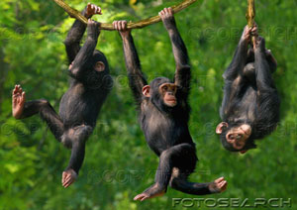
Exhibit furniture
(Structural Enrichment)
展区装饰（结构丰容）
Homogeneous enclosures with large, inflexible, continuous supports
笼舍设计单一，仅有大型固定的支撑结构
Complex environments with smaller, interrupted, flexible supports
笼舍环境复杂，支撑结构小巧、间断并可灵活调整
vs.

Slide 22
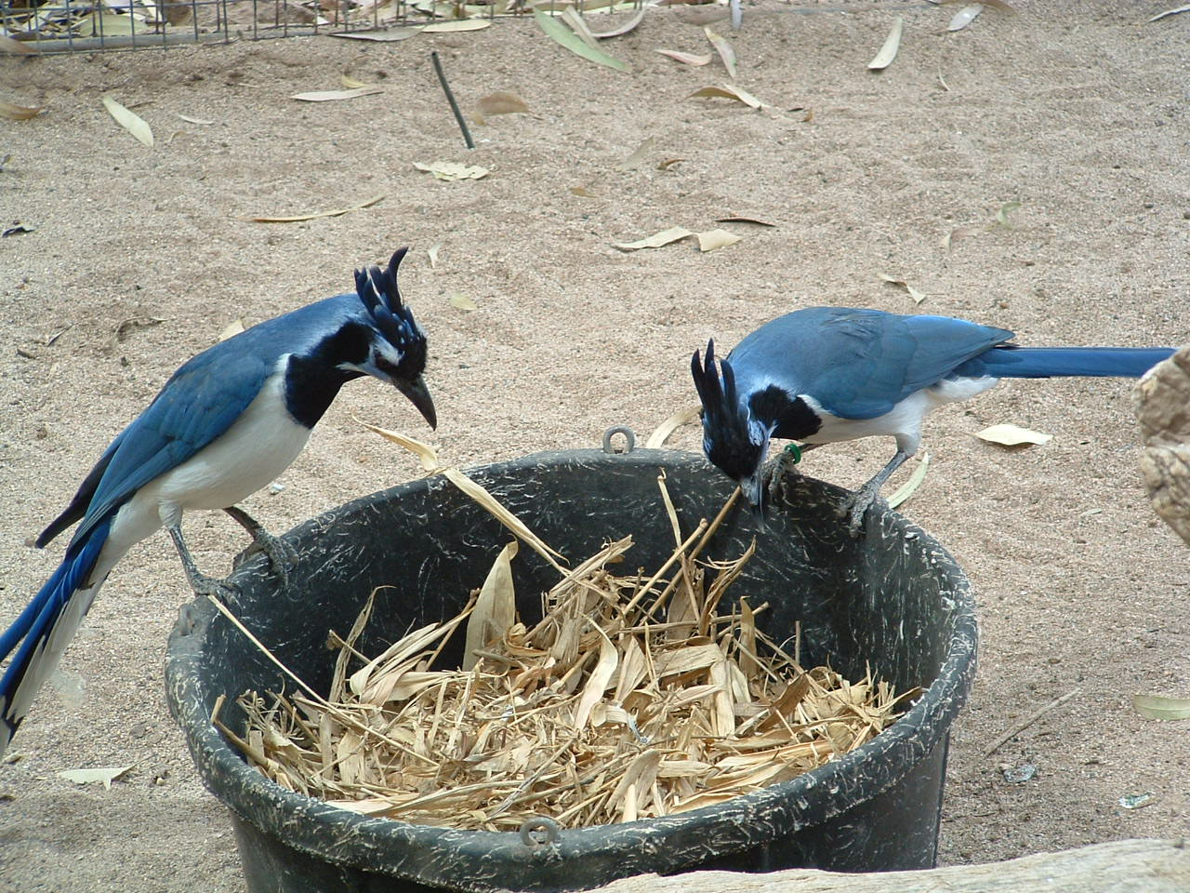
Induced Foraging
(Substrate enrichment)
诱导觅食（垫料丰容）
Extended foraging time
增加觅食时间
Natural stashing of items
自然藏食的地方

Slide 23
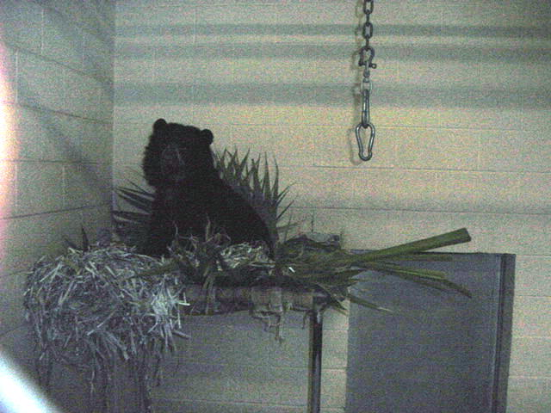
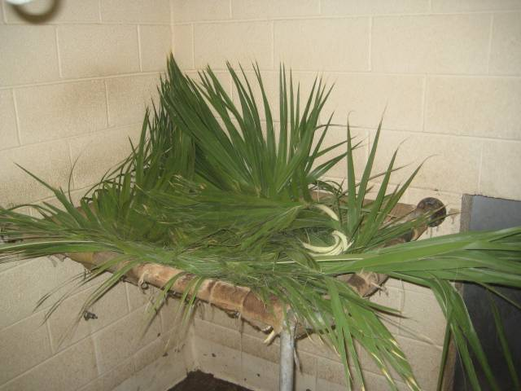
Induced Nest Building
(Substrate enrichment)
诱导筑巢（垫料丰容）

Slide 24
Playing 玩耍
(Manipulative enrichment)
（操弄丰容）

Slide 25
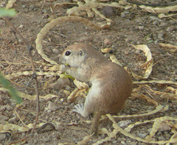
Gustatory Enrichment
(Five senses)
味觉丰容（五官感觉）

Slide 26
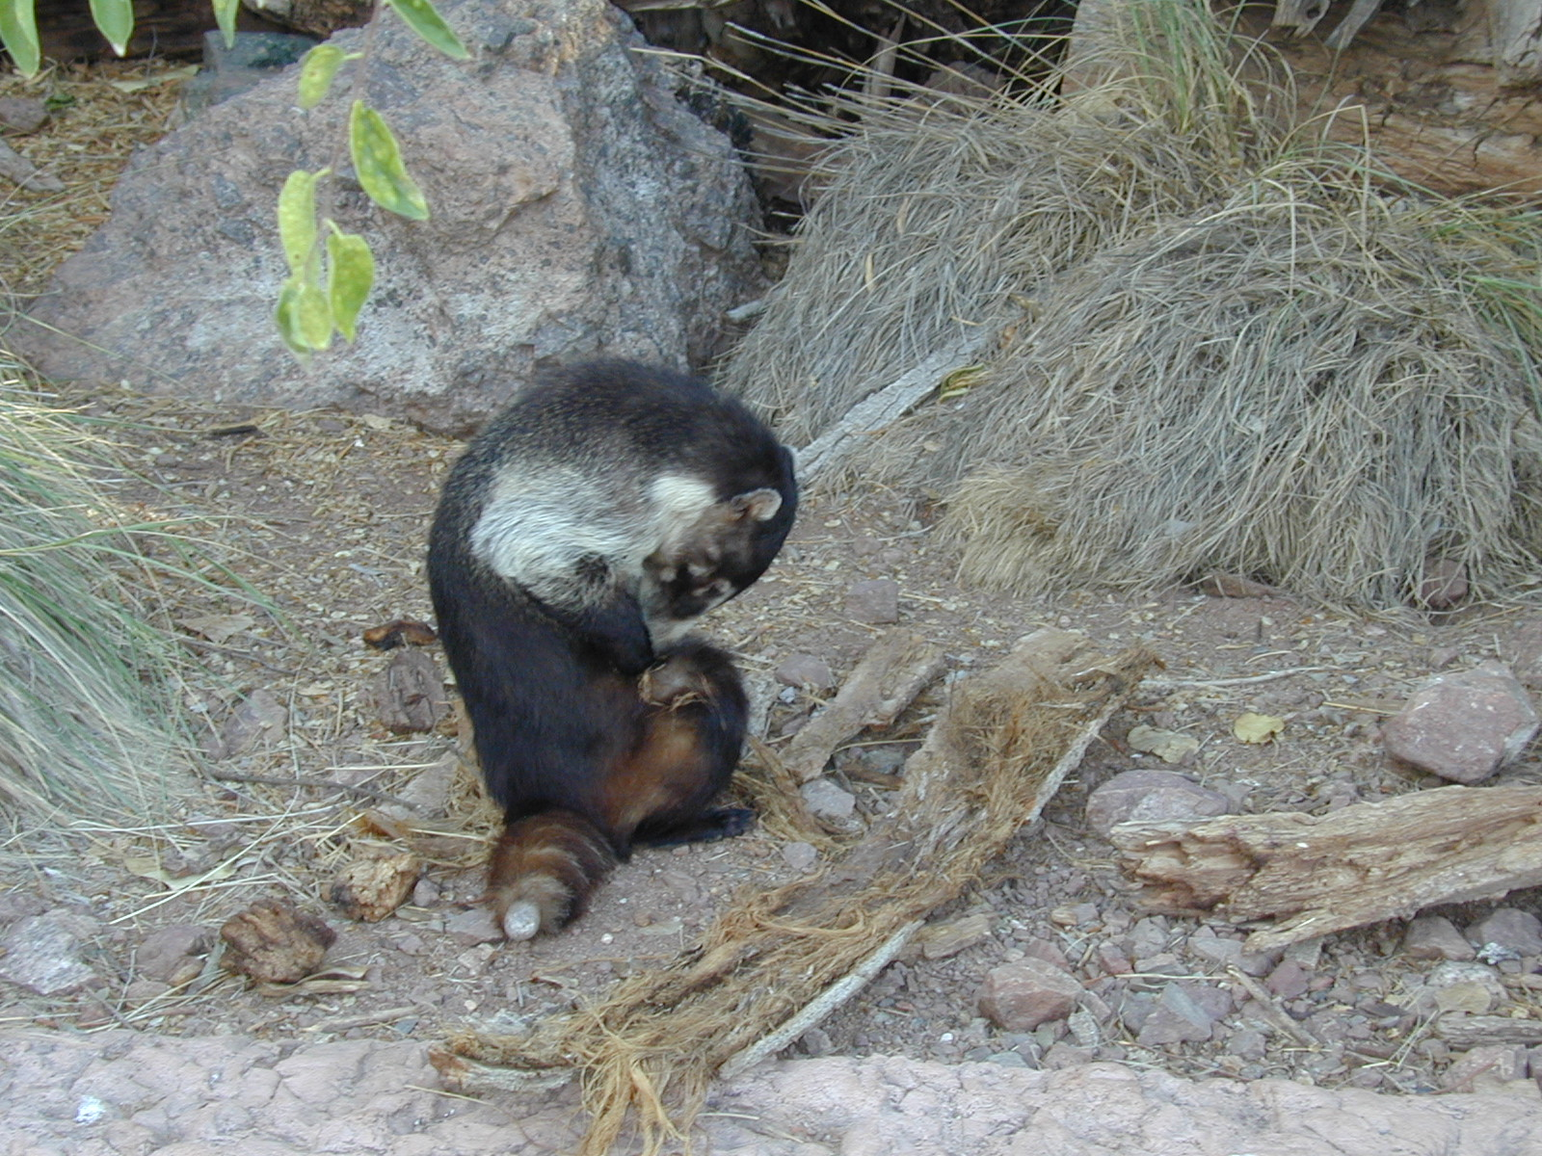
Olfactory Enrichment
(Five senses)
嗅觉丰容（五官感觉）
Fresh cut grass
新鲜青草
Leafy branches 带叶树枝
- Flowers 花
- Nectarines 油桃
- Herbs 药草
- Bark 树皮

Slide 27
Adequate perching and joint care
(Husbandry enhancement)
足够的栖木和关节护理
（饲养丰容）
Less variation of perch diameters
栖木无粗细变化
Large variety of perches with different diameters
有很多粗细不一致的栖木

Slide 28
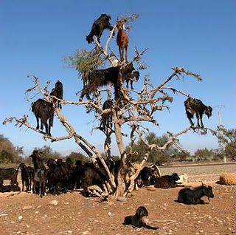
Adequate space using three dimensions
(Husbandry enhancement)
充足利用的三维空间（饲养丰容）
Shape and design considered with dimensions or volume.
设计充分考虑不同维度和空间

Slide 29
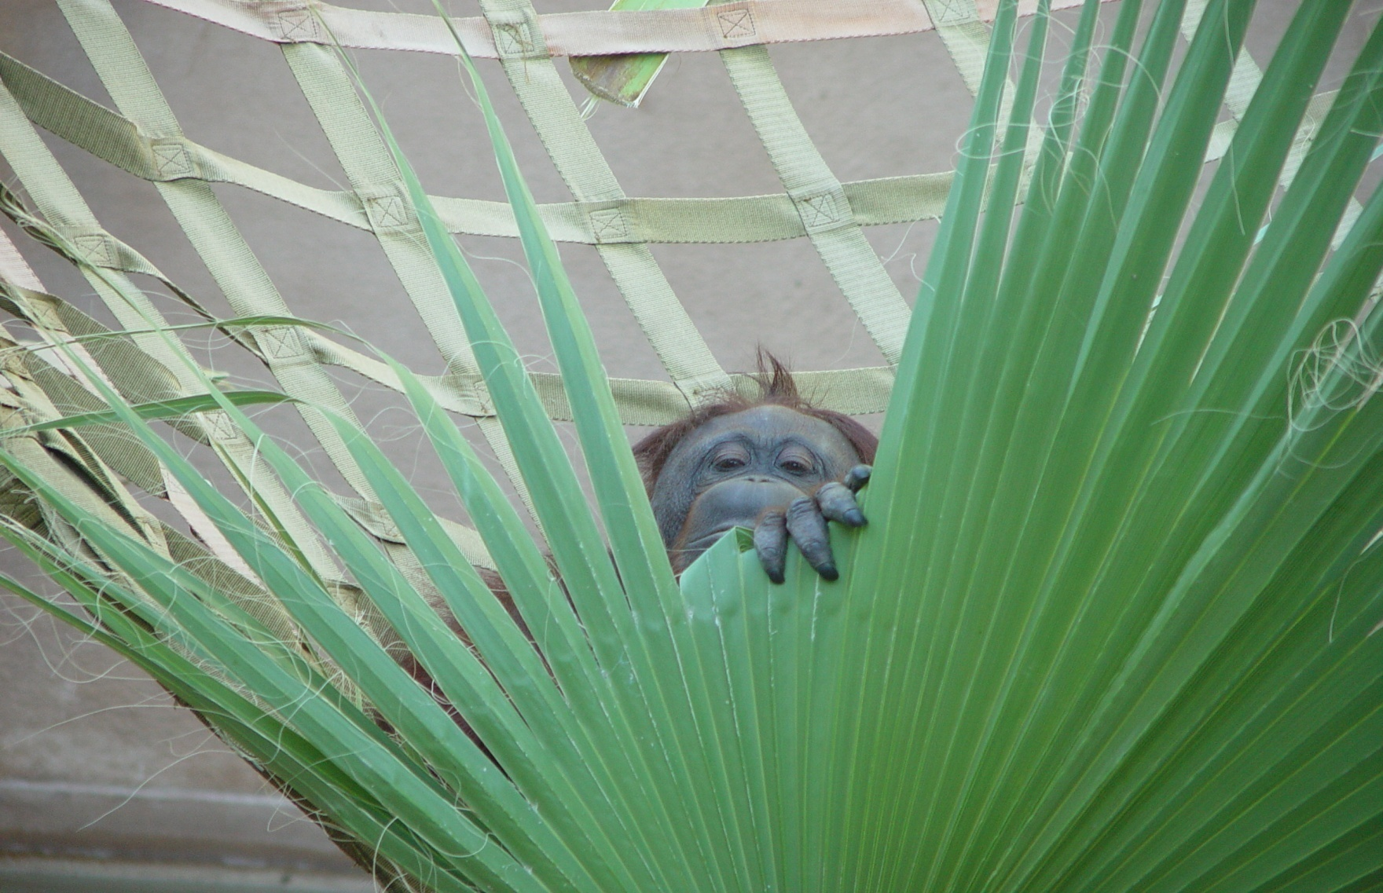
Hiding places
(Husbandry enhancement)
躲藏地点（饲养丰容）

Slide 30
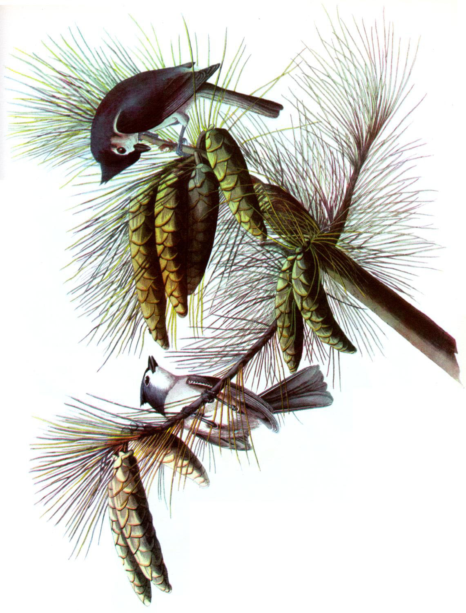
Developing motor skill, strength, balance and coordination
(Husbandry enhancement)
开发动作技能、力量、平衡、协调（饲养丰容）

Slide 31
Normal postural adjustments with adequate freedom of movement
动物有足够的活动空间来调整正常的姿态
(Husbandry enhancement)
（饲养丰容）

Slide 32
Soft surface to prevent possible foot problems
(Medical aid)
柔软的地面能防止足部问题
(医学辅助)

Slide 33
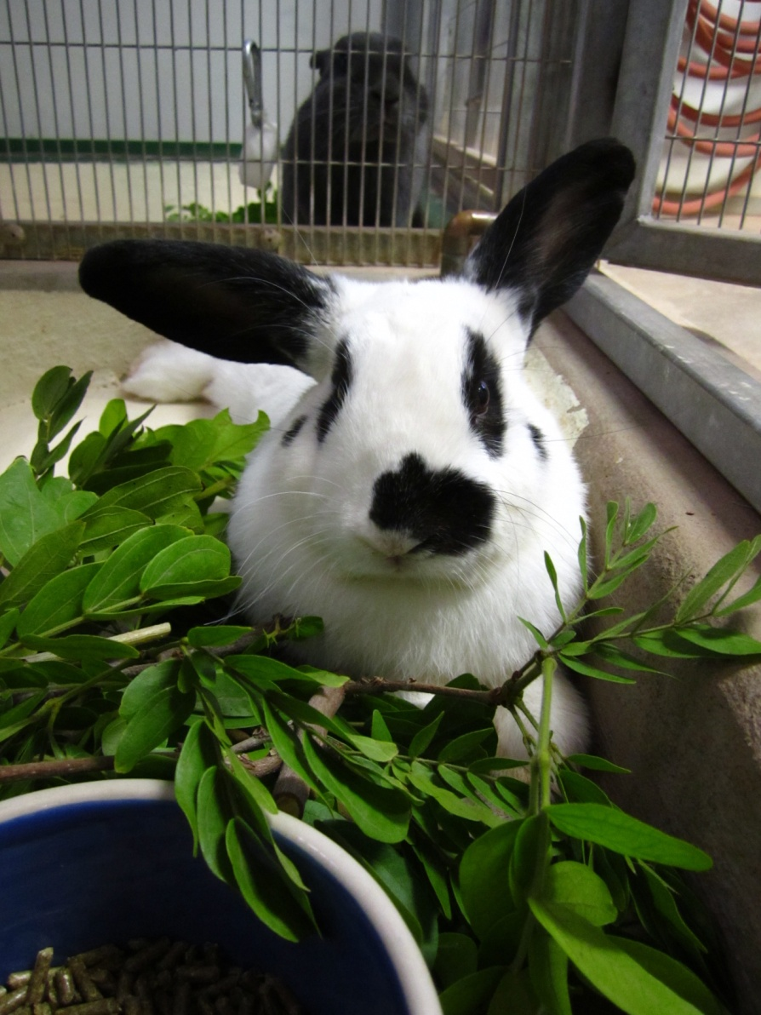
Dental care and pain relief
(Medical aid)
口腔护理、疼痛缓解（医学辅助）
Material for gnawing to control dental and beak growth 给动物啃咬材料，控制口腔和喙的生长
Salix (willow) species contain varying amounts of Salicylic acid, a natural anti-inflammatory and fever reducer. Browsed to animals with upset stomachs.
柳树含不同柳酸，是天然的消炎药、退烧药。胃不好的动物可以吃

Slide 34
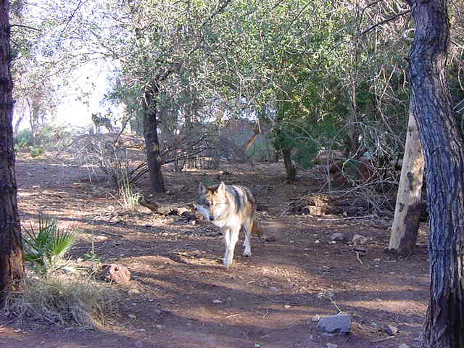
Naturalistic exhibits自然化的展区

Slide 35
Shade and temperature control
Grass itself decreases exhibit temperatures by 10-15 F.
树荫和温度控制
青草本身能够降低展区温度10-15华氏度

Slide 36
Edible Landscape and Browse Gardens 能够吃的布景和园区植被
The temperate climate of Phoenix Arizona allows the landscape to be filled with a great variety of edible plants.
亚利桑那凤凰城的温度允许园区内种植各种可以吃的植物
Most of the mature trees were planted early in the zoo’s history. These trees are inaccessible due to their height making them inadequate candidates for browsing. They provide shade and some frost protection for the surrounding plants. 许多大树都是动物园早期种植的，这些树因为太高，不能成为动物自由取食的对象，但是可以提供树荫，也可以保护周边的植物受霜冻。
As the zoos’ collection increased, so did the need for more browse-able plants. 随着动物园动物增加，对于可取食的植物的需求也增加。

Slide 37
Formal Plan-2008正式计划-2008年
Written proposal indicating the purpose and details of new gardens
书面计划，包含了新园区的目的和细节计划
Master Enrichment Browse List - Combination of all browse information onto one master copy 丰容植物总清单—将所有植物信息集中到一张总清单
Master Diet Browse list - Creation of list of all plants incorporated into every day diet by Nutrition Services. 可食植物总清单– 由营养部门提供加入日常饮食的植物清单
Updating amount and frequency of both lists by Behavioral Enrichment Committee Representatives由行为丰容委员会代表更新上述清单的数量和使用频率
Management approval 管理审批
Donations- Information gathering of possible plant donations from Nurseries, Home Depot, Lows, and contractors to reduce cost
捐助-收集可能的捐献来源信息如托儿所、家得宝（家具连锁店）、Lows(纺织品商)或承包商等以降低成本
Locations, plants and cost estimation. The location of gardens, estimation of acres, list of species and amounts of new plants and final cost by Curator of Horticulture 地点、植物、成本估计、植物的品种、数量以及最终成本，该部分由园艺馆长完成
Proposal of plan to volunteer support groups 志愿者支持团队计划建议

Slide 38
Edible Landscape可以吃的景观
While the logistics of the browse gardens were planned……..
当园区植被计划完成后……
Inside exhibits展区内部
Edible trees were planted inside the exhibits to be a part of the landscape.
展区内种植了可以吃的树木，成为景观的一部分

Slide 39
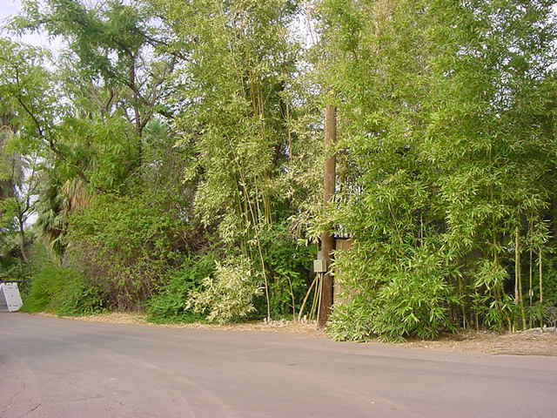
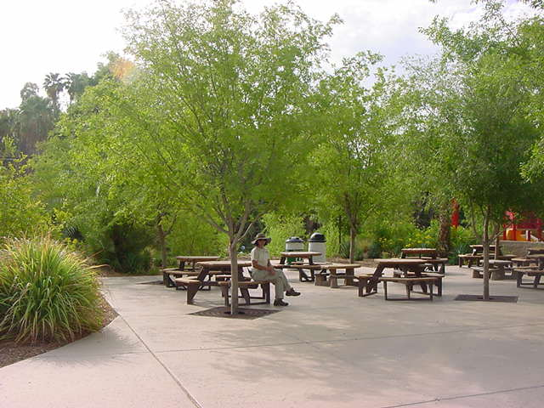
Edible Landscape可以吃的景观
Outside exhibits展区外面
Shaded areas for guests enhancement. Use of browseable trees along walkways
树荫可作为游客丰容
道路旁种植可食用的树木
Hedges created for animal privacy and aesthetics树篱保护动物隐私以及保持美观
Honey suckle, natal plum and bamboo
金银花、双刺假虎刺、竹子
Chinese elm榔榆

Slide 40
The Phoenix Zoo currently has
Designated Browse Gardens
目前凤凰城动物园
有13个自由取食植物园
13

Slide 41
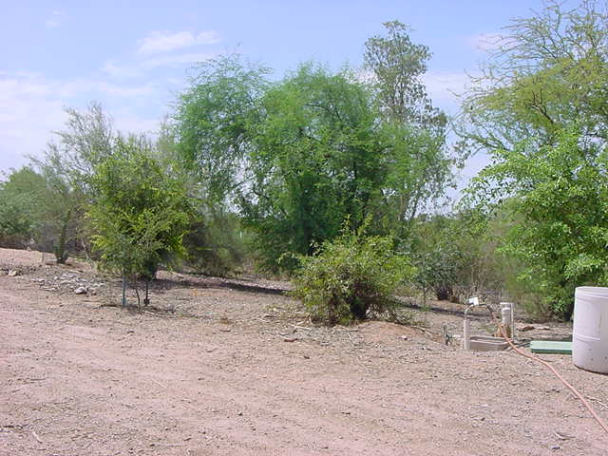
Browsemus maximus 可食植物的种类
Carob, Pomegranate, Sissoo, Elm and Acacia
角豆树、石榴、黄檀、榆树、刺玫

Slide 42
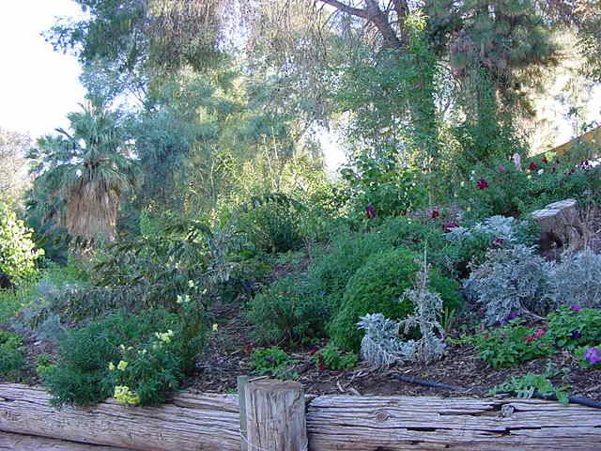
Sissoo Slope黄檀坡
Sissoo trees planted to control erosion. Perennials were added to create a colorful first impression.
种黄檀树可以控制土壤侵蚀，再种上宿根花卉，增加色彩感

Slide 43
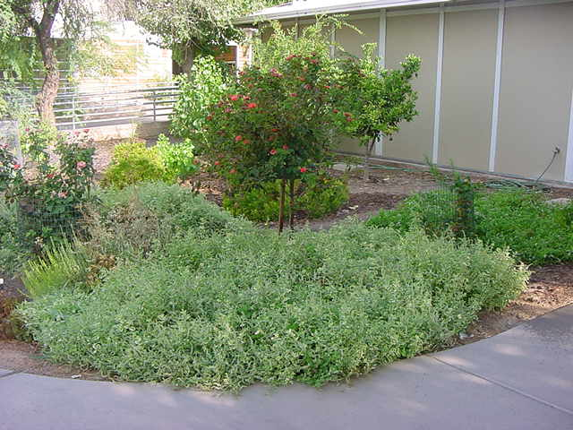
Harmony Farm Sensory Garden
和谐农场感官花园
An exotic variety of edible flowers such as roses and an assortment of mints许多外来植物也可以吃比如美观和各种薄荷

Slide 44
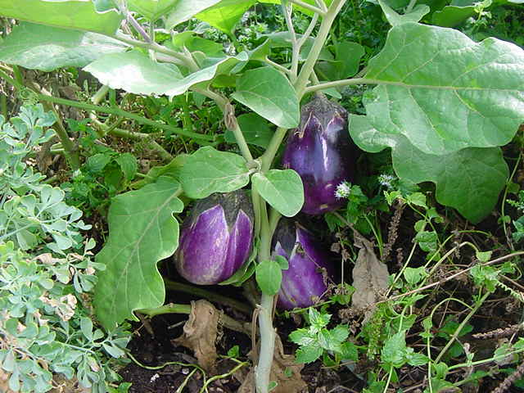
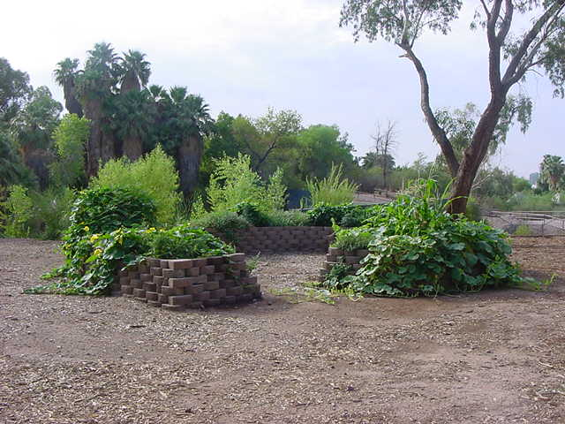
Three Sisters Garden of Knowledge
知识园地三姐妹
Corn - living trellis 玉米—格子棚架
Beans - replenish soil and grows on corn 豆—补充土壤、种植在玉米地
Squash - living mulch keeping the soil temperature cooler 南瓜—植体覆盖，可保持地面温度较低

Slide 45
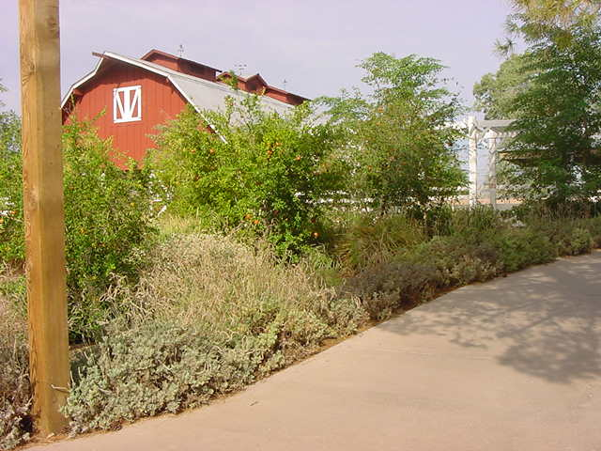
Farm-egranate Lavender Garden
Farm-egranate 薰衣草花园

Slide 46
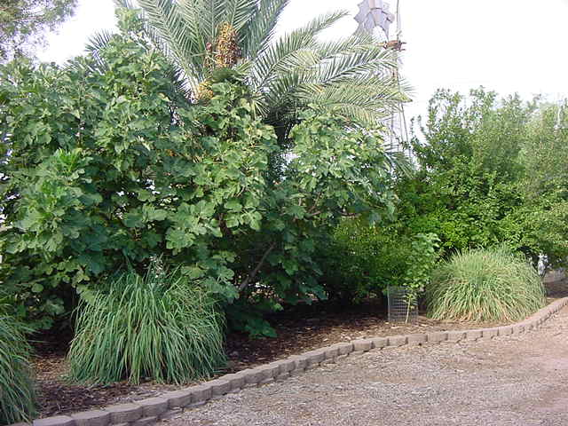
Food Forest 食物森林
Date, Fig, Plum, Pomegranate, Guava, Lemongrass, hibiscus, lavender and cannas
枣椰、无花果、李子、石榴、番石榴、柠檬草、芙蓉、薰衣草、美人蕉

Slide 47
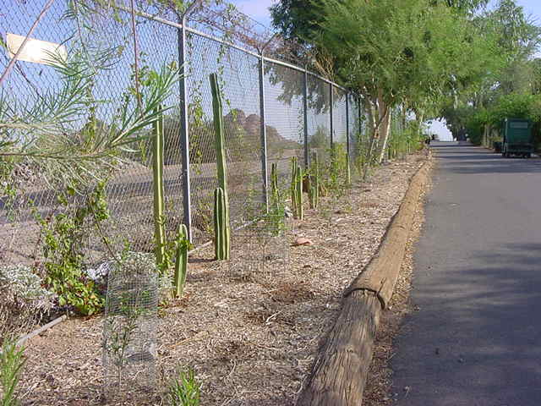
Pomegranates on Parade
在道旁种植石榴

Slide 48
Conservation Center Browse Hill
Ficus, Sissoo and Mesquite
保护中心的植物山 无花果、黄檀、豆科

Slide 49
School Group Browse老派的成群植物
Lake shore was cleared of cattails and replaced with native, browsable vegetation including cottonwoods and willows
清理河岸边的香蒲，由本地可采食的植被替代，其中包括三叶杨和柳树

Slide 50
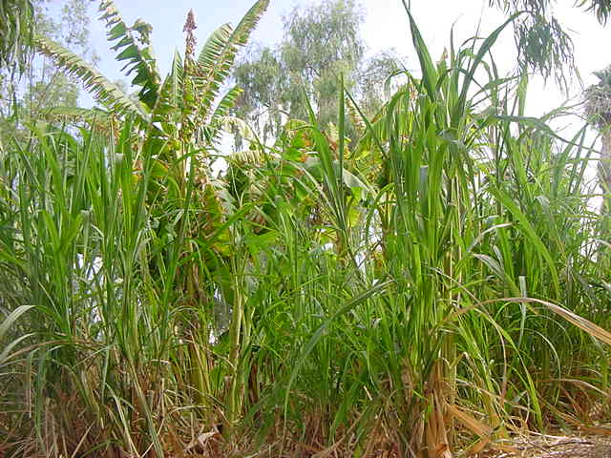
Elephant Browse Garden
象的植物园
Banana and Sugar cane 香蕉和甘蔗

Slide 51
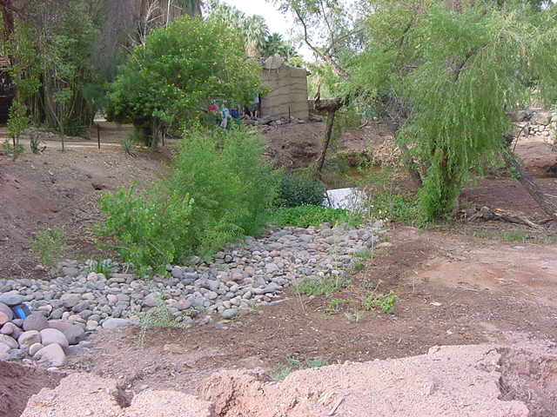
Uco Swamp Garden
中央俄克拉荷马大学的沼泽花园
Ficus, Willow, Cottonwood and Elm榕树、柳树、榆树

Slide 52
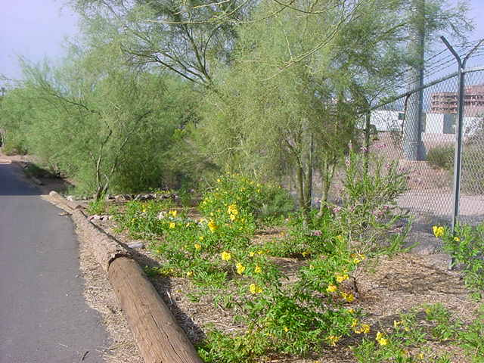
Tecoma Crossing黄钟花
Tecoma, Desert Willow, Palo Verde
黄钟花、沙漠柳树、绿皮树

Slide 53
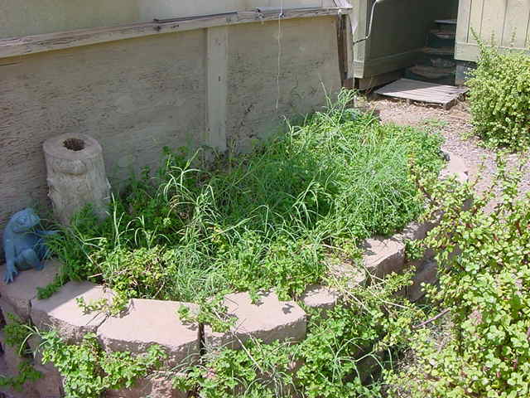
Greenhouse Herb garden
温室草花园

Slide 54
Potential Future Browse Gardens
未来可能的植物花园
Maned wolf鬃狼
Entire perimeter of this exhibit will be utilized
整个展区的周界都可以利用起来
Warty pig疣猪
Behind exhibit utilizing hillside and creek
展区后部用小山和溪流
Dam Road 水坝小路
Plant edibles along Lake Shore
沿着湖岸种植可食植物

Slide 55
Donations- another source of browse
捐助-另一个植物来源
The Phoenix Zoo has 55 species of animals to browse weekly. That’s 556 branches!!
凤凰城动物园每周有55种动物要吃556种植物！
Donated tree limbs are received from local landscapers and municipalities. Palm fronds are provided by neighboring golf course, local farm donates mulberry branches and a local tree company donates branches and mulch. Employees supply browse from their yards and neighborhoods.
当地景观设计者和市民会捐献树枝给动物园，旁边的高尔夫球场会捐献棕榈树叶，农场则会捐献桑葚枝叶，一家当地的木材公司会捐献树枝以及覆膜，员工也会从自家院里或者找邻居贡献一些来。
Safe storage安全储存:
  Reduces time spent by Horticulture catering browse to individual exhibits省掉了单个展区的园艺修理时间
  Keeps browse fresh for a longer period of time使得植物的保鲜时间更长一些
  Reduces wasting browse 减少植物浪费

Slide 56
Questions?
提问环节

