Slide 1
我是大象，我骄傲！ Let them be elephants!
希尔达 特雷斯&海瑟 怀特
Hilda Tresz and Heather Wright
菲尼克斯动物园Phoenix Zoo

Slide 2
菲尼克斯动物园 The Phoenix Zoo
目前居住着三头雌性亚洲象
Currently houses three female Asian Elephants
动物园通过不同方式迎来了
The zoo, through various circumstances, acquired
尹杜Indu -1998
瑞巴Reba – 1999
西纳Sheena - 2000
Notes:
All three came from other organizations with a variety of health and behavioral problems, some of which have been exasperated since arriving at our facility . Each of these elephants has had a troubled past and they were labeled as “problem animals”.

Slide 3
尹杜INDU
1998年出生Born in 1998
其母亲1965年出生在泰国Born in Thailand -1965
牙齿问题Bad teeth
痤疮不断发作Recurring hip abscesses
腿部正常Good feet
体重稳定Stable weight
曾有攻击人类和其他大象的记录
History of aggression towards people and other elephants

Slide 4
瑞巴REBA
1999年出生Born in 1999
其母生于1970年国籍不详（来自亚洲）
Unknown origin (Asia) - 1970
左前肢不断出现脓疮
Recurring abscesses on front left foot
两侧前肢均有关节炎
Arthritis in both front leg
体重稳定Stable weight
有严重攻击人类和其他大象的历史
Serious history of aggression towards people
History of aggression towards other elephants

Slide 5
西纳SHEENA
2000年出生Born in 2000
其母1971年生于印度
Born in India - 1971
身体条件总体良好
Overall good physical condition
足部健康Good feet
体重稳定Stable weight
有攻击人类和其他大象的记录
History of aggression towards people and other elephants
疑惑或恐惧时有“放空”的倾向Tendency to “shut down” when confused or scared
这三头大象都曾伤过人，其中一头杀死过饲养员
All the animals have injured people – one has killed a caretaker

Slide 6
Behavioral Management Changes 改进行为管理

Slide 7
Changes to the Exhibit 改进外展区
4 climate controlled feeding stations
可调节四种气候的饲养站
Barriers added to break up the exhibit
设置屏障来隔断外展区
Grass草地
Wallow 泥地
Elephant activated shower
大象自主触发的淋浴装置
Scratching post蹭痒桩
Numerous smaller puzzle feeders
若干小型的益智喂食器
Large piles of sand added where the elephants sleep
在大象睡觉的地方添加大量沙堆

Slide 8
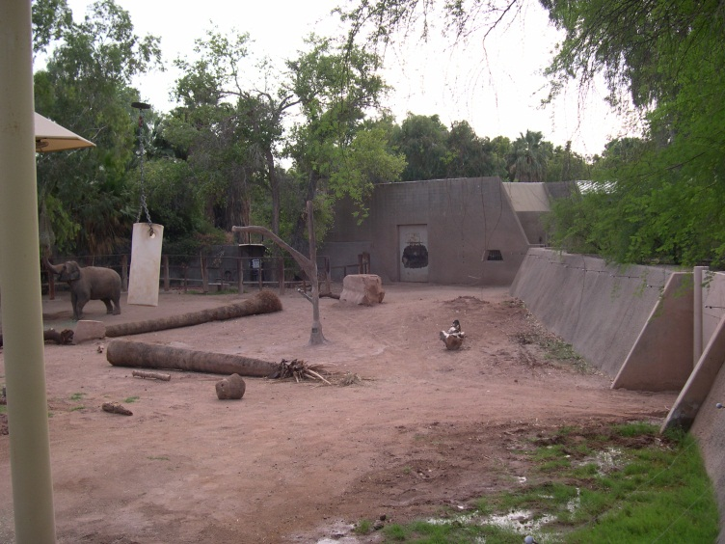
Exhibit Changes 改进外展区
之前Before
之后After

Slide 9
Eliminated bulk feeding from the ground 避免将食物直接堆放在地面

Slide 10
Deep Sand Bedding in Holding Yard 内舍铺设厚实沙层
Notes:
2 feet deep, regularly churned up.

Slide 11
New Wallow新的泥池
Notes:
Very popular, especially in summer

Slide 12
Scratching Post蹭痒桩
Notes:
Stopped giving scrub baths with soap in favor of just giving showers and letting the elephants do the scratching themselves, as they would in the wild.

Slide 13
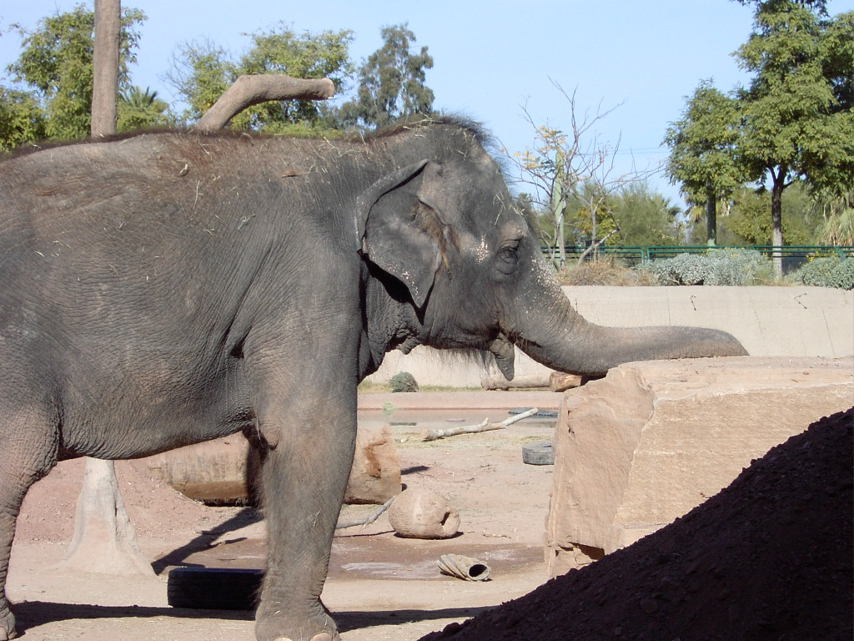
Sandstone Boulders巨型砂岩
Notes:
Added sandstone boulders to scratch on, also became a great area to rest heavy trunks.

Slide 14
Large Piles of Dirt大型土堆
Notes:
Not only good for dusting and laying down, but they also create barriers- encouraging more walking. Softens ground in attempt to reduce foot stress.

Slide 15
New Exhibit Feeders外展区的新喂食器
Four elevated mechanical feeders were added
添加了4个可上下移动的喂食器
Each feeder has two feeding stations which can be raised or lowered by keepers
饲养员可以上下移动两个喂食站以控制每个喂食器
Climate controlled areas with fans and misters
气候控制区域配有电扇及喷雾器
Notes:
In this picture, you can also see that Reba had to use problem solving skills to reach the feeder. She pushed the ball over so she could stand on it and reach higher. These feeders would be a great help during introductions.

Slide 16
Holding Yard Feeders 内舍的喂食器
Different types of puzzle feeders were added to the holding areas
在内舍添加了不同类型的益智喂食器

Slide 17
Barn Feeders 室内喂食器

Slide 18
2002
2005
An interesting side note…. over time we began noticing changes in the elephants. Their trunks were
getting stronger and the muscles in their necks, shoulders and legs became more pronounced.
很有趣的一点是……我们注意到大象的变化：它们的象鼻更加强壮，颈部、肩部及腿部的肌肉也更明显。

Slide 19
Training Scope Decreased 降低训练幅度
Trained behaviors were reduced to medical and husbandry behaviors
训练行为减少，只保留医疗及饲养管理的行为训练
“Performance” behaviors were eliminated
杜绝“表演行为”
Keepers exercise the animals by asking them to walk the length of the exhibit and rewarding the behavior
通过奖励在外场散步来让动物进行锻炼

Slide 20
Healthcare Revised 调整卫生保健
之前
Before
之后
After
请来阿兰 鲁克洛夫特进行会诊
Alan Roocroft brought in as consultant
Notes:
Our previous Veterinarian (Dr. Eng) and one of our keepers (Steve Koyle) attended the First European Elephant Management School in 2004 for further education on footwork, healthcare, and training. Alan Roocroft regularly visits teaching proper footcare techniques.

Slide 21
Discussion 讨论

Slide 22
在行为管理项目开展之前，三头“问题”大象居住环境狭小，活动量非常有限Prior to the changes in behavioral management program, three “problem” elephants were exhibited in an inadequate environment with a very poor activity budget

Slide 23
工作人员受训不足，仅运用传统管理大象的方式——训练大象表演马戏来娱乐大众
Inefficiently trained staff that followed traditional elephant management techniques - trained non-natural performance type behaviors to entertain the public

Slide 24
将草料丢放在地上，大象进食时间很短，除进食外整天无所事事
Feeding from ground provided only a short time for foraging behaviors
The elephants had very little to do for the rest of the day

Slide 25
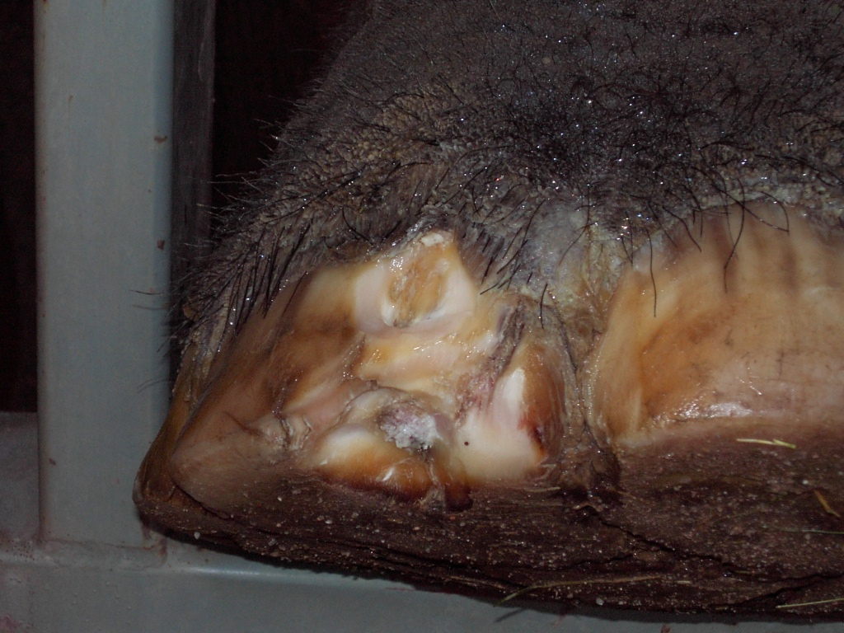
Having the elephants locked in barns for extended periods of time and kept on concrete floors generated further boredom and foot problems
大象长时间被关在象舍内，水泥地面增加无聊的感受，以及足部疾病

Slide 26
The animal’s past, coupled with boredom and health issues, led to further aggression towards keepers and conspecifics
以前大象生活单调而且伤痛不断，进一步导致其攻击饲养员和同类
By educating ourselves and bringing in a consultant with a new point of view we were able to shift our way of thinking
通过自我教育，聘请顾问，转换视角，我们改变了思路

Slide 27
我们开始关注如何例如延长进食时间等方式加强大象的自然行为，鼓励它们做真正的大象
We began focusing on increasing natural behaviors, such as extending foraging time, trying to encourage the elephants to just be elephants

Slide 28
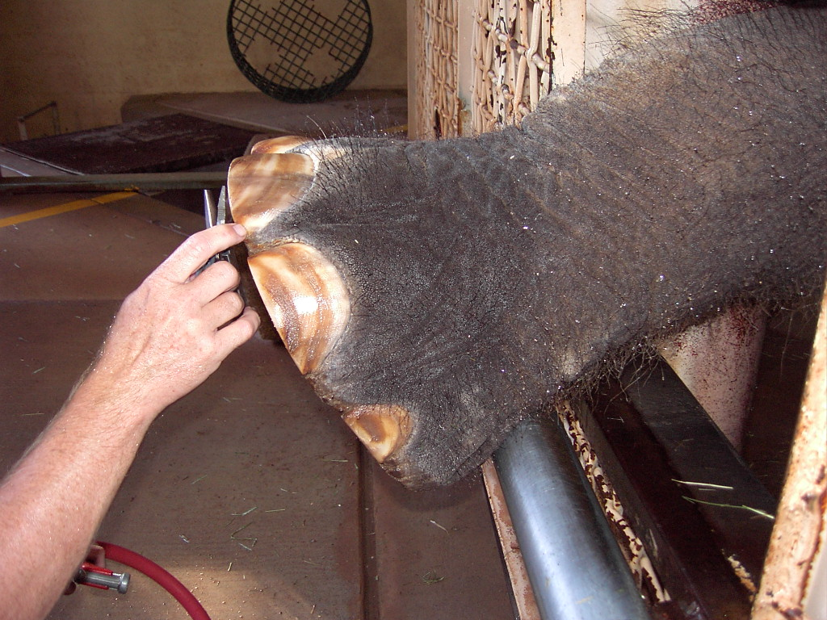
The elephants became much more cooperative…..
大象更乐意合作了……
Sheena extends her foot all the way through foot window…. never did this prior to the changes in the program
西纳把脚掌整个从足部检查窗口伸出来……这在改进项目开始前从未有过
We started asking less from the elephants….
我们不再苛求大象做什么……
Reduced our training scope to husbandry and medical behaviors
只做医疗和饲养管理相关的行为训练
Notes:
We started asking less from the elephants. The interesting thing was that the elephants actually began offering us more.

Slide 29
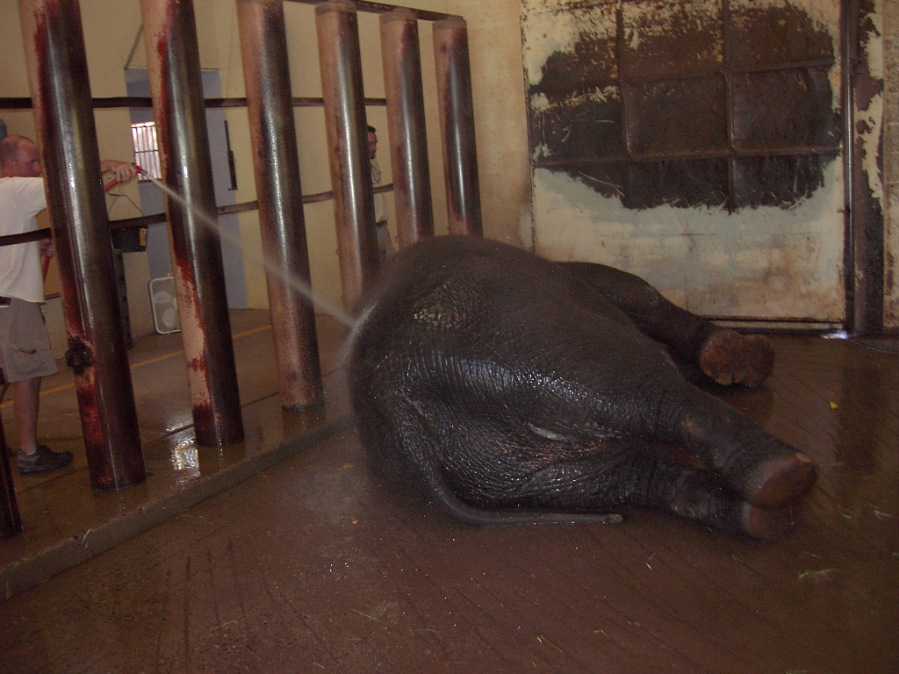
Reba actually started to lie down during her showers - had never done this before
瑞巴也史无前例地躺下冲凉洗澡
Positive changes in the elephants’ behaviors, both in working with the keepers and while by themselves led to a point where introductions of the two subordinate animals could be attempted
大象有了积极的行为变化，不仅是更配合管理员的工作，对同伴也更友善。使得我们可以尝试给两只年轻小象合群
Notes:
Reba actually started to lie down during her showers, something she had never done before. With the positive changes we had seen in all of the elephants’ behaviors, both in working with the keepers and while spending time by themselves, it was determined that we were at a point where we could try to introduce the two subordinate animals.

Slide 30
After setting up the exhibit with feeding stations and barriers which broke up the space, introductions began.在外展区设置饲养站和隔离屏障后开始给大象合群
The first few days were difficult, but after just a few instances of keeper intervention with CO2 blasts to deter aggressive physical contact, the elephants began to establish a positive relationship.
前几天很艰难，但是管理员几次喷射二氧化碳抑制大象肢体接触，它们开始积极互动
Both elephants began to calmly eat at different feeding stations
两头大象也开始安静地在不同的饲养站进食

Slide 31
Over time the elephants began to be more comfortable in closer proximity随着时间流逝，大象逐渐习惯更亲密接触

Slide 32
At times, they even feed from the same feeding station
Overall, it has been a successful introduction
它们甚至时不时在同一饲养站进食。总之，这次合群很成功

Slide 33
Reba’s future introduction to the other two elephants is being carefully choreographed
我们精心演练瑞卡与另外两只大象的合群
Notes:
We are actually looking into the possibility of bringing in a fourth elephant to help change the herd dynamics.

Slide 34
Phoenix Zoo staff feels that the behavioral management changes we made resulted in significant positive
improvements in our elephants’ behavior. We feel we are beginning to restore the dignity of our elephants!
菲尼克斯动物园的工作人员认为改进行为管理让大象的行为有了积极的进步。
我们感到大象重获尊重！
Notes:
They seem to be more content, more relaxed, less aggressive and are spending more of each day foraging, walking and interacting with eachother… much like their wild counterparts.

Slide 35
Special Thanks to our Behavioral Observation Team 特别鸣谢我们的行为观察团队

Slide 36
Much Appreciation to the Phoenix Zoo Management and the Operations Department Staff for making it all possible 非常感谢菲尼克斯管理及运营部的同事鼎力相助

