Slide 1
Feline enrichment at the Phoenix Zoo
Need the best picture in here or several really good ones

Slide 2
What to know about cats?
Solitary animals (mostly)
Predators
Incredible physical abilities
Rely on smell
Territorial
Playful
Resting
Prefer heights
Do not like water (mostly)
Extremely curious
Clean
Notes:
Photo credit: http://www.ebsqart.com/Artist/Tracey-Allyn-Greene/476/Art-Portfolio/Cat-Tails-the-question-mark/48354/

Slide 3
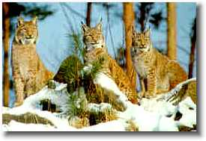
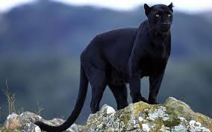
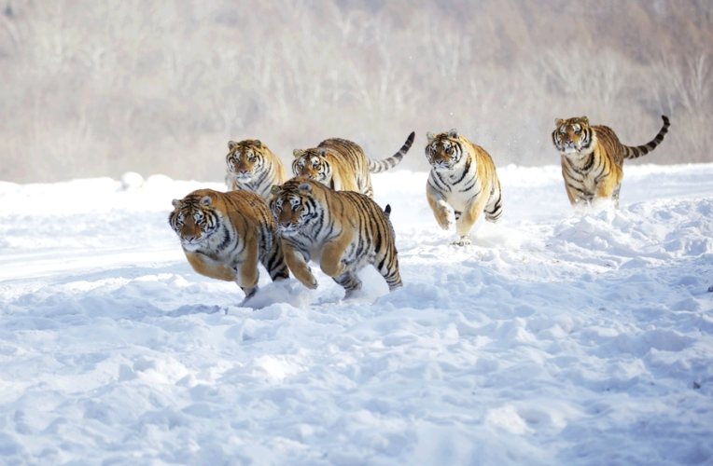
Not always unsocial
Mostly solitary (with occasional “socialness”)
No inherent need or desire to comply with anyone's wishes but its own
Tiger male was seen spending time with the female and cubs in a relaxed social group. In Russia tracks found in the snow suggest that up to six or seven adult tigers have been travelling together.
Snow leopards, tigers and some small wild cats help out in the hunting process during raring offspring
Eurasian and Canadian lynx group hunting
Notes:
Photo credits:
http://wallpeperhd.com/animal-wallpapers/black-jaguar-cat.html
http://dialspace.dial.pipex.com/agarman/bco/behav04.htm
http://i.imgur.com/MJfkB5U.png

Slide 4
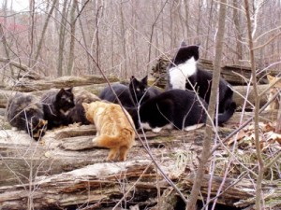
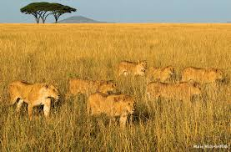
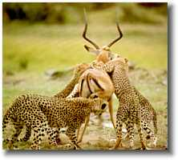
Not all species are solitary
3 social species (by no means all are always social)
Lions (pride)
Cheetah (male coalition)
Feral cats (clowder)
Perhaps of greatest advantage in grassland areas
Protecting them against larger lone males or other groups
Notes:
Photo credit:
http://www.nwf.org/news-and-magazines/national-wildlife/animals/archives/2013/apex-predators.aspx
http://dialspace.dial.pipex.com/agarman/bco/behav04.htm
http://trapneuterreturn.com/how-to-tnr/resources-trappers-traps/how-to-trap-an-entire-colony/

Slide 5
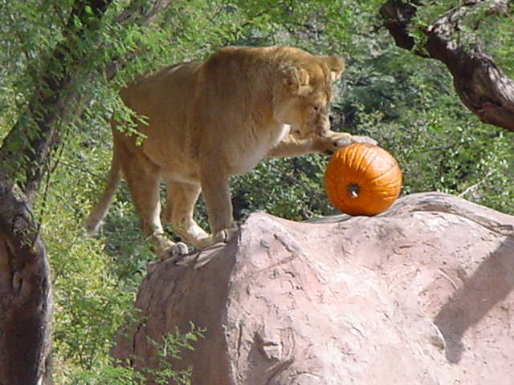
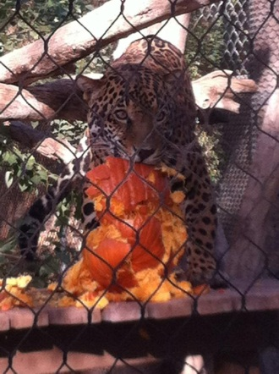
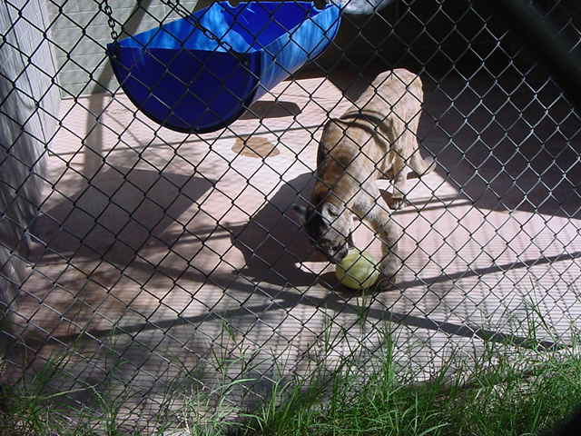
Predators
Foraging is a complex behavior of:
Searching for food
Acquiring food
Eating
Digesting
Cats search for food long, hunt and eat fast, digests fast → First two needs to be emphasized by enrichment
In captivity
No real prey to hunt, but still need to express play-attack, chasing, pouncing, “killing”, biting, destroying, etc., behaviors.

Slide 6
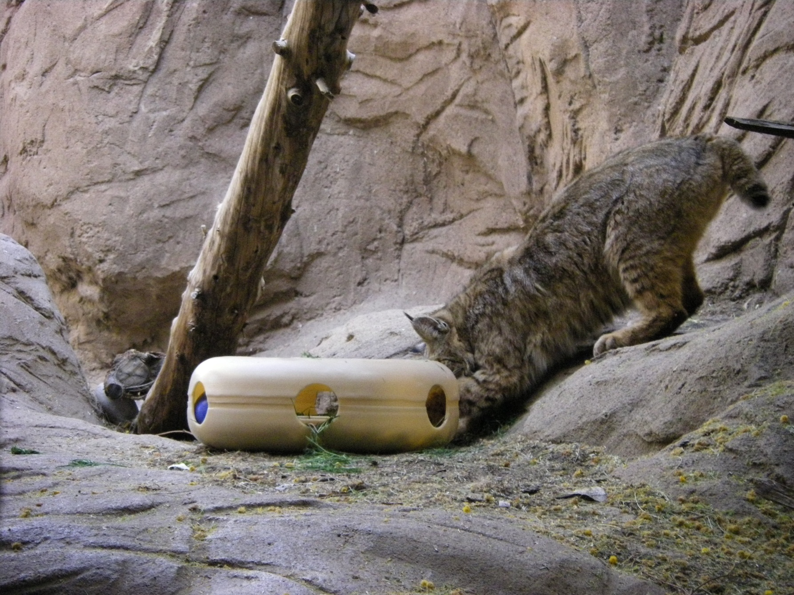
Like to reach in from sideways

Slide 7
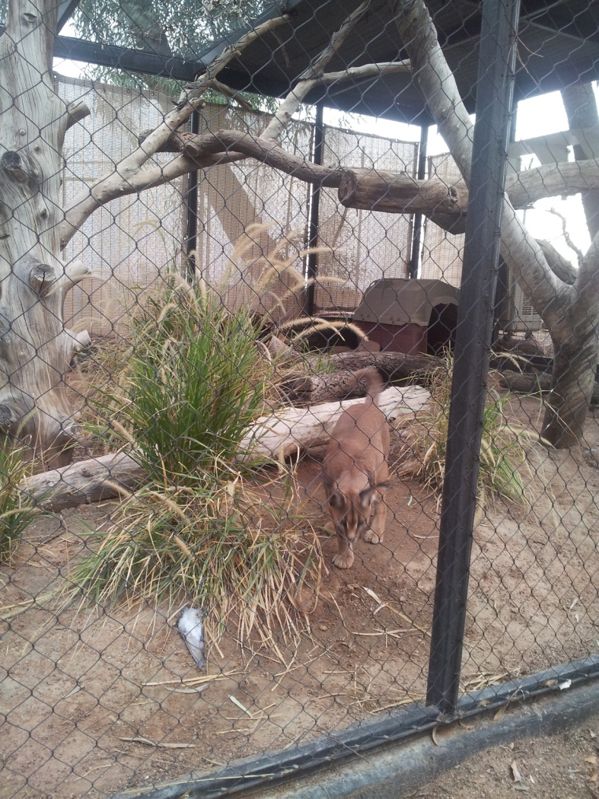
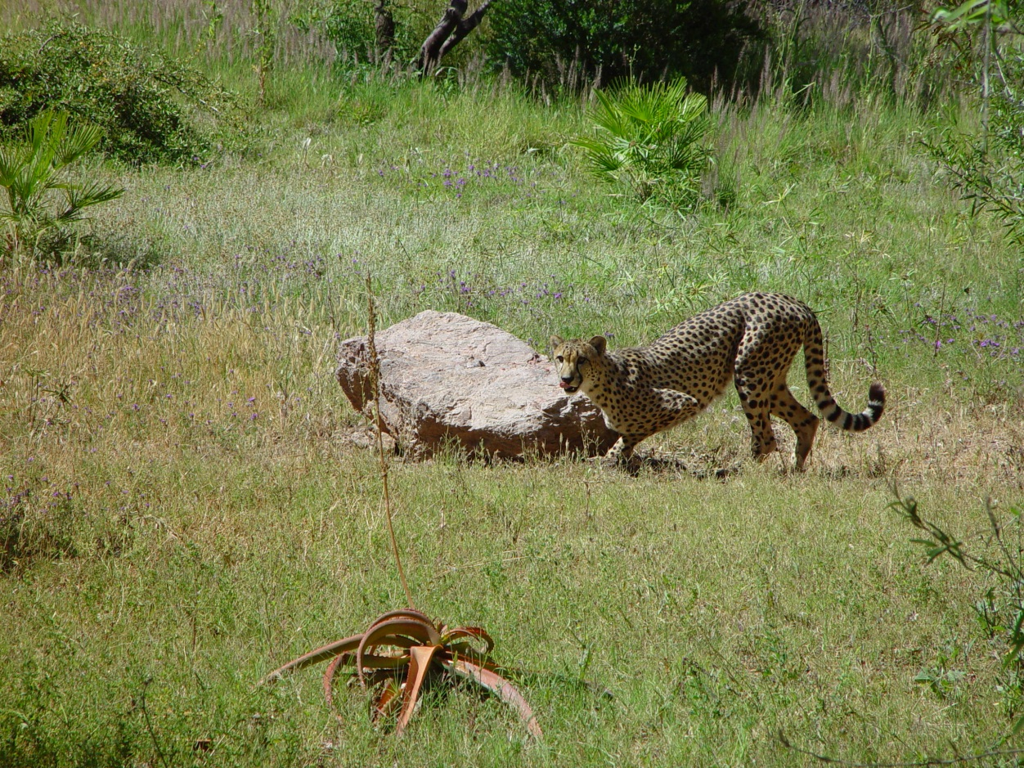
Increasing searching for food
Hiding food on exhibit
Behind, on and under furniture, etc.

Slide 8
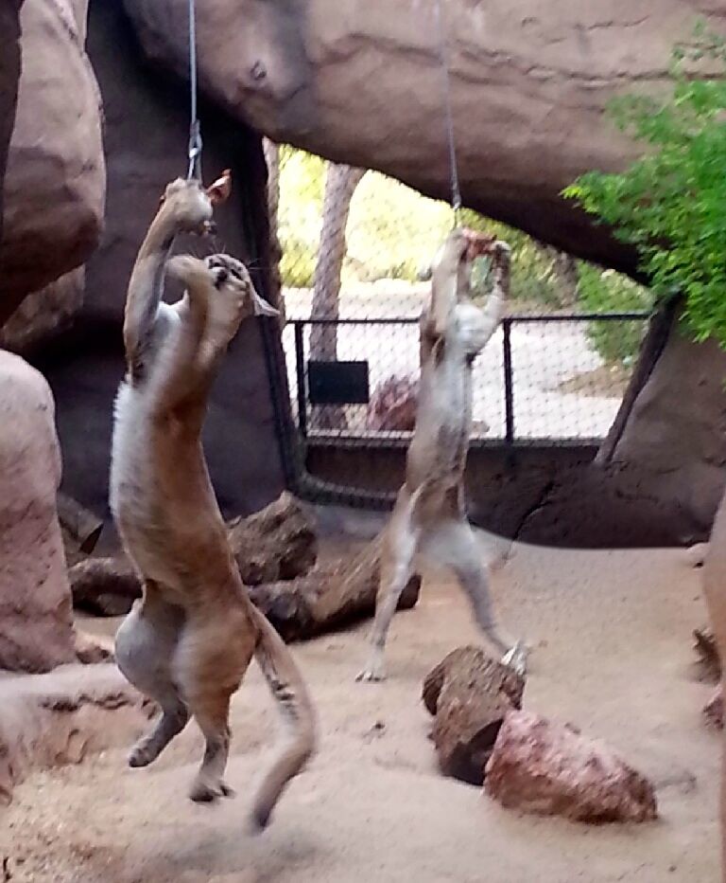
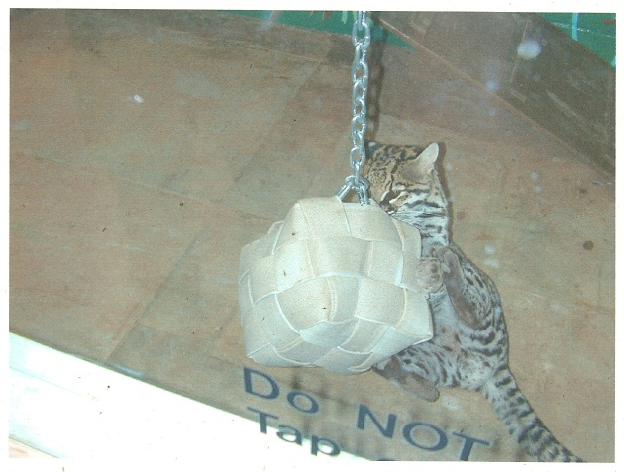
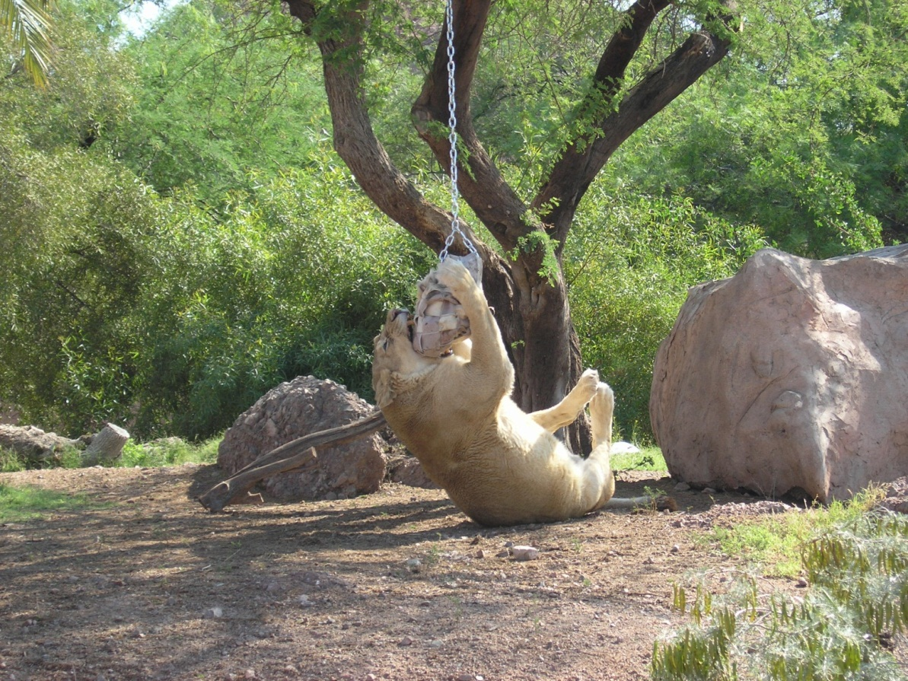
Difficulty level of acquiring food
Need video of high tech
Feeders (bungee, pole)
Piñatas
Puzzle feeders
Fire hose balls
Cardboard boxes
Etc.

Slide 9
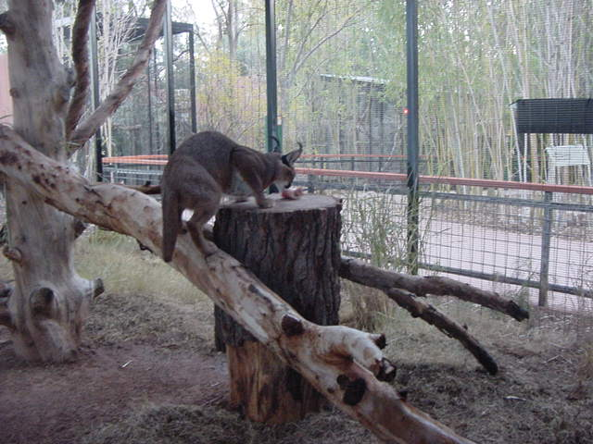
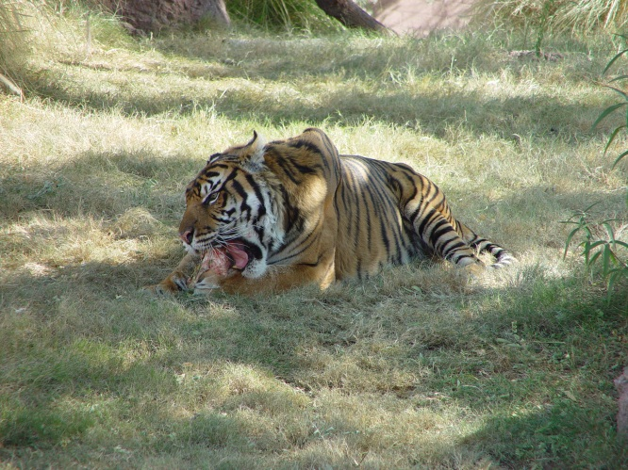
Bones to extend foraging time

Slide 10
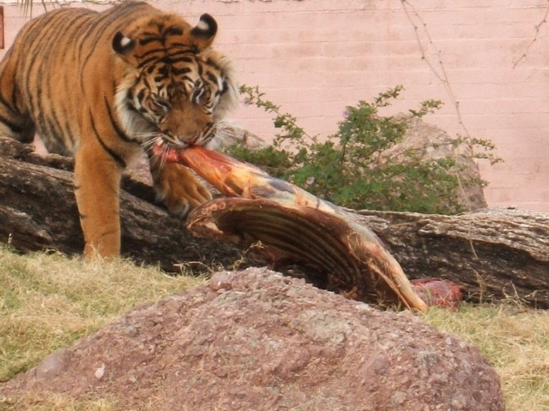
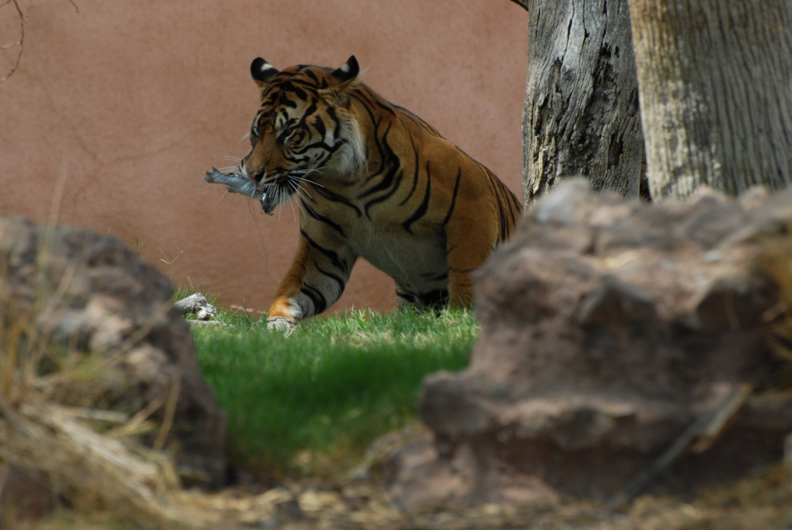
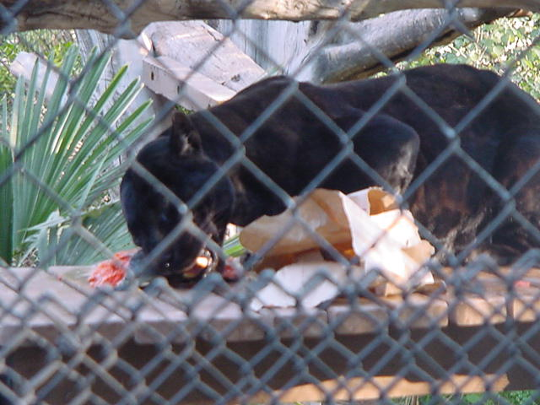
Whole prey/carcass feeding
Horse meat
Pigeon
Quail
Salmon
Etc.

Slide 11
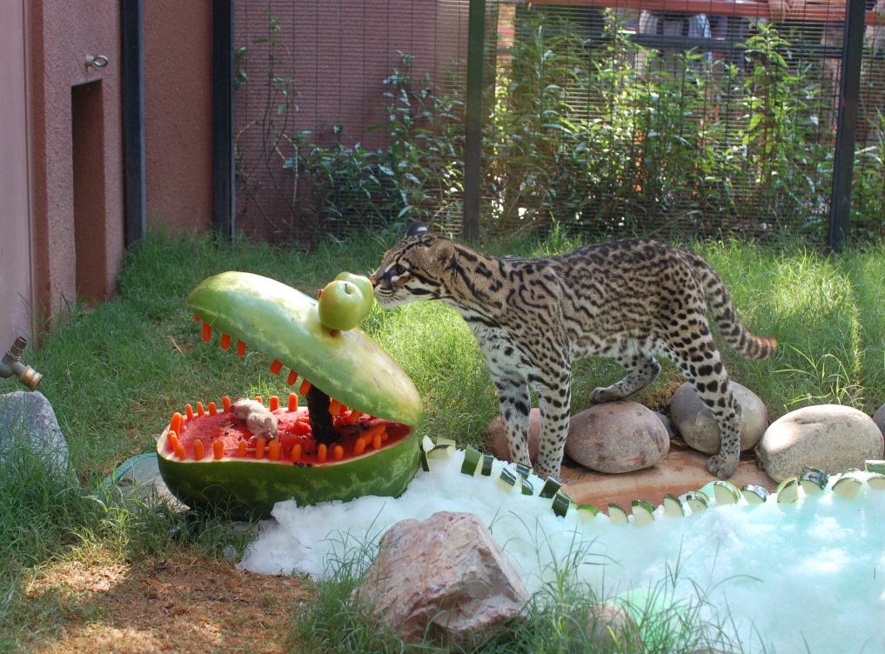
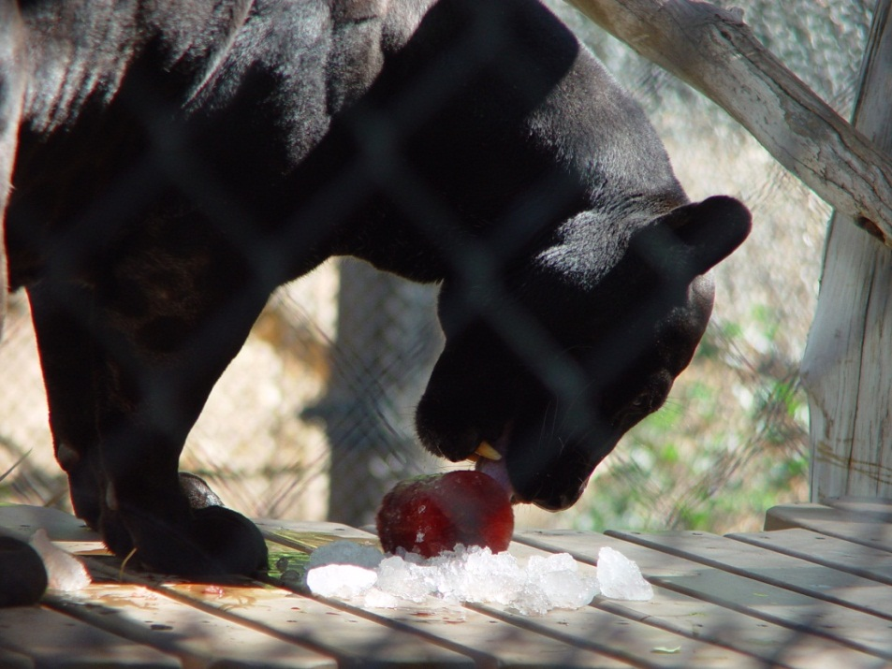
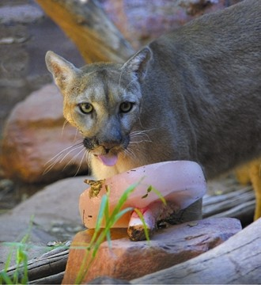
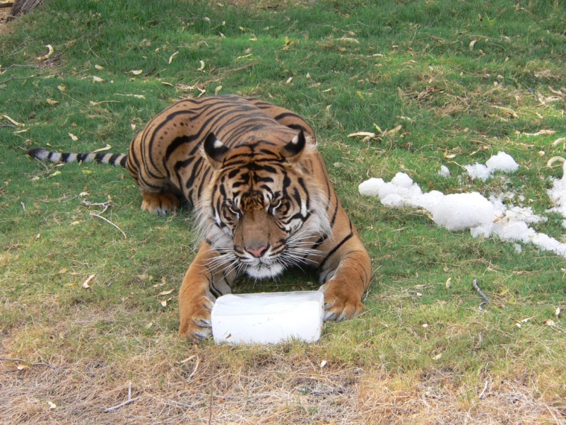
Frozen products to extend foraging time
Notes:
Photo credit: Martina Wiesner

Slide 12
Extreme physical abilities
Agile, flexible, adaptable, etc.
Set the bars high!
Video

Slide 13
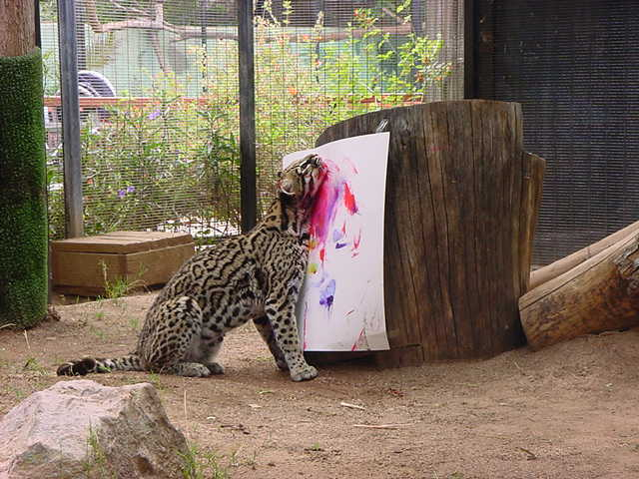
They rely on smelling
Cats can easily identify the odor of catnip when its concentration is 1 part per billion!
Kittens are born deaf and blind but their sense of smell is already sharp and working
Video
Herbs (fresh or dry)
Fragrances
Extracts
“Christmas trees”
Paints
Etc.

Slide 14
Territorial animals
Scent glands along the tail, on each side of forehead, around mouth, on chin and cheeks, on back and underside of their front paws to mark territory.
Cats mark their territory by:
Scratching (leaving visual as well as a scent marks)
Urine spraying
Feces
Rubbing
To prevent destructive behaviors provide:
Logs
Scratching posts
Destroyable toys
Need video, pics of scratching post, poles, animals urine marking, destroying things

Slide 15
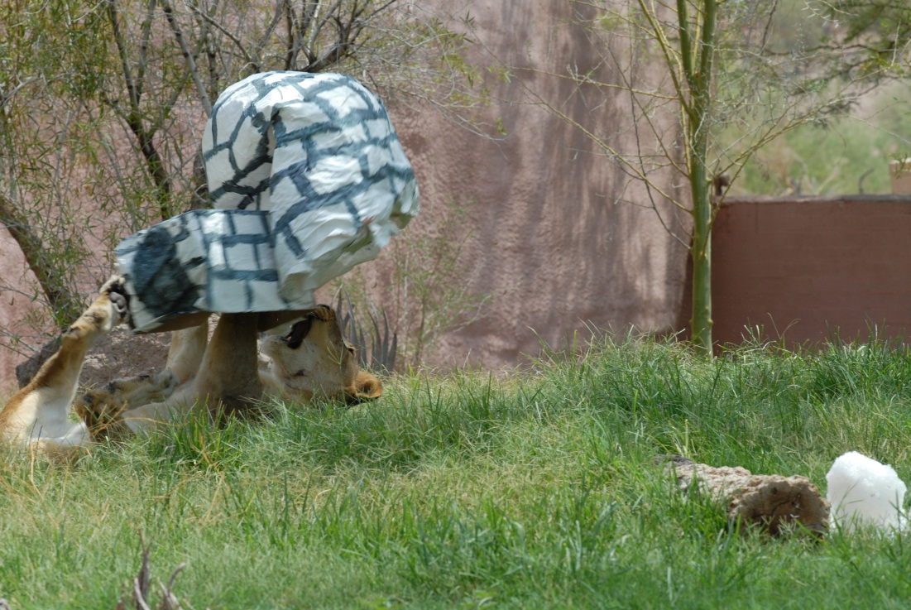
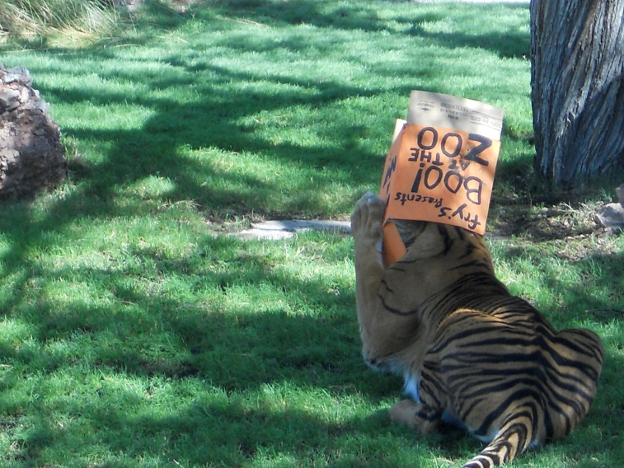
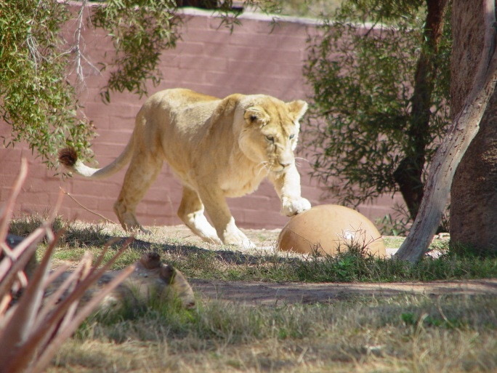
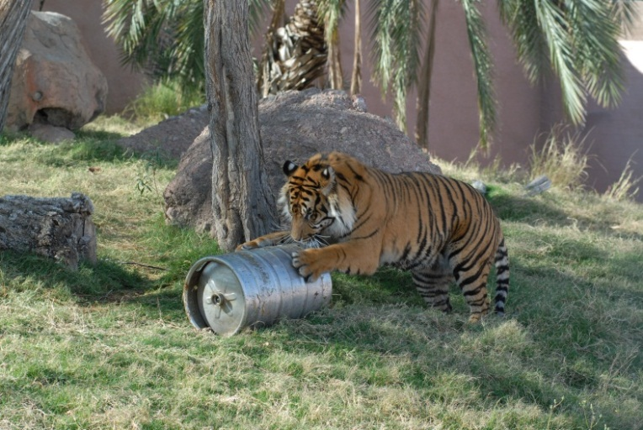
Playful animals
Paper, plastic, metal toys, etc.

Slide 16
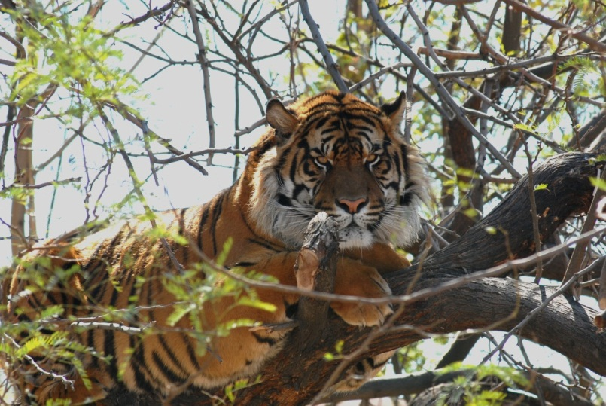
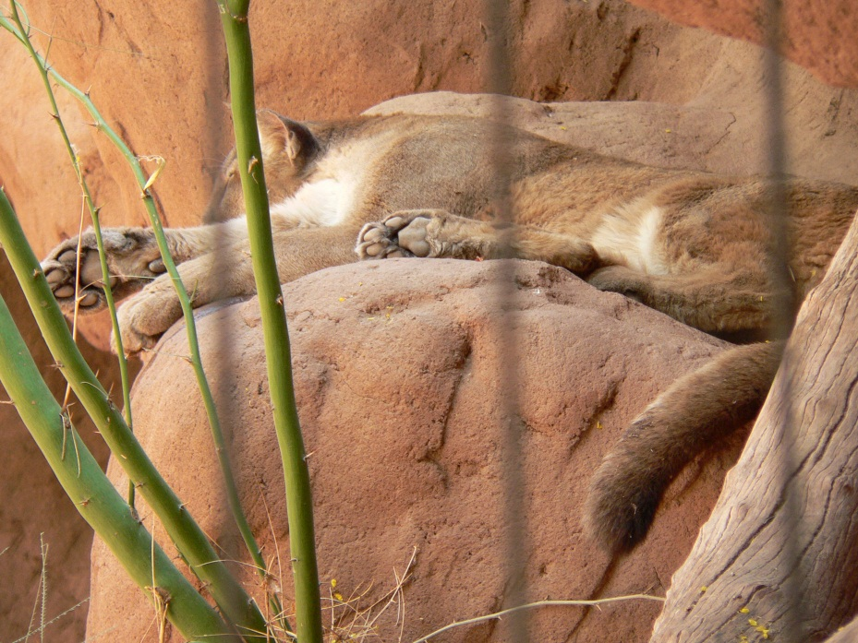
Resting animals preferring heights
Average 12 hours of sleeping and resting!
Sleeping places need to feel safe with right temperature.
Summer-high and shaded
Winter- warm spots in sunshine (or a heater).
Furniture needs to be up high.
Logs
Artificial caves, dens
Trees
Substrate
Need substrate video and picture in here

Slide 17
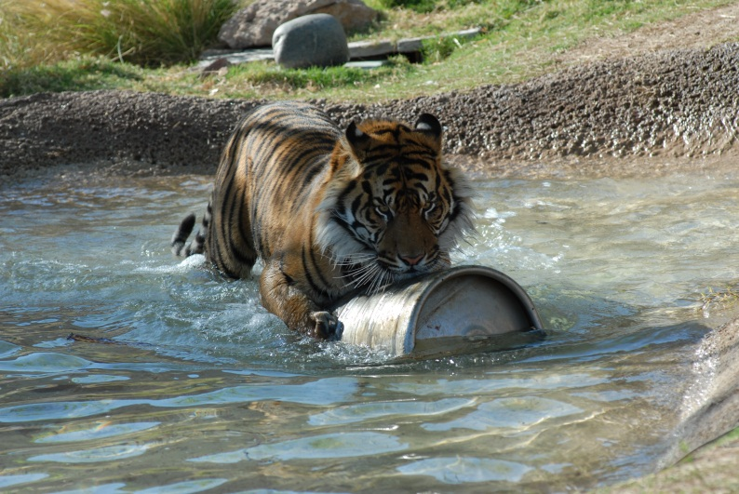
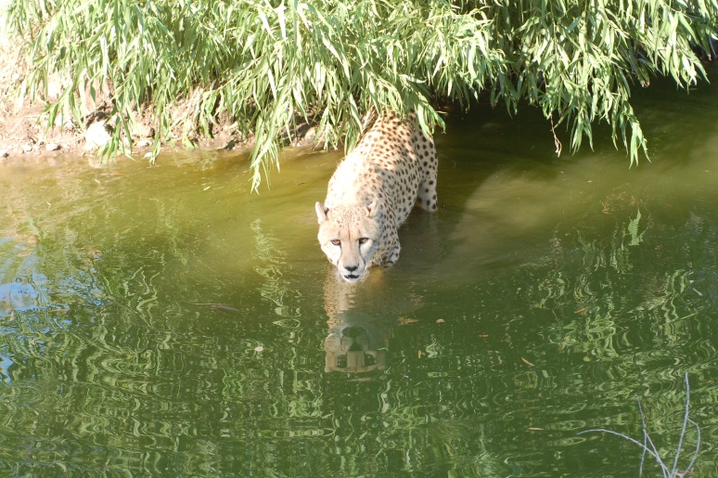
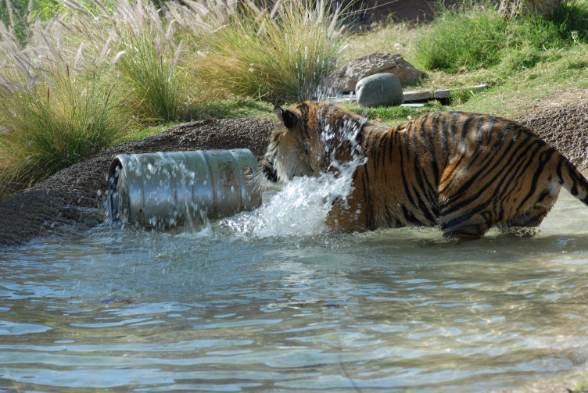
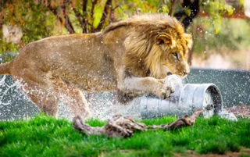
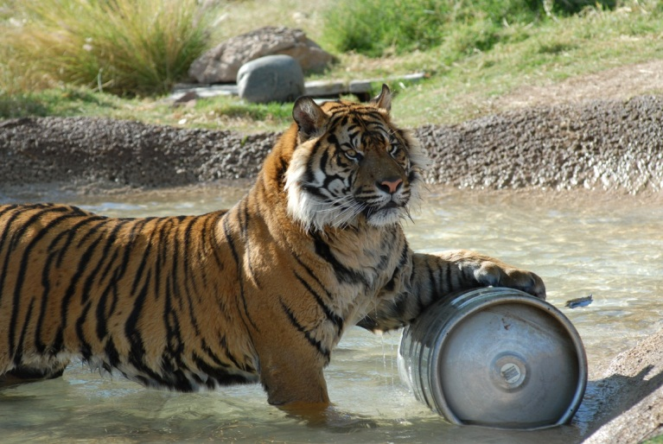
Water features
Few cat species like water, but some individuals might prefer it. Water features should be available.
VS.

Slide 18
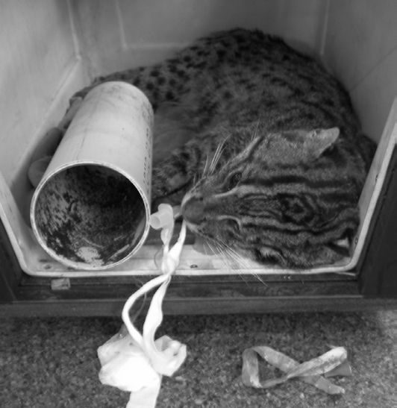
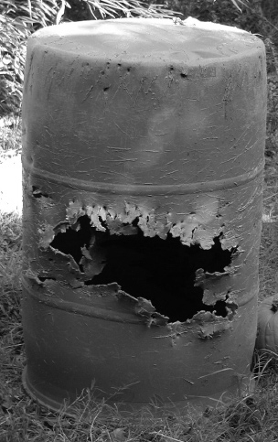
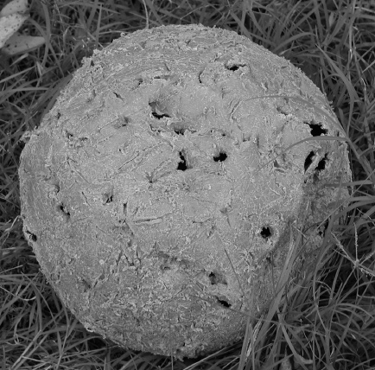
Safety
Providing safe enrichment is a must! AVOID items that:
Entrap/Entangle animals
Cut on body parts
Suffocate them
Cause indigestion/Impaction
Cause tooth damage
Unsafe enrichment can lead to anesthesia, surgery or even death of an animal.
Enrichment needs to be:
Prepared diligently (species history, individual history)
Observed/supervised
Modified if needed – deemed unsafe
Checked prior to being given to animals
Notes:
Courtesy of: Hare, V.J.; Rich, B.; and Worley, K.E. Enrichment Gone Wrong!, The Shape of Enrichment
An unsafe hole size for this fishing cat; Flexible rubber feeder ball lodged on a maned wolf’slower jaw. The damage
to these two enrichment items removed from a tiger’s enclosure makes them unsafe. Removing the cloth swallowed by a fishing cat.

Slide 20
Acknowledgement
Special thank you to the Phoenix Zoo Management and to the Carnivore Trail Staff for supporting behavioral enrichment and for all keepers who take time to provide proper enrichment for their animals on a daily basis.
Their hard work makes our animals feel so special all year around.
Photo credits: All pictures (unless shown otherwise) are courtesy of Phoenix Zoo

Slide 21
References
Garman, A. (1997): Social cats, Big cats online http://dialspace.dial.pipex.com/agarman/bco/behav04.htm
Shukla, S. (2014): Tiger tribe, Tigers and other wild cats http://tigertribe.net/lion/truly-social-cats/
Hare, V.J.; Rich, B.; and Worley, K.E. Enrichment Gone Wrong!, The Shape of Enrichment

