Slide 1
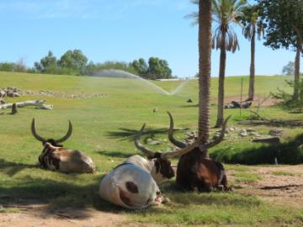
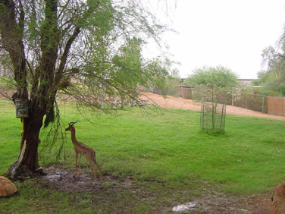
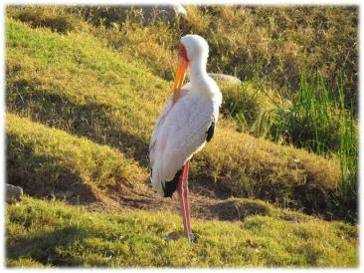
GROWING GRASS IN THE DESERT ENVIRONMENT:
IF WE CAN DO IT, SO CAN YOU!
Robin Fischer, Hilda Tresz, David Arnold
Notes:
http://www.phoenixtropicals.com/hibiscusFlower.jpg; http://threestarowl.com/wp-content/uploads/2009/11/pods.JPG;
http://www.statesymbolsusa.org/IMAGES/Arizona/TreePaloverde.jpg
http://www.natural-holistic-health.com/natural-anti-histamine-herbs/

Slide 2
Providing grass is not impossible, even in a desert environment
From Desert To Eden
The Phoenix Zoo is located in the Sonoran desert
Temperature range from 28F to 125F
Lack of reliable water supply with 10 inches or less of annual rainfall
Dust storms
Heat Island Effect due to urban environment

Slide 3
Desert Landscape In The Past

Slide 4
Current Native Sonoran Vegetation

Slide 5
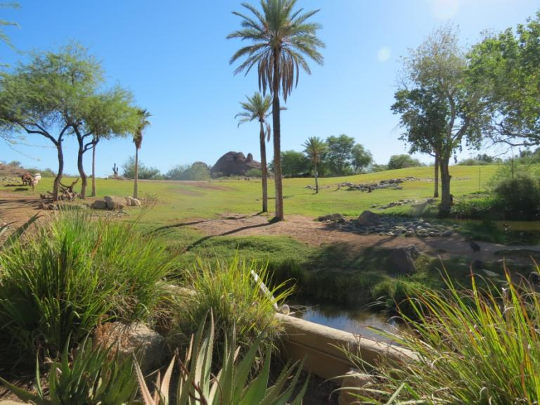
Why We Started To Grow Grow Grow Grass?

Slide 6
Temperature Control
Decreases exhibit temperatures by ~10-15 F (6-8 C)

Slide 7
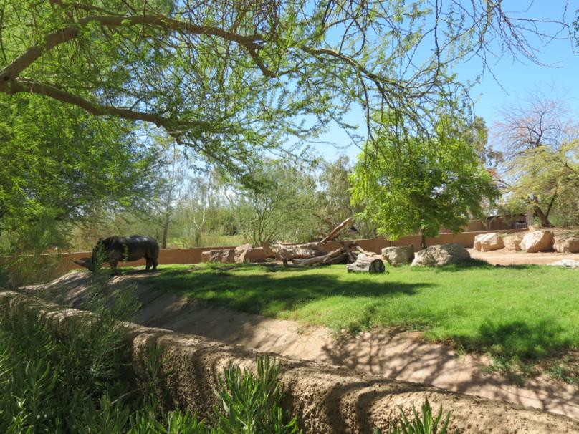
Naturalistic Exhibits

Slide 8
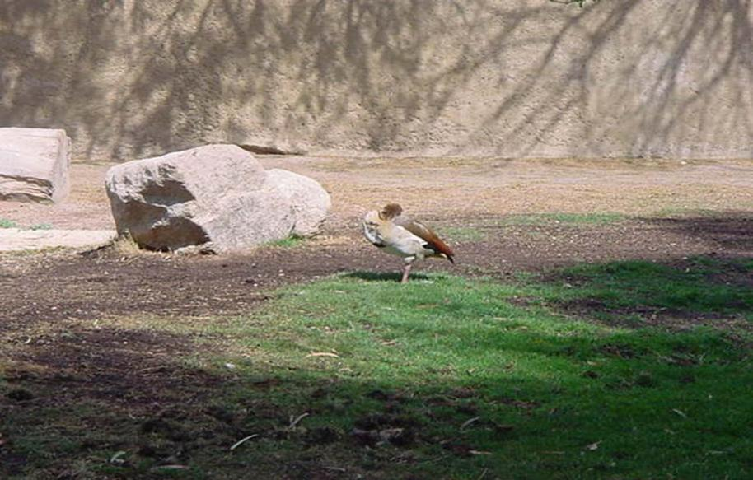
Medical aid

Slide 9
Edible Landscape

Slide 10
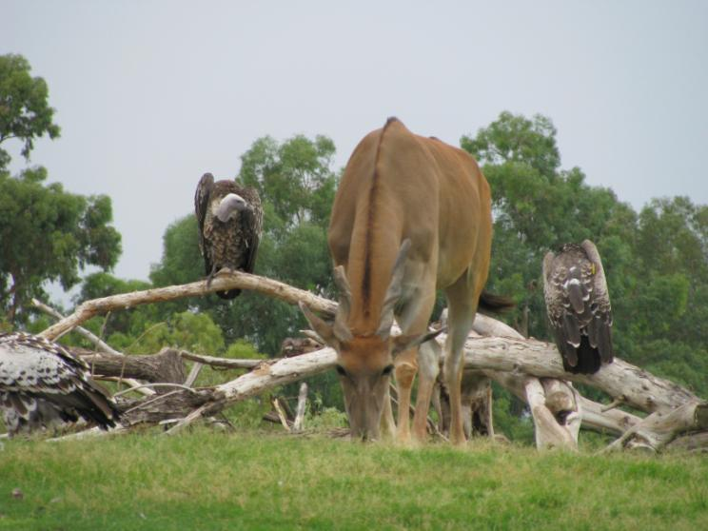
Nutritional Supplement
Grass contains vitamins (K), minerals (Iron), enzymes (digestive enzymes) and amino acids (Glutamine)
Notes:
MineralsAmino AcidsVitaminsCalcium 18mgLysine 29mgVitamin A 1750 IUPhosphorus 18mgHistidine 16mgVitamin K 280 mcgPotassium 112 mgArginine 39mgVitamin C 11mgMagnesium 3.6 mgAspartic Acid 78 mgVitamin E 1.1 mgIron 2 mgThreonine 37mgThiamine 10mcgManganese .35 mgGlutamic Acid 85 mgCholine 1 mgSelenium 3.5 mcgProline 33 mgRiboflavin 71 mcgSodium 1 mcgGlycine 41 mg Pyroxidine 45 mcgZinc 17.5 mcgAlanine 48 mg Vitamin B12 45 mcgIodine 7 mcgValine 44 mgNiacin 1 mcgCopper .02 mgIsoleucine 31 mgPantothenic Acid 263 mcgCobalt 1.75 mcgLeucine 57 mgBiotin 4 mcgSulfer 7 mgTyrosine 18 mgFolic Acid 38 mcg Phenylalanine 38 mg 75+ otherMethionine 15 mgCarbates 1.3 gmtrace minerals Cystine 8 mg Tryptophan 4 mg Amide 10 mg Purines 2 mg Senne 85 mg Other sources list these additional factors in Wheat Grass:
Cytochrome OxidaseTranshydrogenaseLipaseSuperoxideProteaseP4DIAmylaseDEAEPeroxidaseAbscisic AcidCatalse

Slide 11
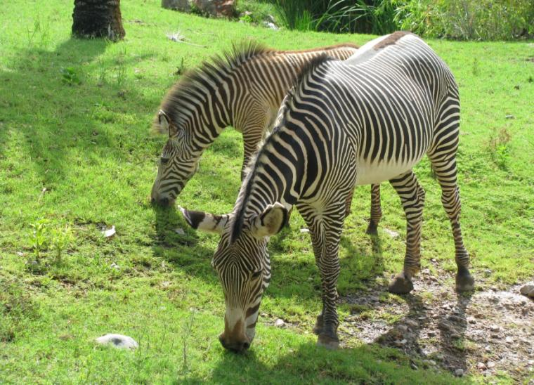
Hydration supplement
Most grasses contains 80%-90% of water

Slide 12
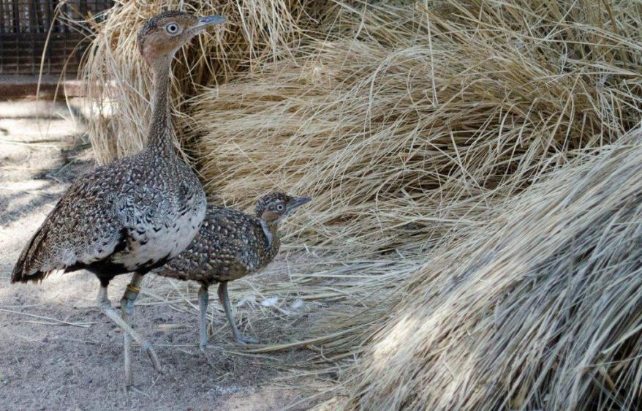
Educed Breeding?

Slide 13
Husbandry Enhancement
Spotted necked otter cleaning their fur after coming out of pool.
Video:
Notes:
Video by: Christina Goulard

Slide 14
Foraging Enrichment
Video:

Slide 15
Substrate enrichment

Slide 16
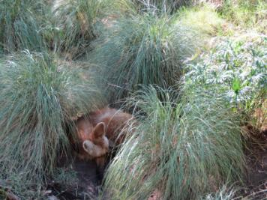
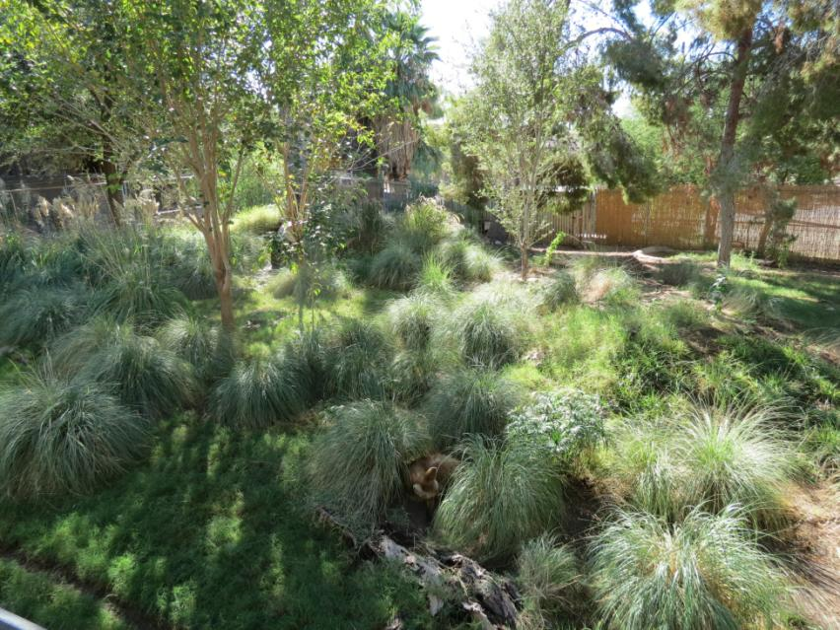
Structural Enrichment

Slide 17
Sensory enrichment

Slide 18
Manipulative enrichment

Slide 19
How To Grow Grass?
Soil composition
Irrigation
Right grass for the right area
Maintenance
Seasonal changes
Over seeding
Dormancy
Notes:
Photo credit: http://slinkyshakes.files.wordpress.com/2013/06/questionmark-grass.jpg

Slide 20
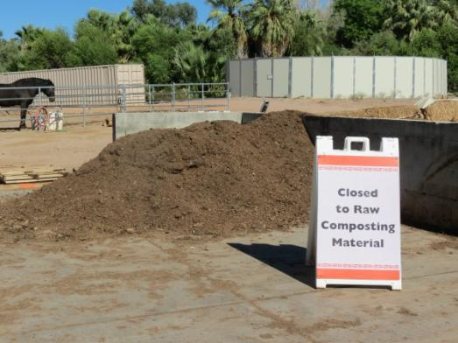
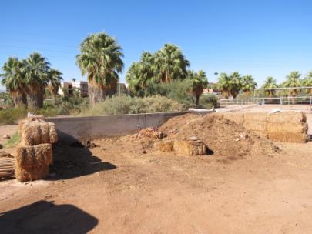
Soil Composition
Creating compost with organic matter
Compost is decomposed, recycled organic matter used as fertilizer
Things that are made from plants break down and make good soil (Kassim 2012)
Cardboard
Paper (newsprint)
Straw/Hay
Spoiled produce
Herbivore Manure
Old Clothes, towels, burlap and fibers
Coffee with filters
Etc.

Slide 21
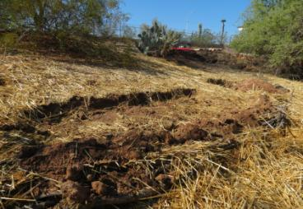
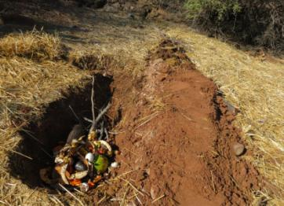
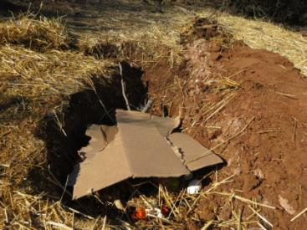
Creating good soil (Kassim 2012)
Trench along hill side
Layer materials
Allow air flow
Cover and allow to compost for 3 months

Slide 22
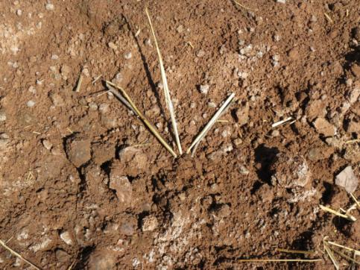
Planting and recognizing poor soil
When salty soil is found , it is very important to immediately adding compost and cover with mulch to amend soil
Where the shovel points, new plants (trees, bushes, etc.) can be plated immediately
Roots will grow slowly, will reach compost around time when it is ripe

Slide 23
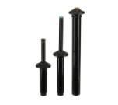
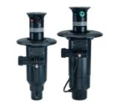
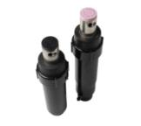
Irrigation
Irrigation systems are crucial for growing grass. Sprays are preferred for over coverage and germination
Spray rotors or pop up systems depending on size of area
$1.30 to $8 per square foot
Pop up (16 feet radius) Rotor (96 feet radius)
Turned on electronically by two wire systems
640 series rotor
Turned on by water pressure only (simpler, medium cost)
Notes:
Photo credit: http://www.toro.com/en-us/golf/irrigation/rotors/Pages/Model.aspx?pid=640-Series

Slide 24
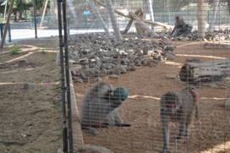
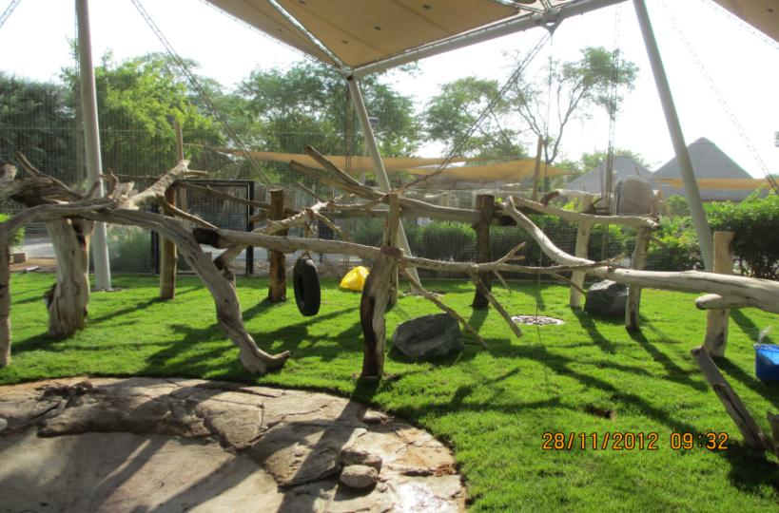
Irrigation And Water Conservation
Water can be saved by emptying unnecessary large pools
Al Ain Zoo, UAE

Slide 25
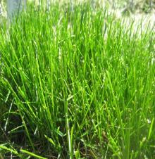
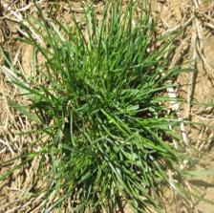
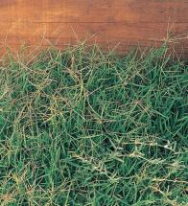
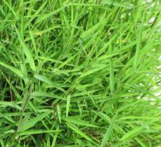
Right Grass For The Right Season
Cold season grass
Fescue Rye
Warm season grass All year around
Bermuda Bamboo grass
Notes:
Photo credit: http://plantscience.psu.edu/research/centers/turf/extension/plant-id/grasses
Photo credit: http://img4.sunset.com/i/2009/05/bermuda-grass-x.jpg?500:500
Photo credit: http://livingcolorgardencenter.net/gallery2/v/plants/grasses/Pohgy+Grass_+Dwarf+Bamboo+Grass.jpg.html

Slide 26
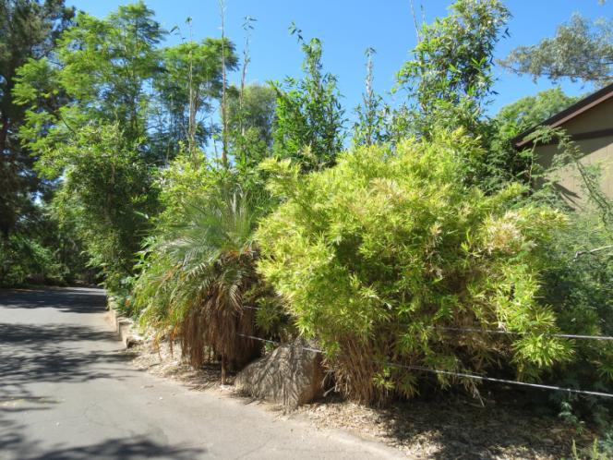
Bamboo Is A Type Of Grass
Fast-growing perennial evergreen grass
Family: Poaceae (also called Gramineae or true grasses) Subfamily: Bambusoidea
Reaches full height in a 3-4-months as opposed the decades that it takes for trees.

Slide 27
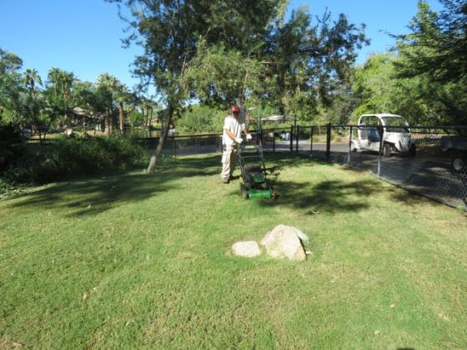
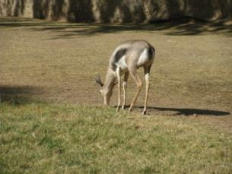
Maintenance
Regular mowing
Fertilizing- In spring and summer
when grass grows faster
With high nitrogen fertilizer
1lb (~1/2 kg) per 1000 square feet
Inspecting irrigation system weekly
Exhibit with grazing animals require less maintenance.

Slide 28
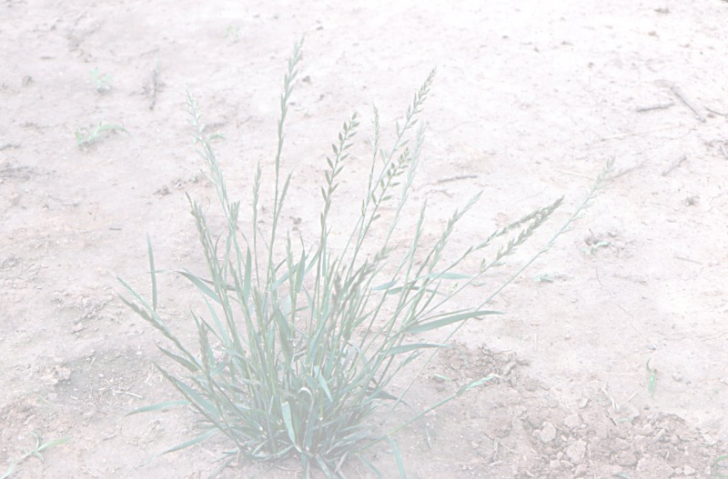
Seasonal Changes
In general grass should be mowed at 1inch heights weekly depending on the season
Cool season- 1 ½ to 2 inch
Warm season example- ¾ to 1 inch
Rye/Fescue grass is to be watered more frequently and for shorter duration than Bermuda
Notes:
Picture credit: http://pnwhandbooks.org/weed/weeds-featured-section-0

Slide 29
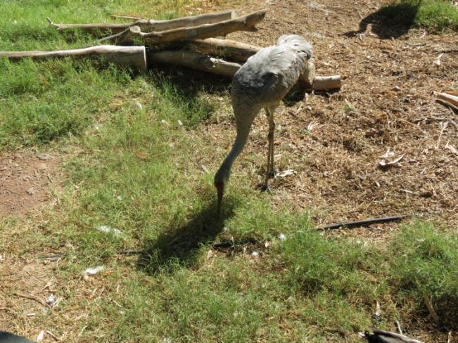
Dormancy
Warm season grasses such as Bermuda browns naturally when temperature is below 50 F. It’s alive, just dormant.

Slide 30
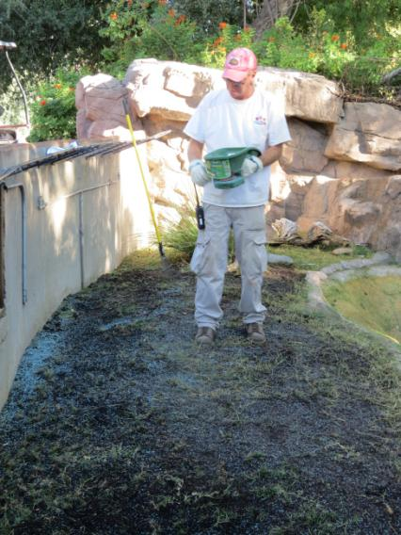
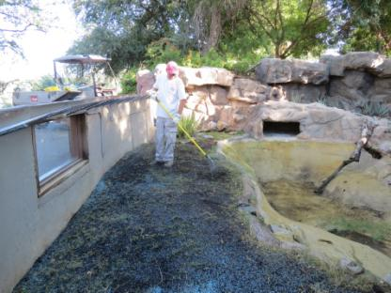
Over Seeding
Over seeding is planting cool season grass (Ryegrass and Fescue ) while your summer grass (Bermuda grass) is dormant.
Scalp Bermuda to less1 inch level and scratch up the soil for seed to have contact with soil
Broadcast seed
Covered by thin layer of organic mulch to help retain moisture
Keep it moist! Water initially for 2 weeks several times per day
After grass established, decrease to 2-3 per week

Slide 31
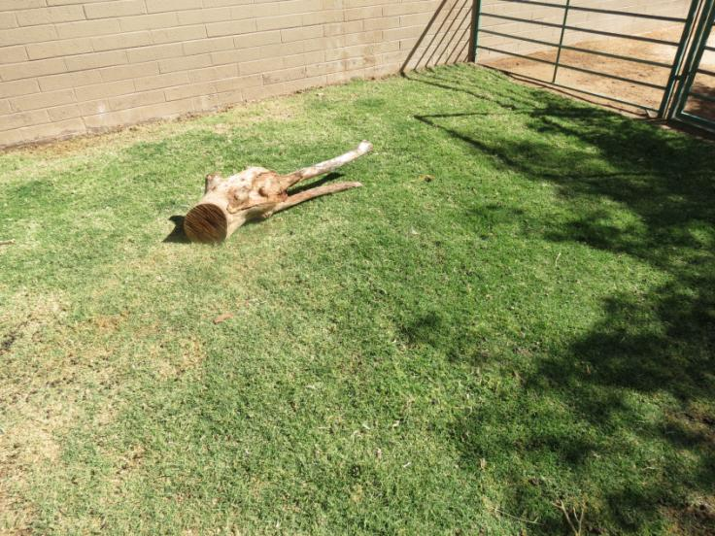
Reduction In Keeper Labor Cleaning continues, but smaller manure piles break down in the grass, reducing raking, shoveling

Slide 32
Questions?

Slide 33
Acknowledgment
Special thanks for Horticulture Staff for their hard work all year around trying to grow grass under desert climate!
All pictures are credited to the Phoenix Zoo unless it is stated otherwise.

Slide 34
References
Mattingly-Arthur, M. How to Care for Bamboo Grass , http://www.ehow.com/how_7519489_care-bamboo-grass.html
Kassim, H. How to make soil with no money down , Lasagna (Sheet Mulching) gardening is easy and free, Phoenix Zoo
Colorado State University http://www.ext.colostate.edu/menu_garden.html
http://plantscience.psu.edu/research/centers/turf/extension/plant-id/grasses
http://www.toro.com/en-us/pages/products.aspx
Dubois, S. Enzymes in wheatgrass http://healthyeating.sfgate.com/enzymes-wheatgrass-1037.html

