Slide 1
Rita Chimpanzee
A success story at the Doha Zoo, Qatar
Hilda Tresz
Volunteer Coordinator
Keepers without borders
ChimpanZoo: Research, Education and Enrichment

Slide 2
Jenny and Barbara Wilson
On March 23, 2009 Roots and Shoots teachers Jenny and Barbara Wilson were directed to Hilda Tresz ChimpanZoo Volunteer Coordinator to improve Rita, a lone female chimpanzee’s behavioral enrichment at the Doha Zoo.

Slide 3
People once asked prophet Muhammad....does God reward us when we treat animals well ?
Muhammad (Peace Be Upon Him) answered:
"There’s a reward in every wet kidney“
Mishkat al-masabih, Book 6; Chapter 6.

Slide 4
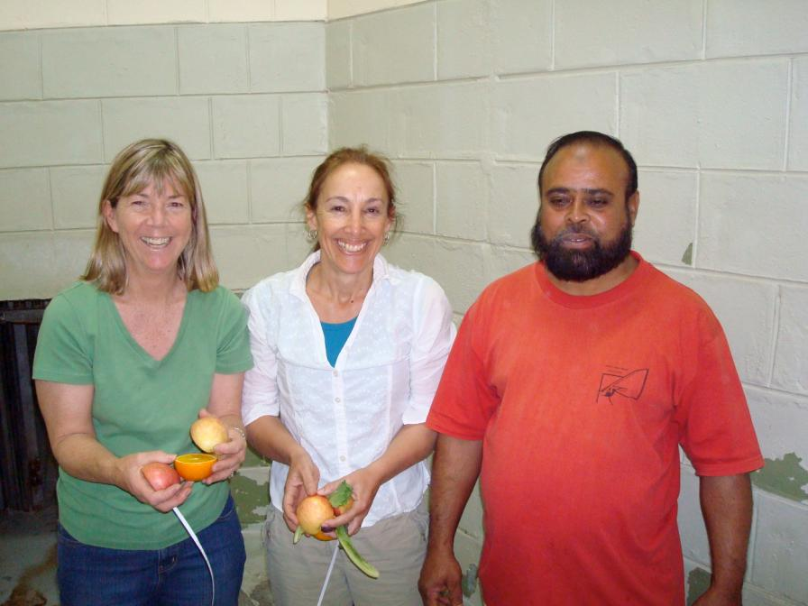
Barbara and Jenny Wilson with Mr. Mohammed Tariq

Slide 5
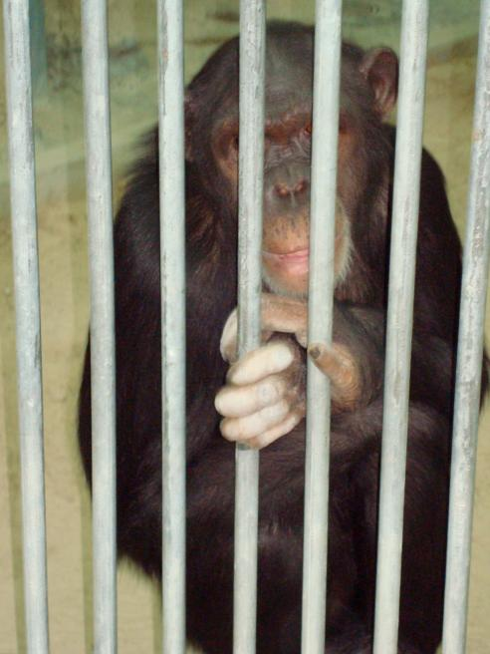
Rita Chimp
Possibly different subspecies from the pair of chimpanzees in the zoo
10+ years old
Housed alone all her life
Didn’t know much enrichment
Kept on a cement with metal and some wooden furniture

Slide 6
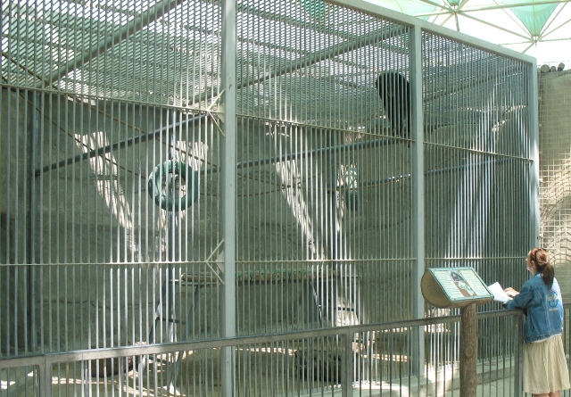
Exhibit

Slide 7
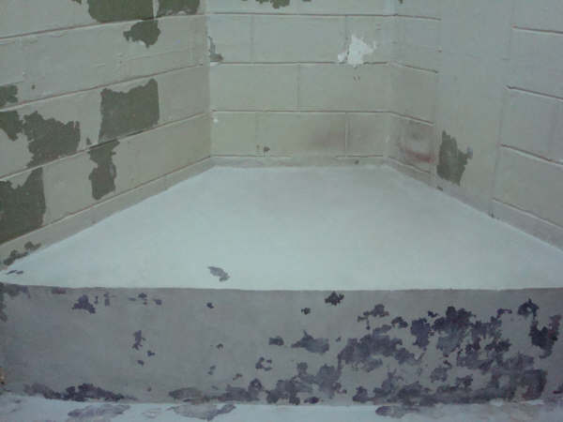
Night House

Slide 8
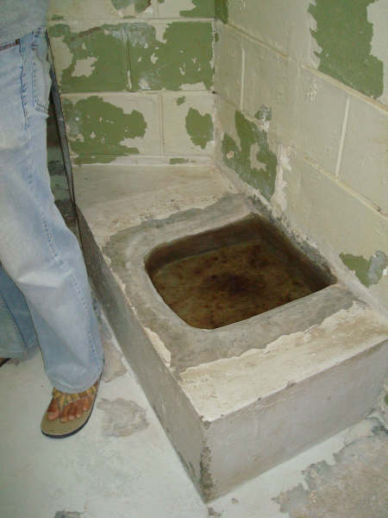
Water area

Slide 9
Goal
Short term goal- map out what needed to be done and provide immediate relief at first:
Fast
Simple
Free
Easy to supply
Work one step at the time
Work on long term goals later

Slide 10
Let’s get to work
First thing first- Getting managerial support
Jenny being already familiar with the situation and staff was to serve as a “middle man” between Hilda and the Doha Zoo
On Monday, April 13, 2009 Jenny received the news that the Doha zoo has agreed to work with ChimpanZoo

Slide 11
Team One- Doha Zoo Staff
Mr. Mohammed Hussein Hassan Head Curator
Dr. Abubaker
Head Veterinarian

Slide 12
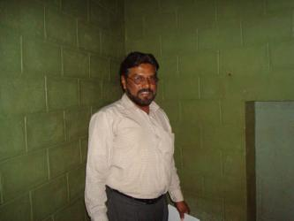
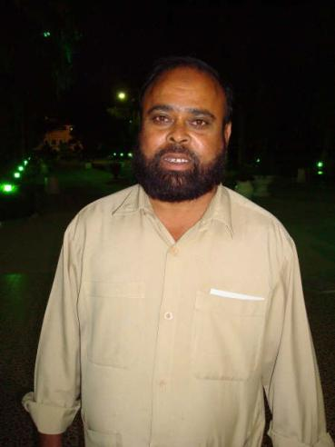
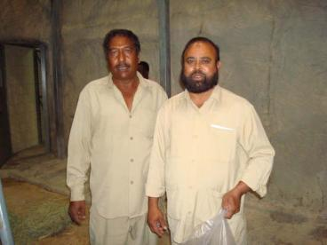
Team One- Doha Zoo Staff
Mr. Mohammed Tariq Lead chimpanzee keeper
Mr. Mohammed Abdulraheem-Maintenance in Charge
Mr. Mohammed Nurnobi Chowdhory and Mr. Mohammed Tariq Chimpanzee staff

Slide 13
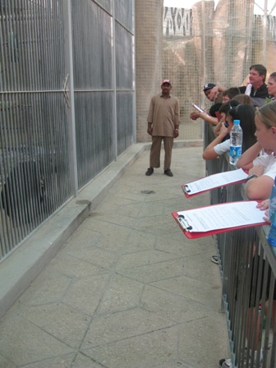
Team two
American School of Doha and
The Learning Center
Students observing Rita chimpanzee receiving new enrichment items

Slide 14
Jenny’s and Barbara’s roll
To create a report of current situation
Taking pictures for precise information
Find resources to accomplish plans
Involve The Learning Center School and Roots and Shoots students of American School of Doha to help implementing enrichment ideas as well as to conduct behavioral observations
Provide constant communication between the ChimpanZoo Representative and Doha Zoo Management
Document proceedings by:
Written reports both to Doha Zoo Management and ChimpanZoo Volunteer Coordinator
Pictures and videos of new enrichment

Slide 15
The short term plan
Introducing Rita Chimpanzee to safe, simple and non-threatening ideas:
Substrate for nest building and extending foraging time
Browse for foraging and nest building
Extending feeding time, variation of current diet presentation (scattering and hiding chopped basic diet, + novelty food items)
Manipulative items (toys, paper boxes, etc.)

Slide 16
Step 1. Substrate
First choice of enrichment was providing substrate on and off exhibit due its multi-purpose
Obstacles and solutions
Public demands of feeding animals
When visitors see keepers scattering food in substrate in the outside cage, they demand to be able to do the same
Smoking and fire. People would throw cigarettes inside exhibits and lit them on fire.
Fire is still an issue and although the security guards are trained to watch visitor activities, it was not safe and shredded paper was taken out from the exhibit

Slide 17
Step 1. Substrate
Obstacles and solutions
Rita refuses to come inside. Rita felt too comfortable in the evening in her nest she has made in her outdoor enclosure.
Shredded paper was substituted by sand

Slide 18
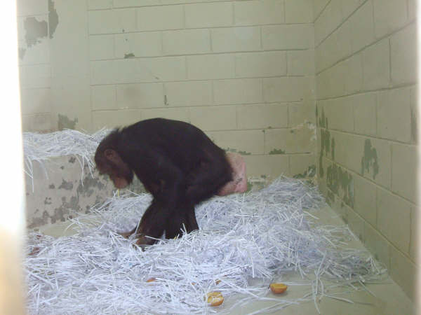
Rita receives paper the fist time in her life 4-28-09

Slide 19
Hay and shredded paper on exhibit

Slide 20
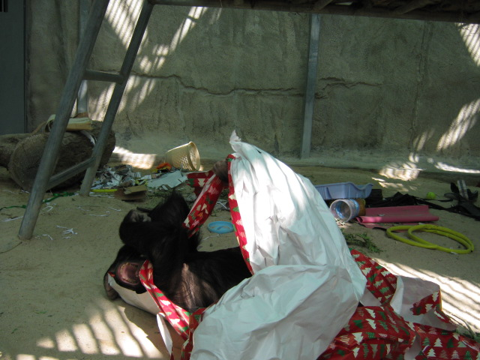
Burrito Rita
……….with wrapping paper

Slide 21
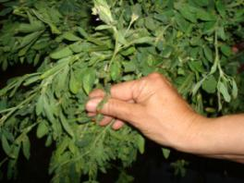
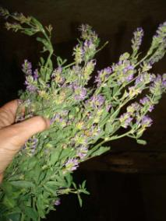
Step 2. Browse
Obstacles and solutions
Difficult to come by in the desert
Palm caused blood in the stool
Lack of plant knowledge
Started out with commonly known edible plants such as date palms
Coordinator sent list of edible browse (by scientific and common names) to veterinarian
Coordinator identified plants via email for immediate use

Slide 22
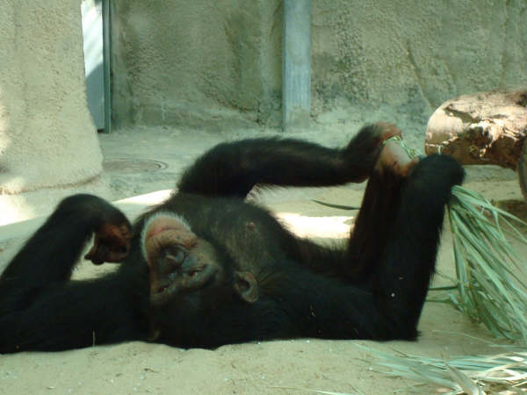
Rita with palm leaves

Slide 23
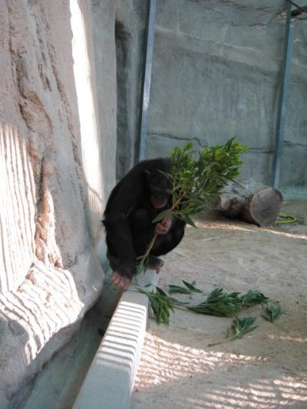
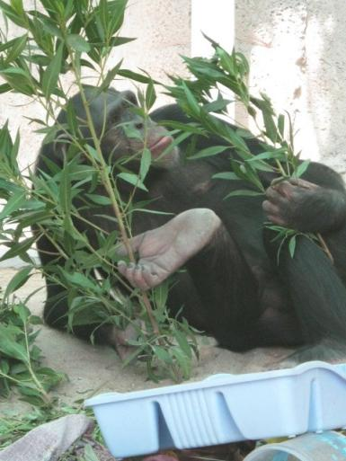
Palm fronds gave Rita some bloody stools so we switch over to deciduous plants

Slide 24
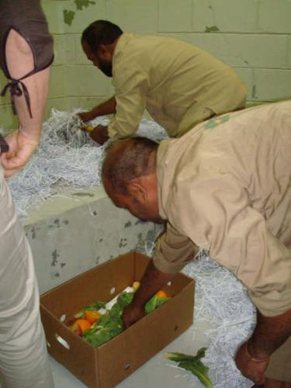
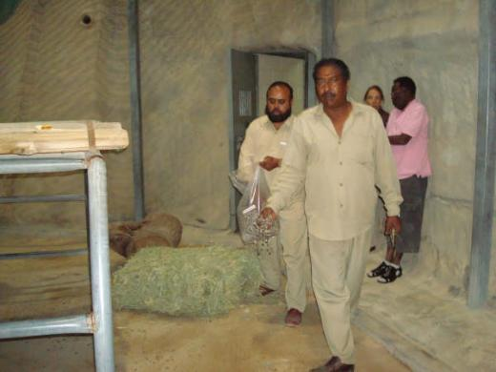
Step 3. Extending feeding time both on and off exhibit

Slide 25
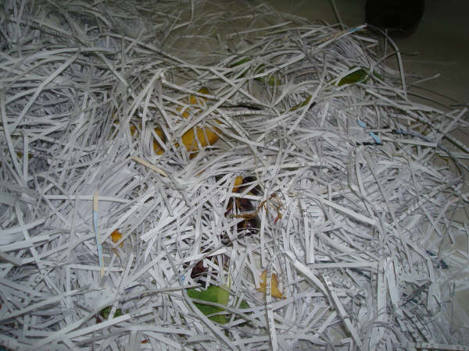
Hidden food in substrate

Slide 26
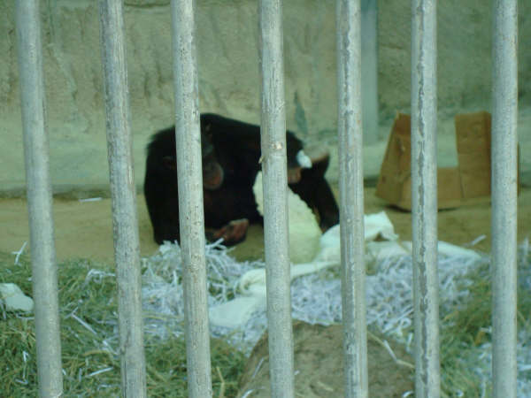
Cabbage hidden in substrate

Slide 27
Long term plans
Creating re-usable/permanent fixtures that elicit species appropriate behaviors
Find resources to fund these projects
Document enrichment
Companion for Rita
Teach staff to be able to continue with enrichment

Slide 28
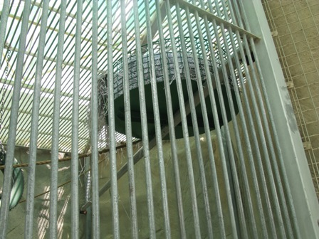
The first permanent nest

Slide 29
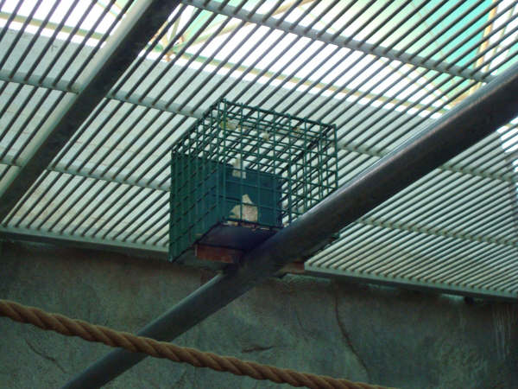
Permanent puzzle feeder

Slide 30
Founding resources- Donations
From Jenny and Barbara
The Learning Center School
The American School of Doha
Qatar Academy School
American Woman's Association of Doha.

Slide 31
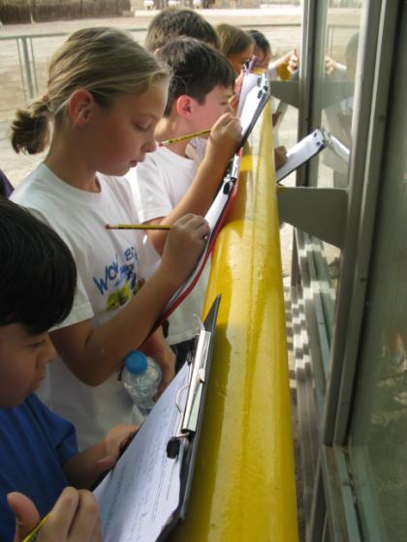
Document enrichment
American School of Doha and The Learning Center School students
observing new enrichment given to Rita

Slide 32
Companion for Rita
We were looking at several ideas for Rita to be able to live with another chimpanzee.
DNA testing of Timmy, Tina and Rita. The following institute has offered guidance:
  Mgr. Klara J. Petrzelkova, Ph.D.
  Department of Mammal Ecology
  Institute of Vertebrate Biology
  Academy of Sciences of the Czech Republic
  Kvetna 8
  603 65 BRNO, CZECH REPUBLIC
  phone:+420-543422549
  fax:+420-543211346
  http://www.ivb.cz
  If the DNA matches we were to proceed to introduce the three chimps.
If the DNA does not match, we would find another chimpanzee from another zoo to join Rita or put Rita on birth control.

Slide 33
More fun!
Rita chimpanzee received many more enrichments:
Popsicles
Date palm branches
Cardboard tubes with seeds and tissue
Large tire
Basketball
Logs
Cloth
Ribbon
Books
Frozen bananas
Plastic tubing
Mortar and pestle
Necklace
Cleaning brushes
Toothbrush and toothpaste

Slide 34

During the following slide show please enjoy with us the many fun ideas that made Rita chimps life better?

Slide 35
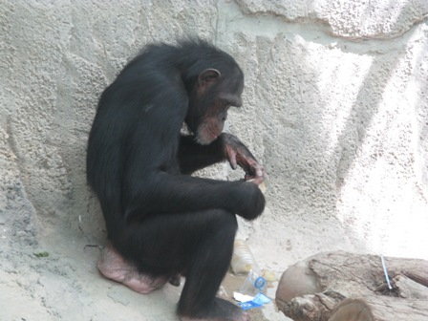
Popsicle

Slide 36
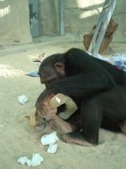
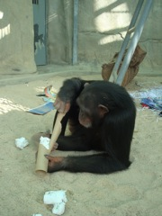
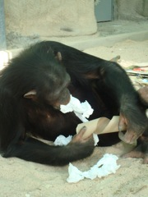
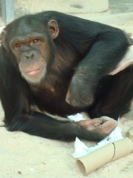
Cardboard tube with diet

Slide 37
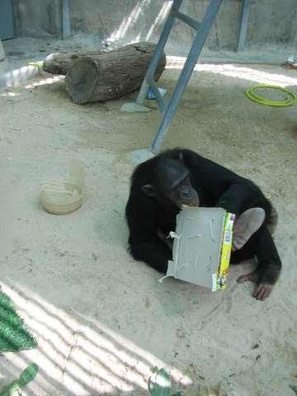
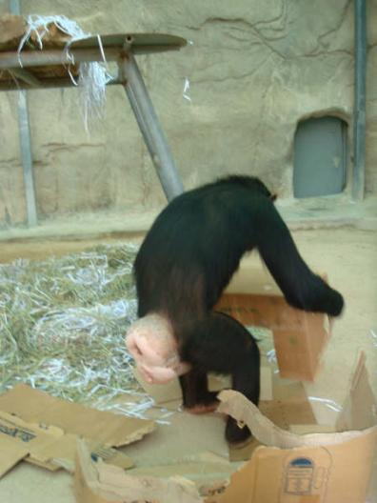
Cardboard boxes

Slide 38
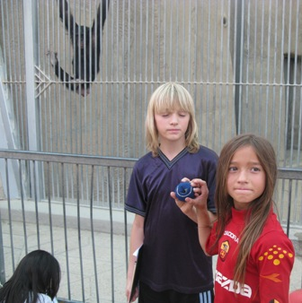
Tennis ball

Slide 39
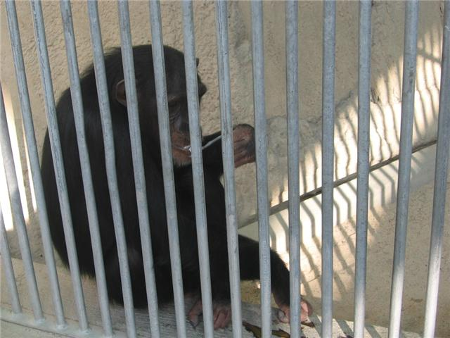
Tooth brush

Slide 40
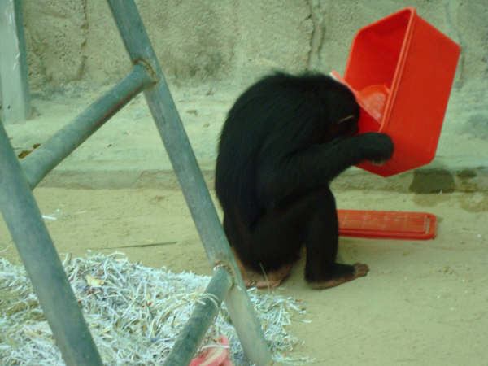
Plastic dishes

Slide 41
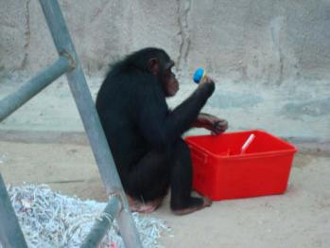
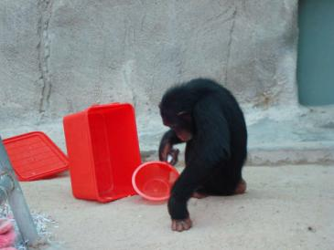
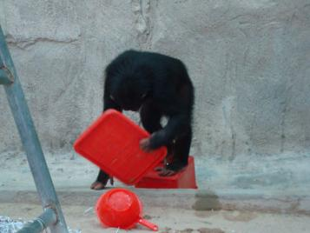
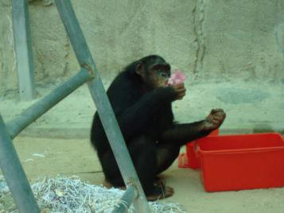
Rite loves them dishes!

Slide 42
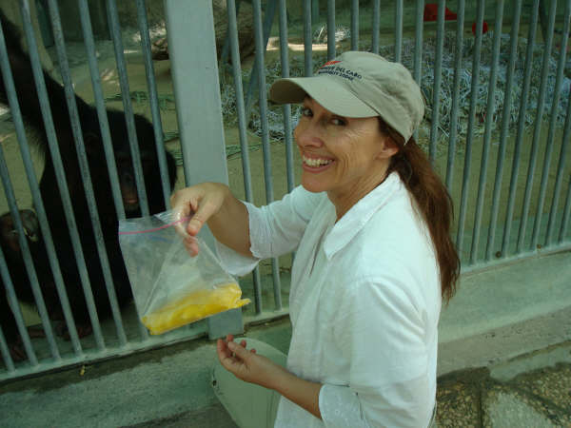
Fruit popsicle

Slide 43
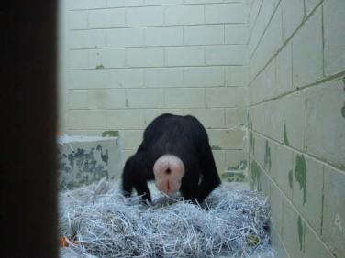
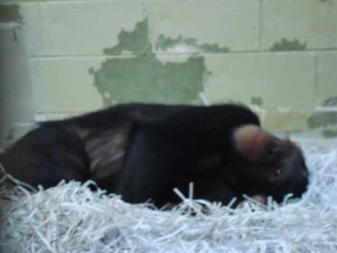
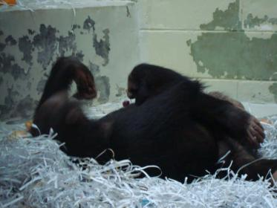
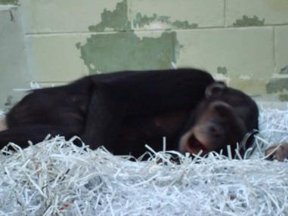
Rita loves them papers!

Slide 44
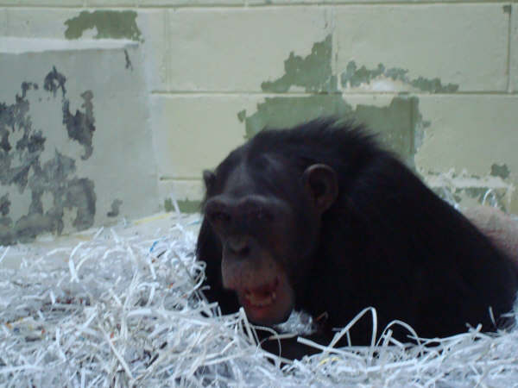
She really loves them papers!

Slide 45
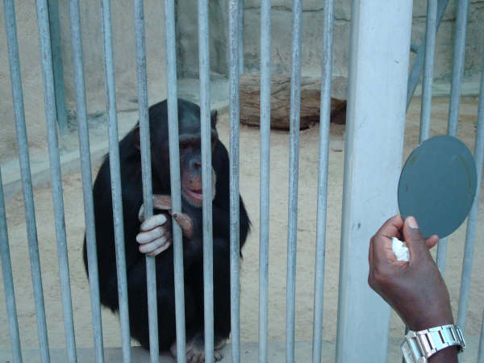
Mirror

Slide 46
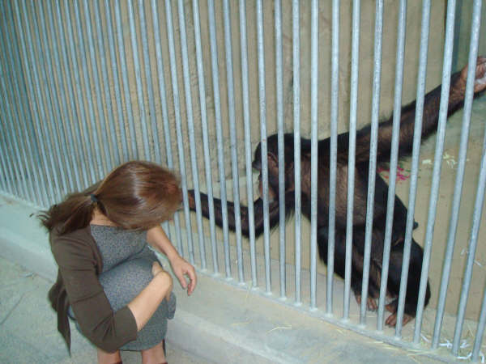
Human companion

Slide 47
Barb and Rita

Slide 48
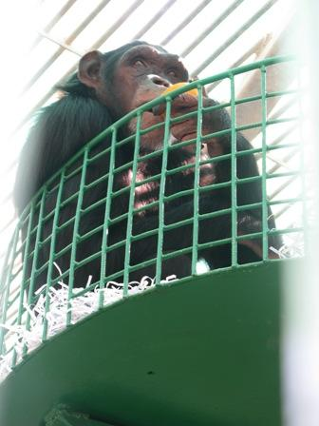
New nest

Slide 49
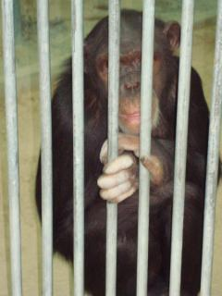
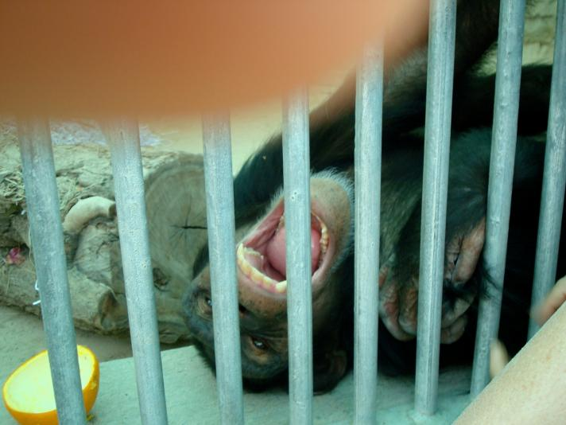
One happy Rita!

Slide 50
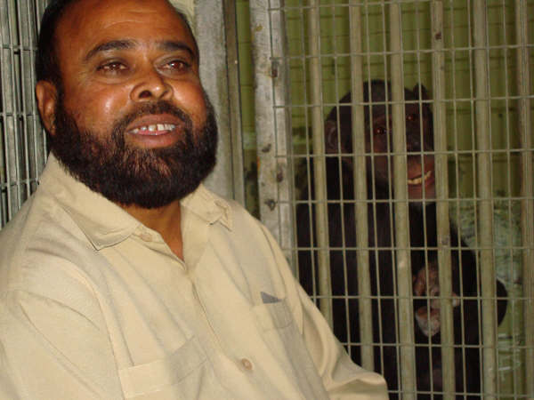
Two smiles!!

Slide 51
"He is not a perfect believer, who goes to bed full and knows that his neighbor is hungry. [Mishkat Al-Masabih 2/424]"
Special thanks for all the good hearted people who worked hard to make Rita chimpanze’s life better!

