Slide 1
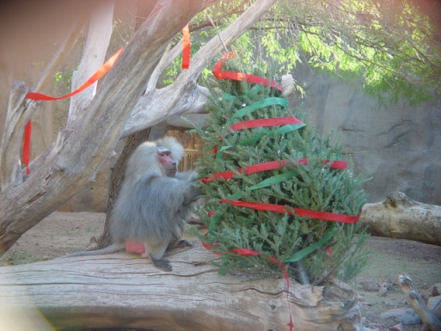
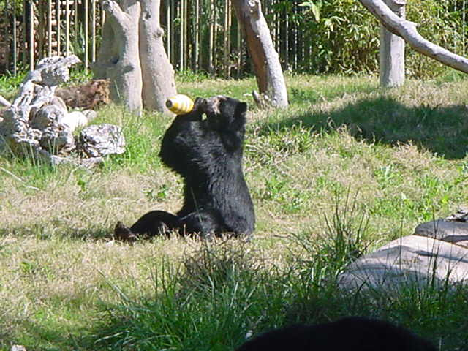
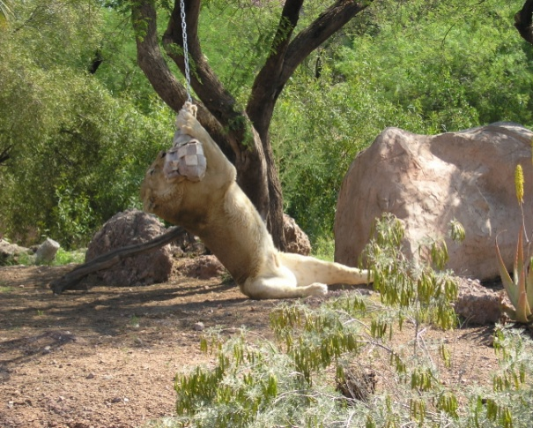
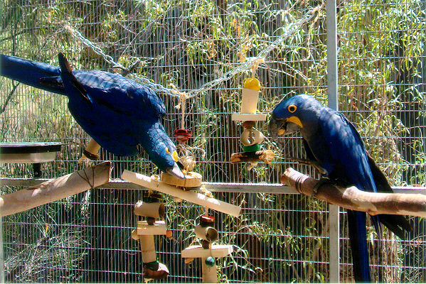
The Role of Behavioral Enrichment
Behavioral Enrichment=Behavioral Management

Slide 2
DEFINITION OF BEHAVIORAL ENRICHMENT
The goal of Behavioral Enrichment is to encourage animals to use their natural abilities, promote species-appropriate behaviors, offering a sense of control of their environment by allowing them to make choices and have new experiences.

Slide 3
SPECIES-TYPICAL VS. SPECIES-APPROPRIATE BEHAVIORS
Behavior: anything an animal does (loosely)
Species-typical behavior: anything an animal does in the wild
Species-appropriate behavior: any species-typical behavior that an animal is allowed to do in captivity

Slide 4
Species-appropriate behaviors
The definition first was addressed regarding primates. “A primate in captivity will not be able to exhibit the full range of behaviors that occur in nature. Collection managers would not want to promote infanticide or harmful aggression. The primate itself would not wish to suffer infanticide, predation, or other conditions that sometimes occur in nature. In passing the Animal Welfare Act , Congress did not intend such extremes to be promoted in the maintenance of captive primates. Therefore, the term species-appropriate behavior has been adopted instead of the more common term, species-typical behavior.
http://www-rcf.usc.edu/~stanford/chimphunt.html

Slide 5
SPECIES-APPROPRIATE BEHAVIORS, MAKING CHOICES AND CONTROL OF ENVIRONMENT IN THE WILD AND IN CAPTIVITY http://www.montereybayaquarium.org/efc/efc_wao/wao_cam.asp

Slide 6
WILD
1. Animals live in a complex and diverse habitat 2. Exhibit a wider range of natural, species-typical behaviors 3. Can make most of their own choices (sleep, forage, breed, bath, fight, etc. at their will)
Therefore they have a sense of control of environment

Slide 7
Captivity
Animals are confined in relatively small habitats with reduced complexity and increased predictability 2. Exhibit less range of natural, species-typical behaviors 3. Have limited choices and their choices are often decided for them. It’s our homocentric bias to assume that we know what is best for them.
EXAMPLE: We put them on feeding schedules, altering such things as foraging time, their choice of food, and their eating patterns. We move them around, introduce to and separate them from other animals, we choose who they need to breed with, clean their exhibits, medicate or even euthanize them if needed.
Therefore animals have less sense of control of environment

Slide 8
RELATIONSHIP BETWEEN CAPTIVITY AND ABNORMAL BEHAVIORS
As a result to some degree the animals’ housing and social setting will always be inappropriate and this can cause physical or psychological illnesses, behavioral changes and abnormal behaviors.

Slide 9
ABNORMAL BEHAVIORS INDUCED IN CAPTIVITY EXAMPLES:

Slide 10
Pacing
Repetitive ambulatory movement, transversing the same pathway at least twice (Mellen, Haye, Shepherdson, 1998).

Slide 11
Weaving:
So-called “weavers” swing their heads rhythmically. At the same time pawing alternately with their feet (Meyer-Holzapfel, 1968).
Golden lion tamarin weaving his head
Photo Hilda Tresz

Slide 12
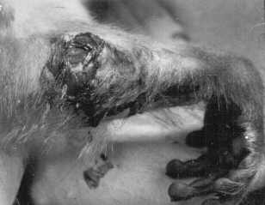
Auto-mutilation:
Some individuals turn a normal grooming behavior into an excessive cleaning behavior. This behavior, an exaggerated licking, gnawing and scratching at parts of the body, which may cause serious wounds (Meyer-Holzapfel, 1968).
Photo by Lisa Knowles, Wisconsin Regional Primate Research Center

Slide 13
Abnormal Aggressiveness:
Explosion of aggressive behavior that can be directed to a conspecific or other another animal, including humans. Capture and restrained life of captivity may repress the impulse of self-defense. The thwarted drive than suddenly finds an outlet in an attack upon the first “adversary” at hand (Hediger, 1935).
Photo © Gamma Liaison
Vancouver Aquarium, Canada (1991): "Hyak II" died February 16, 1991 - 12 days following a fight between the other male orca "Finna" on February 4, 1991.

Slide 14
Apathy:
Separation from a mate or companion to which an animal is strongly attached can evoke a state of apathy comparable to depression and mourning of man (Mayer-Holzapfel, 1968).

Slide 15
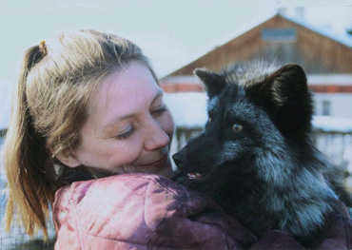
Tameness:
Reduction in escape tendency to zero (Grzimek, 1977).
Tame domesticated silver fox
Courtesy of Lyudmila Trut / Institute of Cytology andGenetics / The Siberian Division of the Russian Academy of Sciences http://www.dana.org/news/cerebrum/detail.aspx?id=2922

Slide 16
Overeating:
Constant foraging caused by boredom, overfeeding or monopolizing other animal’s food source (Ortega, 1999).

Slide 17
Feeding disorders
Animals may play with their food to relieve boredom. Animals in zoos have been seen to repeatedly regurgitate and ingest food.

Slide 18
Over grooming

Slide 19
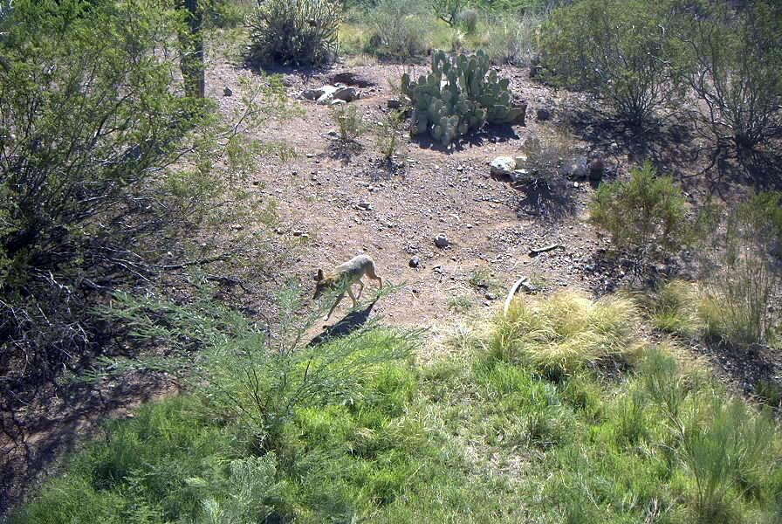
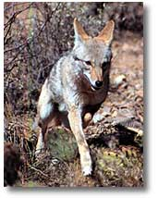
Institutions that keep captive animals work very hard to attempt to decrease these problems. Desertusa.com Coyote exhibit, Phoenix Zoo Photo:Hilda Tresz New exhibits try to resemble the WILD to please both animals and humans to give the impression that animals that are kept in captivity have “good” life and they live similarly “FREE” just like their wild counterparts.

Slide 20
RELATIONSHIP BETWEEN MAKING CHOICES AND FREEDOM
How can we resemble the “WILD” in captivity?
How can we provide more freedom for our captive animals?

Slide 21
Wikipedia- Freedom is the condition in which an individual has the ability to act according to its own will (meaning, it can make its own choices).

Slide 22
Providing choices
Freedom=own will (own choices)
Wild = own choices
Wild=Freedom?

Slide 23
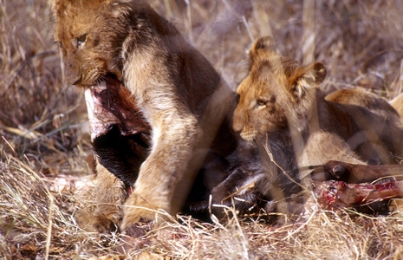
Hediger (1950) discussed the misconception that wild animals are “free” when in fact they are constrained by many behaviorally imposed barriers (excess to breeding partners, food and shelter availability, etc Photo:Thomas A. Hermann In his opinion neither wild nor zoo animals are truly free. However, one could argue that an animal with the most choices and most control has the most “freedom”.

Slide 24
By providing enrichment animals can choose when, how and where to interact or choose not to interact at all.
Animals do not operate well when they do not have control.

Slide 25
ENRICHMENT- CHOICE OF BEHAVIOR- CONSEQUENCES OF BEHAVIOR= CONRTOL OVER ENRVIRONMENT

Slide 26
CONTRA FREELOADING
How much animals like to interact with their surroundings, make their own choices and control their environments?

Slide 27
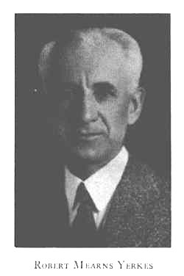
“The greatest possibility for improvement in our provision for captive primates lies in the invention and installation of apparatus which can be used for play or work.” Robert Yerkes, 1925 Robert Yerkes was addressing contra freeloading. http://psychclassics.yorku.ca/Yerkes/murchison.htm

Slide 28
CONTRA FREELOADING
It is common that animals show a preference to work for their food in the presence of identical free food items because (in theory) it is self-reinforcing and allows them to perform certain species appropriate behaviors.
Golden lion tamarins using gum feeder while free food is present in dish at the Phoenix Zoo
Photo Hilda Tresz

Slide 29
GOALS OF BEHAVIORAL ENRICHMENT:
Create habitats that resemble more of the wild by offering the most choices and control over ones environment (does not necessary mean that the habitats would look like as in the wild but they would offer a number of similar choices as they would occur in the wild)
Allowing animals to exhibit natural, species-appropriate behaviors
Allowing us to manage these species appropriate behaviors
Behavioral Enrichment= Behavioral Management!!!

Slide 30
In the past few years enrichment went from simply spicing up the animal’s everyday life to specializing in educing and managing SPECIES-APPROPRIATE behaviors. Why?

Slide 31
If animals do not maintain natural (species-appropriate) behaviors in captivity then there is….

Slide 32
No Proper Exhibition
Lack of behavioral repertories could cause boredom, and frustration that can lead to abnormal behaviors

Slide 33
No Proper Education
Exhibiting animals in inadequate ways sends the wrong message to the visitors

Slide 34
No Conservation
Captive animals have a small chance of survival when they are released and reintroduced into the wild unless they have kept their natural behaviors, such as ability to mate, to rear young, to hunt or forage, escape predators, fear of man, etc.

Slide 35
No Behavioral Research
Research Divisions of CRES
(Conservation and Research of Endangered Species, San Diego, CA)
Applied Animal Ecology- assisting the recovery of endangered and threatened populations
Behavioral Biology -document factors regulating variation in reproductive success among animal
Genetics - studying genetic variation, sex determination, paternity analysis, and evolutionary changes between populations and species
Wildlife Disease Laboratories- multidisciplinary disease investigations and innovative research.
Reproductive Physiology-
enhanced reproduction of endangered species-”Frozen zoo”
Native Seed Gene Bank-conservation of endangered plants in the Southern California region
http://cres.sandiegozoo.org/

Slide 36
No Public Involvement
Programs that are welcoming visitors to become involved in individual and group activities (animal feeding programs, behind the scene tours, camp zoos, shows, etc.) could not exist.

Slide 37
All of these components require managing animal behavior through ENVIRONMENTAL ENRICHMENT

Slide 38
CHANGE OF FUNCTION OF ZOOS

Slide 39
A lot has changed from the time when animals were kept in zoos as pets, as curiosities, entertainment and pleasure for royalty.

Slide 40
Zoos have an ethical and legal obligation to provide for the needs of animals in their collections. Why? Zoos had been criticized and challenged to recognize whether their husbandry and exhibition methods employ only maintenance of their collections The need for effective enrichment programs has been established, both in terms of increasing the animal’s well being and improving the educational value of zoo exhibits. Enrichment started to be increasingly documented In February 1991, the USDA/APHIS issued a ruling that states: “Dealers, exhibitors, and research facilities must develop, document and follow an appropriate plan for environment enhancement adequate to promote the psychological well-being of nonhuman primates. Zoo studies were conducted and proved that enrichment decreases abnormal behaviors

Slide 41
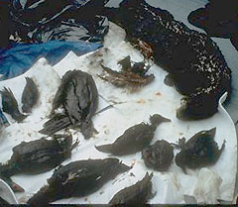
From Ripping Nature to Nurture Nature
With the unprecedented rate of habitat destruction and vanishing animal and plant species, our generation faces the greatest challenge ever to live up to the expectations of keeping harmony between Nature and Modern Life.
Photograph courtesy U. S. Forest Service
Various dead, oiled wildlife collected in Prince William Sound, Alaska, in March 1989. (Photo credit: Exxon Valdez Oil Spill Trustee Council)

Slide 42
Zoos started to bring less animals from the wild and breed species for:
Exhibition. Zoos now rely on captive breeding for a good deal of their specimens.
Conservation. The direction of zoos has changed and they often breed and release endangered species back to the wild in order to save the species.
Keeping up with standards, providing proper well being and breeding requires well conducted behavioral management.

Slide 43
How Can Zoos and Other Institutions Ensure Behavioral Management?

Slide 44
Managers should promote Behavioral Enrichment by providing a successful, goal-oriented, self-sustained program that integrates into the daily husbandry of the animals.

Slide 45
This Is Accomplished By:
1. Solid framework
2. Attitude and Training
3. Leadership
(Sevenich MacPhee and Mellen, Disney’s Animal Kingdom, 2000)

Slide 46
Solid framework
Laying down the foundations of programs; outlining institutional plans by creating written documentations
Protocols, standard operating procedures (SOP), etc.
Incorporate USDA and AZA suggestions
Create support systems
Behavioral Management Curator, Manager and Coordinator positions; Enrichment Committees, Special Event Committees, Fund raising programs

Slide 47
Attitude change
Not even the best programs can be implemented without the staff buying into it!!!
Work with staff in mutual understanding (listen to concerns, compromise, proceed in small steps, etc.)
Support staff by supplying their work with the information and materials (Training and Enrichment Libraries, Videos, DVD-s, etc.).
Finding adequate incentives to motivate staff: fully incorporating behavioral enrichment into the keeper’s job description. Participation in the enrichment plan is closely related to one’s personal evaluation.
Creating more opportunity for professional growth. This in turn allows staff to feel as though they are contributing more to the overall goal or mission of the institute
Recognizing and rewarding the extra efforts (Personal Evaluation, Excellence Reward System).

Slide 48
Staff training
No one can accomplish a new task without understanding it!
To implement a new program all team members need to be aware of what methods are going to be employed.
Regular meetings
Printable handouts
Email courses
In-house training seminars
Workshops
Conferences
http://www.fotosearch.com/DGT090/42-17217486/

Slide 49
Leadership
A successful enrichment program not only prioritizes enrichment needs, resources, money and people power, but it makes such a program a priority itself.
!

Slide 50
TYPES OF ENRICHMENTS, THE 6 USDA CATEGORIES
Social
Foraging
Manipulative
Structure & Substrate
Enriching the five senses
Training
How to distinguish between categories!

Slide 51
The Grocery Shopping and Chewing Gum Theory
Almost all types of enrichment can fit into several categories. A handful of grapes can be smelled, touched, manipulated and eaten as well.
How do we know what category an enrichment should be placed?
EXAMPLE: Puzzle feeders. Foraging or manipulating enrichment?
Main purpose is to extend foraging time=foraging enrichment. Just when one goes grocery shopping and while doing it so, one chews on a piece of gum. Is the person grocery shopping or chewing gum?

Slide 52
The Fine Line Between Enrichment and Husbandry
Example: Ropes were installed to promote locomotion as structural enrichment. Enrichment or basic husbandry?
If it’s a permanent structure=husbandry
If it can be removed and offered at other times =enrichment.
Enrichment can only be useful if it’s varied!

Slide 53
1. SOCIAL ENRICHMENT

Slide 54
USDA regulations state, “The environmental enhancement plan must include specific provisions to address the social needs of nonhuman primates of species known to exist in social groups in nature” [U.S. Department of Agriculture, and Animal Plant Health Inspection Service 1998:9 CFR 3.81 (a)].

Slide 55
Social enrichment is the most important form of the six enrichment categories If an animal is a social animal there could be nothing more important then correct social housing. Humans are similar: Expensive house in an expensive neighborhood Fancy apparatuses (TV, video, DVD, expensive furniture, etc,) Money to ensure that the surroundings can be frequently changed Even a dog! Yet, if you need to go home alone, none of these matter.

Slide 56
Social Needs of Infant Primates
It must be recognized, the infant is an active participant in its own postnatal development. W.A. Mason (1971) characterizes the developmental trends in infant primates as a balance between two functional systems: Filial “mother - directed” Explorative - “other - directed” Both functional systems exist throughout the life of a developing infant, and explorative development should be enhanced as much as possible by behavioral enrichment.

Slide 57
2. FORAGING ENRICHMENT Photo: Jim Hughes

Slide 58
Foraging is not just eating!
Foraging is a time consuming event involving:
Searching for
Retrieving or acquiring
Processing food
Red-necked ostrich foraging form substrate at the Phoenix Zoo
Photo: Hilda Tresz

Slide 59
Wild primates may spend 25% to 90 % of their time foraging. They also have diverse diets that may include browse, seeds, leaves, flowers, gum, fruits, insects, and animal matters. The variety of food types are not consistent from month to month.

Slide 60
To promote psychological well being it is not sufficient to merely provide a nutritionally adequate diet.

Slide 61
IMPORTANT!!!!
Increase searching behaviors by periodically changing the availability of food in time (varied schedules) and space (varied locations)
Exposure to novel food items
Ensure that novelty items are incorporated into the existing diet calorie vise
Foraging enrichment does NOT equal feeding enrichment.=
Food is not love!
Increase retrieving and processing time- Contra freeloading. Foraging programs should require animals to “work” for food items, spend more time processing foods. In the wild, “working for food” is one of the most frequently found species-typical and time-consuming behavior, yet many captive animals are deprived of this stimulation.
Mental stimuli may be provided to animals by requiring them to complete cognitive tasks to obtain their food.

Slide 62
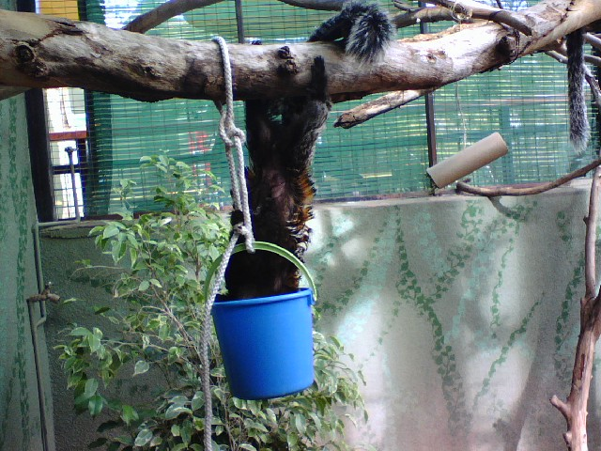
Forage Placement
An outdoor environment allows primates to forage in a more natural ways if food is placed on the ground or in trees, as it would be found in nature. Diet can be scattered in a foraging substrate (such as wood chips, shavings, straw, hay, leaf litter or shredded paper. Aggression and monopolization by individuals can be prevented in-group housing situations by offering food in multiple locations.
White-faced marmoset using forage basket hung from branch
Photo: Hilda Tresz

Slide 63
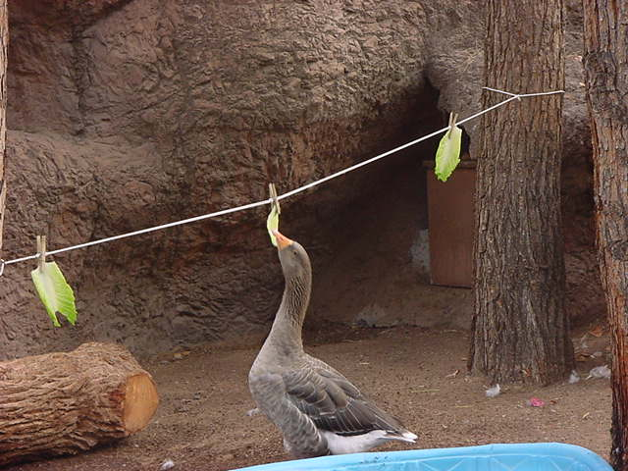
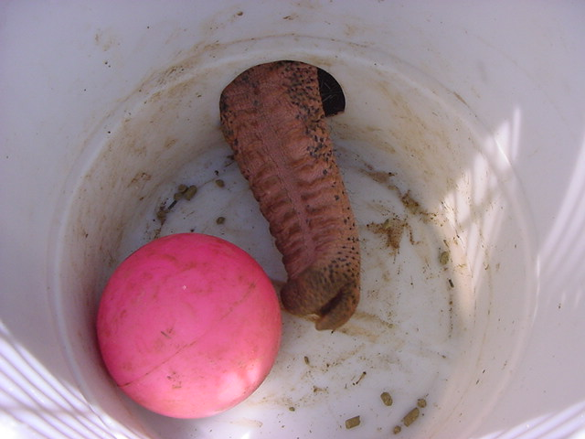
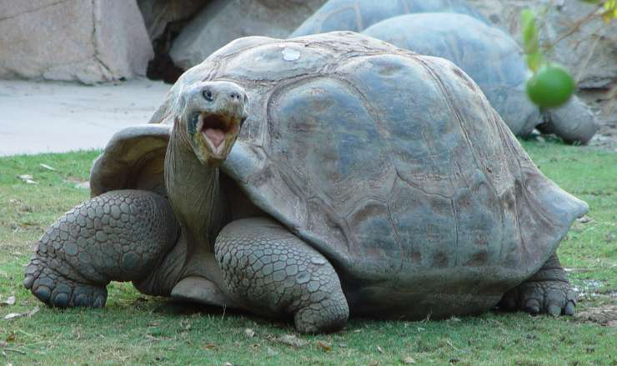
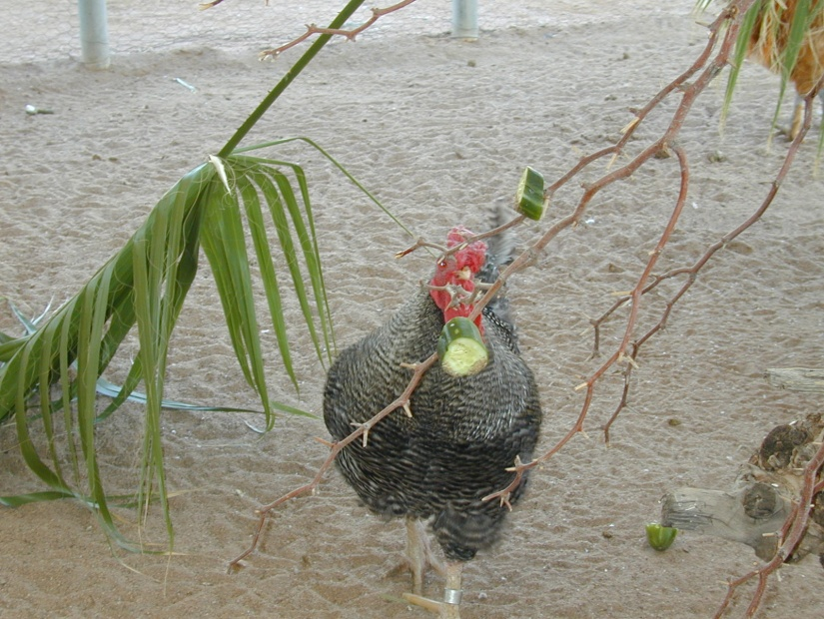
Examples of forage placement

Slide 64
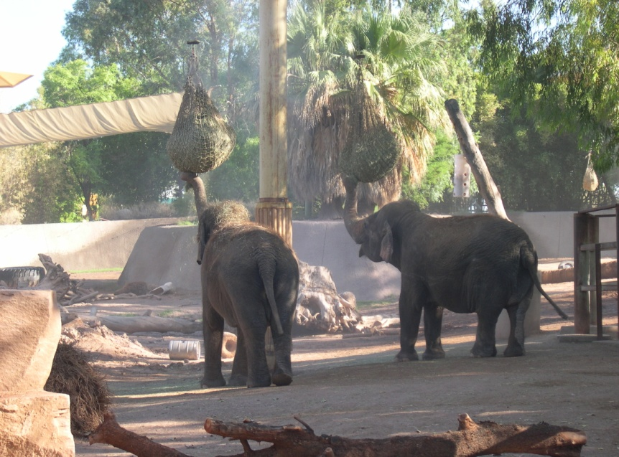
Foraging Devices
Foraging devices are range from feeder boxes, acrylic food puzzles feeders, to various shaker boxes, toys and peg boards placed outside enclosures where food has to be manipulated with “tools” to pull it through the peg maze. Foraging devices can be made more complex by suspending them. Different species, age groups, and individuals may prefer different types of foraging devices (C. Wattson 1997). Not all foraging devices are effective in a given situation (Lutz and Farrow 1996), and facilities may need to try several methods
Black howler monkey and Asian elephants using puzzle feeders at the Phoenix Zoo
Photo: Hilda Tresz

Slide 65
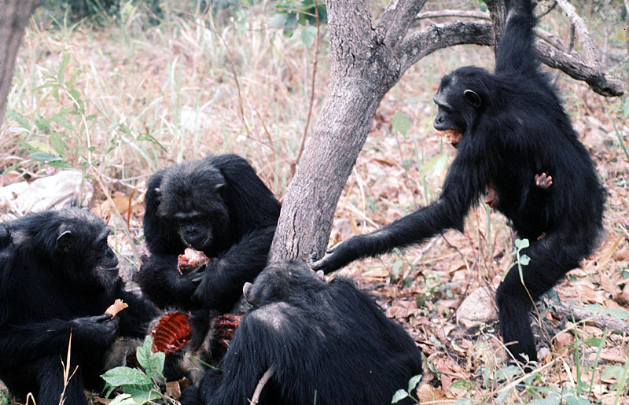
Live Prey
Allows primates to work for their food. Live prey allows them to stalk, grab, poke, and pry for their food. Live prey can include a variety of insects and feeder foods Insects can be provided in either passive (allow slow dispersal of the live prey) or active (require the primate to “work” to obtain live prey) dispensers
Golden lion tamarin using cricket feeder at The Phoenix Zoo
Photo: Hilda Tresz
http://ecol.zool.kyoto-u.ac.jp/~chaka/DPSE/sapporo-j.htm
Photo: David Bygott

Slide 66
Gum Arabic
An ingredient in many food products, including bakery, confectionery, dairy, and frozen dessert products. The gum mixture can be presented in free-hanging liquid dispensers; holes drilled in branches, logs, or trees, or specially made dowels.

Slide 67
Browse and herbs
Fresh browse is a great source of natural enrichment. Herb gardens can be grown in wooden boxes covered with wire mesh, protecting the roots. The veterinarian can offer plants with medicinal value. Herbs can control parasites and gastrointestinal disorders, regulation of fertility, and possible antibacterial or anti-hepatotoxic activities (Huffman and Wrangham 1994)

Slide 68
Specialized Foraging Adaptations of Different Species
When foraging techniques are employed, species characteristics must be considered:
Are the primates leaf, gum, insect, or fruit eaters?
Are they terrestrial or arboreal foragers?
How do they forage?
What body positions do they take?
How do they use their hands?
Do they use tools?
Levels of cognitive ability?

Slide 69
Motor skills
The opposable thumb
images.acclaimimages.com/_gallery/_SM/0028-04...

Slide 70
Learning techniques in foraging
A Chimp observes a peer opening a cube for food Image: Lewis Haughton

Slide 71
Tool using techniques in foraging

Slide 72
Tool using techniques in foraging 2.

Slide 73
Tool making techniques in foraging !!!!!!!!
Chimpanzees in Senegal have been observed making and using wooden spears to hunt other primates.

Slide 74
3. Manipulative Enrichment or Manipulanda

Slide 75
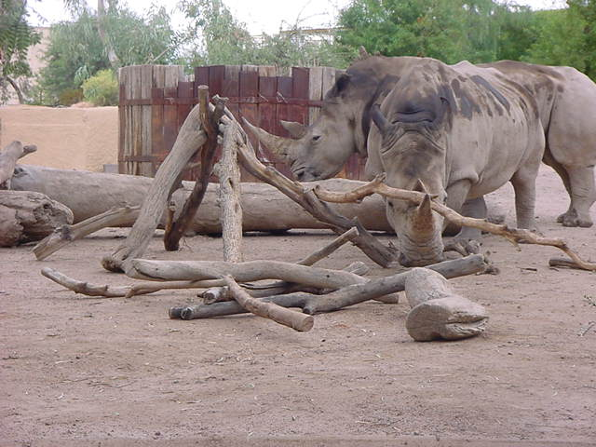
What is manipulanda?
Manipulanda are objects that can be moved, used or altered in some manner by the animals’ body parts. The items may be artificial or natural.

Slide 76
Objects to stimulate curiosity and play with
When toys are new they may stimulate curiosity and may increase play behavior. Animals, however, loose interest in or habituate to toys over time. Rotating toys on the basis of texture, shape, and color helps to maintain interest (NRC/ILAR 1998).

Slide 77
Objects that can induce species-appropriate behaviors
Manipulable objects play a role in social interactions, and infant development, which must be carefully understood. However, the most important aspect of manipulanda may be that, if selected and used well, it can permit the animal to experience novelty and a sense of control over part of its environment.
Black-footed ferret playing and/or imitating hunting behaviors via golf ball
Photo by Tara Sprankle

Slide 78
Cognitive skill use with manipulanda Asian elephant manipulating shower Photo: Jim Hughes

Slide 79
4. Structure and Substrate Spectacled bear resting on artificial tree at the Phoenix Zoo Photo: Hilda Tresz

Slide 80
Adequate space
In order to accommodate species-appropriate behavior, the enclosure must have adequate space. Use of legal cage size will not always meet an animal’s behavioral requirements (NRC/ILAR 1998:18). Adequate space is not just a question of numeric dimensions or total volume, but also one of shape and design.
To promote a space to be structured, usable, and species appropriate the following elements should be considered:

Slide 81
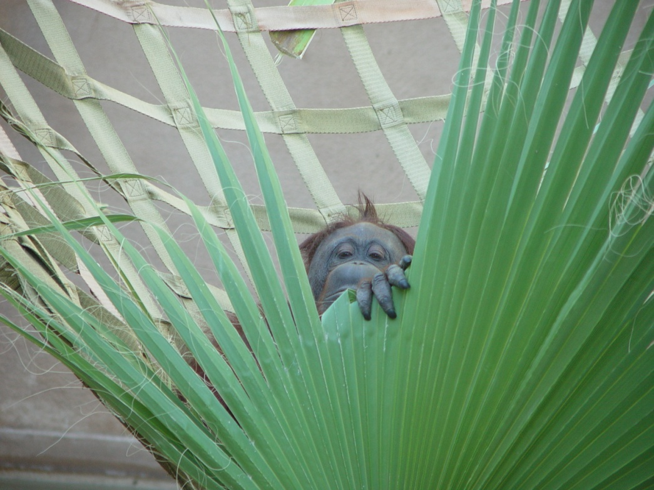
Resting behaviors
Comfort postures during resting and sleeping (lying down; sprawling out prone, sternally or laterally; sitting upright; crouching or vertically clinging, etc.)
Bornean orangutan resting in a hammock at
the Phoenix Zoo
Photo:Jim Hughes

Slide 82
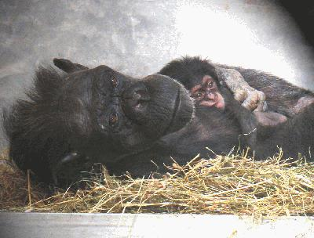
Night and day nests of soft materials
photo by Amy Fultz
Teresa, left, and her daughter Tracy prepare for a nap in the large nest of hay Teresa built earlier in the day.
http://www.chimphaven.org/view-news.cfm?news_id=131

Slide 83
Substrates used to cover the enclosure floor can be soft or hard materials. These materials can effect space utilization (McKenzie et. al. 1986). They may prove comfort, be part of a foraging, and constitute manipulable items.
Fresh browse
Newspaper
Shredded paper
Clothing
Phone books
Hay
Straw
Dry leaves
Frees grass
Wood
Wool

Slide 84
Postures
Enclosures need to be designed for “normal postural adjustments with adequate freedom of movement” required by USDA regulations in 9 CFR Section 3.80(a)(2)(xi)

Slide 85
Locomotion
Locomotor styles vary among taxonomic groups from brachiating through leaping and terrestrial knuckle walking. If the animals do not have room to execute normal locomotion, the implementation of programs of periodically releasing primates into exercise areas should be considered

Slide 86
Special needs of older infants and juveniles
The frequency with which juveniles use certain locomotion styles may differ from that of adults of the same species. The wild ranges of locomotor behavior “provide the greatest opportunity for developing strength, balance and coordination” (Dunbar 1989). “All captive immature animals should be provided with enough space to engage in vigorous locomotor play” (Goosen et. al. (1984) and should be provided with the same interior cage height as adults of their species

Slide 87
Designing for arboreality
All arboreal species should be provided a full use of vertical space and structures such as trees, ropes, walls, poles, jungle gyms, and enclosure wall mesh (Bennett and Davis 1989, Burt and Plant 1990). The International Primate Society Guidelines (1993) recommended that primates be able to “perch above human eye level”.
Primate enclosures should allow individuals to avoid social threats or other noxious stimuli by maintaining sufficient distance or making use of visual barriers, partitions, privacy areas, and escape routes (Applebee and Marshall et. al. 1991)

Slide 88
Designing enclosure furnishing
Enclosures furnished with natural and artificial materials of various sizes and arrangements are better suited to appropriate behaviors.
Animals living in homogeneous enclosures with large, inflexible, continuous supports exhibit different patterns of locomotion than those in more naturalistic and complex environments with smaller, interrupted, flexible supports. Perches, shelves, ladders, swings, ropes, barrels, boxes and other structures can be made of many materials. Wood, plastic and fiber have the advantage of being non-thermo conductive, which is helpful outdoors.

Slide 89
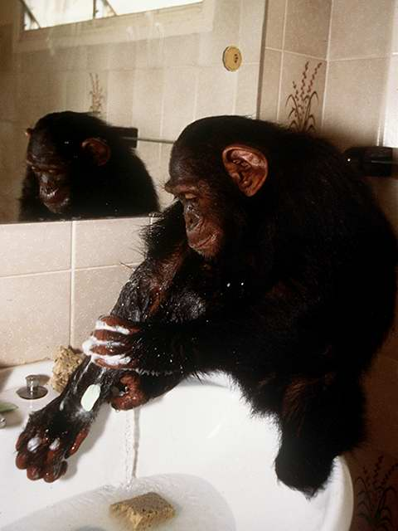
Sanitation
All enclosures with natural substrates (i.e. hay, sand woodchips, mulch, soil, etc.) must be spot-cleaned daily, removing fecal material and food waste to prevent feces accumulation and insect and rodent infestation.
Exhibit props that have been scent-marked (pheromones) should not be regularly cleaned, avoiding unnecessary stress to those animals that would otherwise have to re-mark their territory over and over. Exhibit perching that has been scent-marked can be brushed clean of food and fecal material and then rinsed with water, allowing the scent to be retained.
Exhibit furnishing should be changed when wear or unsafe conditions warrant, but no more than half at a time for scent-marking species.

Slide 90
5. Stimulating all five senses
Visual
Auditory
Tactile
Olfactory
Gustatory
Painting by Congo
In 1957 he curated an exhibition of chimpanzee paintings and drawings at the Institute of Contemporary Arts, London
http://www.search.com/reference/Desmond_Morris

Slide 91
Visual enrichment- Lights
Sunlight. Primates generally require around 12 hours of sunlight daily. When held indoors, natural light from skylights or windows should be provided wherever possible. Replacing bars and walls by clear Plexiglas can alter standard enclosures.
Fluorescent lights that produce full-spectrum illumination should be available on timers in all indoor primate facilities to supplement natural lighting and to extend the photoperiod during the shorter days of northern hemisphere winter to 12 hours of light.
Giving nocturnal animals red or blue lights rather than total darkness during the reverse dark cycle promotes their normal activity levels (Wright et.al. 1989). Simulating dawn and dusk by gradually turning on or off the lights is also beneficial.
Color- Cool-spectrum light (green) can reduce the incidence of anxiety behaviors such as spacing and rocking (Fritz et. al. 1997).

Slide 92
Visual enrichment- Motions and Mirrors
Motion -is used as visual stimulation in various forms such as TV, videos, or video games (Brent and Stone 1996). Television should only be presented in a way that primates have the choice not to watch it.
Mirrors- Monkeys can perceive a mirror images as another monkey while great apes see as their own. Small portable mirrors are repeatedly manipulated and remain the source of fascination over period of months.

Slide 93
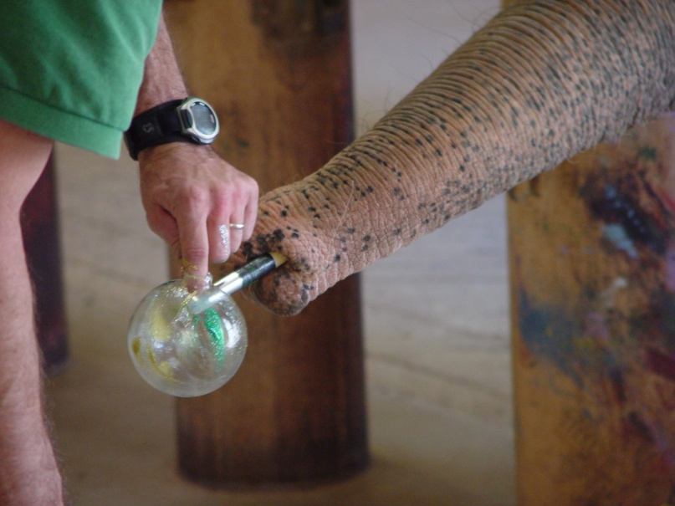
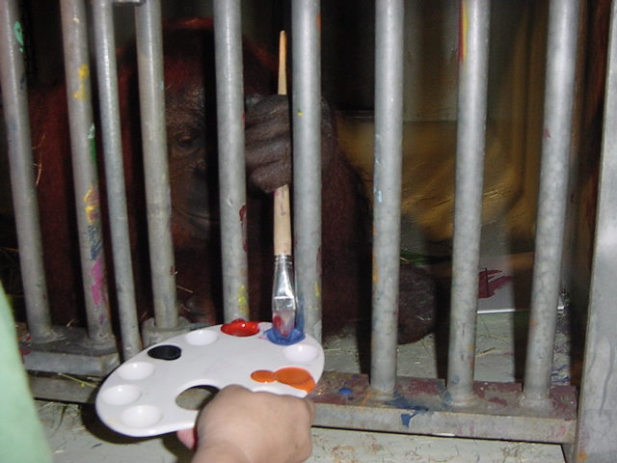
Visual enrichment-Colors
When color dyes are added to food items, it may increase consumption
Murals can be relaxing indoor
Animal paintings
Photo:Jim Hughes and Hilda Tresz

Slide 94
Auditory enrichment
Vocalization from other primates can communicate messages such as danger, fear, discovery of food, etc. Auditory calls are especially important when visual transmission of messages is not possible.
Sounds from the natural environment- Animals also make non-vocal sounds, such as banging or drumming, on furniture to express their emotions.
Music when available at times throughout the day may reduce aberrant behaviors (National Institutes of Health 1991). Giving the choice of turning the music on or off can increase the time spent with playing music.

Slide 95
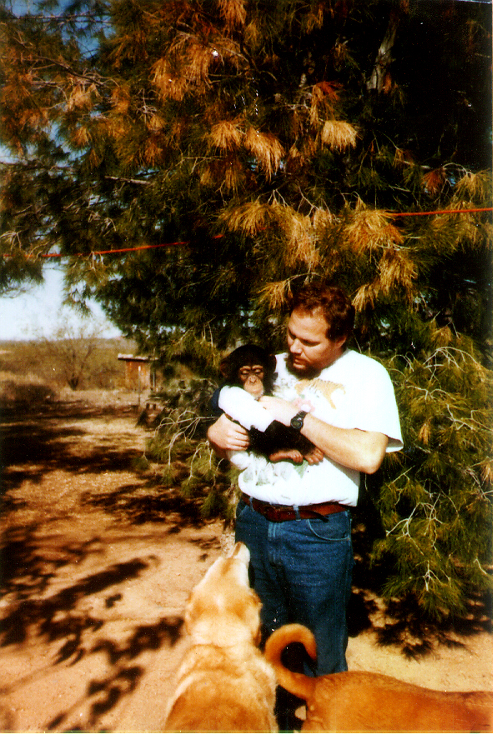
Tactile enrichment
Tactile stimulation is provided by all aspects of a primate’s environment, including:
Cage mates. Primates receive much tactile stimulation when grooming cage mates. If primates cannot be grouped so they are together all the time, tactile contact should be allowed with conspecifics or caretakers on a periodic or scheduled basis or through grooming bars (Crockett et. al. 1997, Taylor et. al. 1998). Grooming can be used in operant conditioning as a positive reinforce.
Floor substrate provides stimulation when they search through it for hidden food items.
Food and toys have tactile stimulation properties
Author’s husband Zoltán Tresz grooms infant chimpanzee, photo unknown

Slide 96
Olfactory enrichment- sent marking
Scent marking- specialized glands produce volatile, strong-smelling chemicals called pheromones to signal the individual’s presence. Olfactory communication is used for territorial defense, to foster aggregation of group members, and to signal alarm or aggression. In some species, scents indicate not only species and gender, but also individual identities. Olfactory stimulation is essential for the scent marking species, and objects must be provided which allow animals to mark their environment.

Slide 97
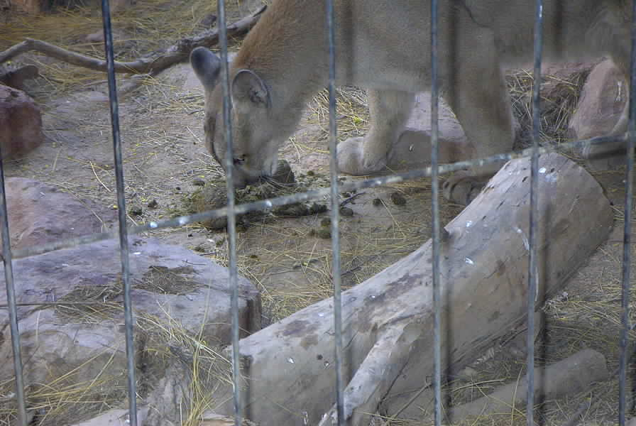
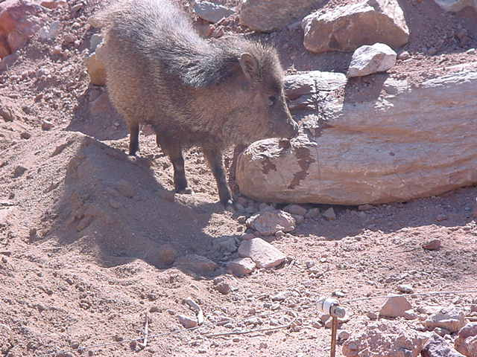
Natural scents
Herbs and spices
Extracts
Fecal
Urine
Javelina smells antelope urine at the Phoenix Zoo
Photo: Hilda Tresz
Cougar smells rhino fecal at the Phoenix Zoo
Photo:Hilda Tresz

Slide 98
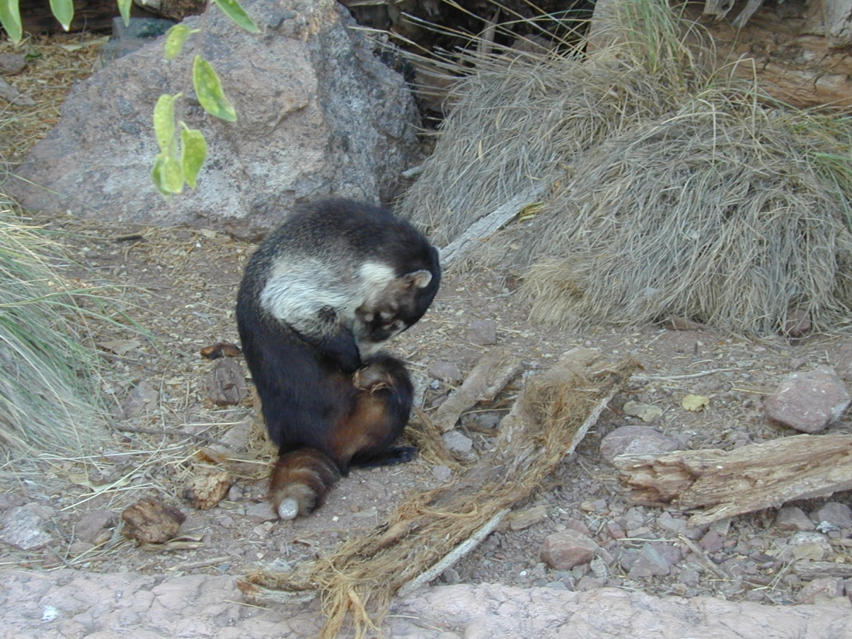
Artificial scents
Providing artificial scents such as perfumes or colognes is a very valuable enrichment.
Coati rubbing perfume
Photo:Hilda Tresz
However, their potential negative effects should be considered. Zookeepers wearing perfumes or other scents could get bitten, heavily groomed or receive other unexpected behaviors from animals with whom they have direct contact.

Slide 99
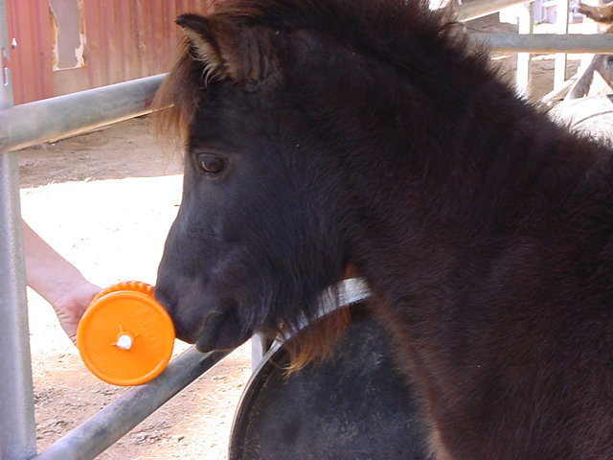
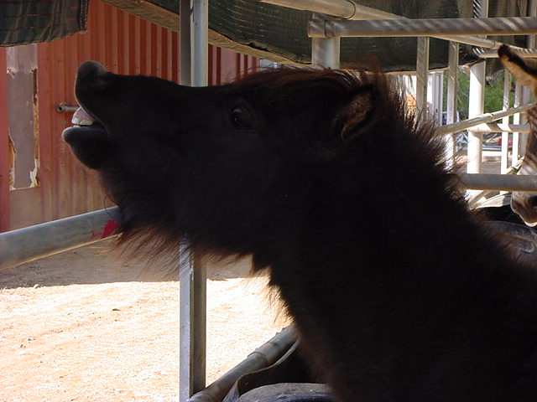
6. Gustatory enrichment- Experience the difference!
The relative lack of diversity in captive animals’ diets restricts their experience of different tastes, textures, consistencies, sizes, and colors of food items.
Miniature horse with a small “Likit’ holder
Photo:Hilda Tresz

Slide 100
Gustatory enrichment-novelty items or regular diets presented differently
Coati with frozen Gatorade Spectacled bear retrieving food by bungee cord
Wild dogs being carcass fed Porcupine tastes novelty food item
Photos: Hilda Tresz

Slide 101
Training
Training, besides providing a medical and husbandry procedure to be learned by the animals is also a type of social enrichment. Animals generally look forward to be trained and interact with their keepers or at some cases with the visitors as well

Slide 102
AZA ENRICHMENT FRAMEWORK- SPIDER
Designing enrichment needs solid framework:
Setting your goals
Planning
Implementing
Documenting
Evaluating
Re-adjusting

Slide 104
4. Documenting-How and want to document?
Keepers document animal’s response to enrichment daily
Identify the animal and enrichment provided
Record the animal’s response
Observe and record the animal’s behavior
5. Evaluating- How to assess effectiveness?
Staff routinely discusses progress and looks for trends in the data
Trends that maybe detected- Frequency of delivery, animal’s response, and relative success
6. Re-adjusting
Based on the evaluation of trends in the data, the goals and plan can be re-adjusted and the process started over again
If any of these components are missing, there is no self-sustained system.

Slide 105
LOGISTICS OF PROVIDING ENRICHMENT
Cheap vs. expensive
Monetary problem often constrain enrichment. Cheap ideas (besides being cost effective) often require no construction or repair. They are easy to maintain and modify, and they can be installed on exhibit or in night houses in less than few minutes.
Mounds raked from gravel
Urine
Feces
Seashells
Logs, browse, fruit, flowers from zoo grounds
Pinecones
Feathers
Recycled paper products
Recycled keg and barrels
Snake skins
Etc.
Warthog plays in dry leaves at the Phoenix Zoo
Photo: Hilda Tresz

Slide 106
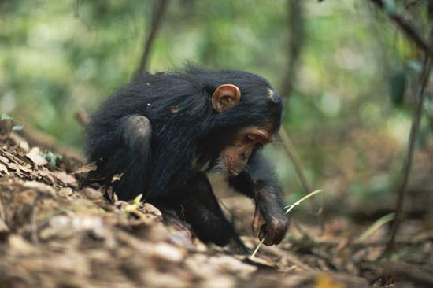
Just give them a stick!
Simple vs. complicated
Instead of trying to create fancy looking enrichment items, keepers should consider the animals’ natural behaviors and enrich them in simple, logical ways.
Stick + Plastic container= Free cognitive enrichment that even an infant can use!
Anup Shah/Nature Picture Library

Slide 107
Effects of location of enrichment
Inaccessible enrichment items- enrichment need to be offered in reachable ways
Example:
Macaws can not hover!

Slide 108
Effects of location of enrichment
Inaccessible enrichment items- enrichment need to be placed within the animals’ cage. Example: Empty cage 2 enrichment, mynah cage –no enrichment! Hmmm!

Slide 109
Effects of temperature factors
The consequences of using an enrichment can determined how often an animal would use it. Example: Iguanas do not like to use the pool during winter time!

Slide 110
Effects of age factors
Old v.s young animals. Example: old chimpanzees have less teeth!

Slide 111
Effects of timing Offer enrichment during the animals’ adequate daily cycle

Slide 112
No time for enrichment! Now what? Need to prioritize!
Small cages vs. large, naturalistic exhibits

Slide 113
No time for enrichment! Now what?
Single housed animals vs. group housed animals

Slide 114
Safety
Does not pose any danger to the animal. The animal cannot get tangled, trapped and caught in it; choke on it and the item cannot fall on the top of the animal.
Cannot be used as a weapon
Will not cause gut impaction.
Will not damage the exhibit.
Cannot be thrown outside of the exhibit or at the visitors.
Will not traumatize the animal.
Cannot help the animal to escape.
Cannot lead to aggression.

Slide 115
When building enrichment:
Use screws and non toxic glue instead of nails
Round off corners and sand objects generously.
Only use non-toxic paints.
Use natural materials if possible.
Items must be free of staples or plastic tapes, strings, plastic or inner liners.
Make sure that any animal parts (e.g. hides) or excretions (e.g. urine, feces) have been approved by veterinarian staff before being used as enrichment.

Slide 116
Enrichment information resources
The following are some websites regarding environmental enrichment:
Perhaps the best and well known website is the “Keeper link” http://veederandld.20m.com/keeperpgs/keeper.html On this site one can found everything they could possible need regarding training, enrichment, and animal behavioral issues.
http://www.aazk.org - The American Association of Zoo Keepers, Inc. (AAZK), published monthly, Animal Keepers Forum, 3601 S.W. 29th Street, Suite 133, Topeka, Kansas 66614, USA
http://www.aza.org- The American Zoo and Aquarium Association (AZA)
http://www.abwak.co.uk – The Association of British Wild Animal Keepers (ABWAK)
http://www.enrichment.org - Their magazine “The Shape of Enrichment” is published quarterly, Shape of Enrichment, Inc., 1650 Minden Drive, San Diego, CA 92111-7124 USA
http://www.psyeta.org/jaaws/- Journal of Applied Animal Welfare Science- published quarterly http://www.enrichmentonline.org/resources/literature.asp - The Fort Worth Zoo presents Enrichment Online

Slide 117
Enrichment information resources
http://animalenrichment.org/ - Disney's Animal Kingdom: Animal Enrichment Programs
http://www.honoluluzoo.org/enrichment activities.htm – The Honolulu Zoo’s webpage
http://www.phoenixzoo.org/zoo/animals/BE/be101.asp - The Phoenix Zoo’s behavioral enrichment webpage
http://www.holezoo.org/animals/enrichment- The Utah’s Hogle Zoo’s webpage
http://www.oregonzoo.org – The Oregon Zoo’s webpage.
http://mywebpages.comcast.net/ExoticAnimalsResourceSite/ExoticAnimalsResourceSite/ - Exotic animal enrichment
http://www.well.com/user/elliotts/smse_enrich.html - Environmental Enrichment for Captive Animals
http://www.psyeta.org/jaaws.html -JAAWS (Journal of Applied Animal’s Welfare Science), published quarterly by the Psychologists for the Ethical Treatment of Animals
http://www.ufaw.org.uk - Reports regarding Behavioral Enrichment of captive animals, published by the Universities Federation for Animal Welfare
http://www.well.com.user/abs/dbs/eesb -Environmental Enrichment Scrapbook, a list of different enrichment ideas

Slide 118
Enrichment information resources
http://www.felidtag.org – An enrichment website for cats
http://www.wolfpark.org/Links enrichment.html- A website that leads to at least a dozen other websites regarding scientific articles and environmental enrichment
http://www.nal.usda.gov- A complete list of articles and bibliographies of laboratory and farm animal enrichment
http://www.primate.wisc.edu/pin/owagner.html – Primate Info. Net- Environmental Enrichment and Operant Conditioning
http://www.brown.edu/Research/Primate/enrich.html - An Index of Laboratory Animal Enrichment Articles, Brown University.
http://www.animalwelfare.com/Lab animals/biblio/enrich.htm- Environmental Enrichment for Primates
http://www.animalwelfare.com/Lab_animals/biblio/ -Primate Enrichment Bibliography.

Slide 119
Enrichment information resources
Refer to related Internet websites like:
The Animal Welfare Institute at http://www.animalwelfare.com,
The Exotic Animals: Care and Conservation Resource Website located at http://www.pacificnet.net/~jmcnary
The Cambridge Center for Behavioral Studies and the Animal Trainers SIG of the Association for Behavior Analysis have put together an excellent overview of the many ways that positive reinforcement techniques are being used by professional animals trainers and in zoos, http://www.behavior.org/animals/frameset.cfm

Slide 120
Table of contents- associations
IMATA- International Marine Animal Trainers Association
IAATE- International Avian Association of Trainers and Educators
ABMA- Animal Behavior Management Alliance
AAZK – American Association of Zoo Keepers
AZA – American Zoo and Aquarium Association

Slide 121
Table of contents-books and articles
Bayne, K.A.L. 1989. Resolving issues of psychological well-being and management of laboratory nonhuman primates. In Housing, Care and Psychological Well-being of Captive and Laboratory Primates. E.F. Segal, ed., Noyes Publications: Park Ridge, New Jersey, pp. 27-39
Bennettt, C.L., and Davis, R.T. 1989. Long term animal studies. In Housing, Care and Psychological Well-being of Captive and Laboratory Primates, E. F. Segal. Ed., Noyes Publications: Park Ridge, New Jersey, pp 213-234
Bloomsmith, M.A. 1989. Feeding enrichment for captive great apes. In House Care and Psychological Well-being of Captive and Laboratory Primates, E. F. Segal. Ed., Noyes Publications: Park Ridge, New Jersey, pp 336-356
Broom, D.M., and K.G. Johnson 1993. Stress and animal welfare. Chapman and Hall; London, England
Buchanan-Smith, H.M. 1997. Considerations for the housing and handling of New world primates in the laboratory. In Comfortable Quarters for laboratory Animals, Eighth Edition, 1997, V. Reinhardt, ed., Animal Welfare Institute: Washington, D.C., pp. 75-84
Chamove, A.S. and J.R. Anderson 1989. Examining environmental enrichment. In House Care and Psychological Well-being of Captive and Laboratory Primates, E. F. Segal. Ed., Noyes Publications: Park Ridge, New Jersey, pp 183-202

Slide 122
Table of contents-books and articles
Coe, John 1992 Plan ahead for Behavioral Enrichment in Environmental Enrichment kaleidoscope: research, management and design.
DeWall, F.B.M. 1989. Peacemaking Among Primates. Harvard University Press: Cambridge, Massachusetts, 294 p.
Duncan, I.J.H., J. Rushen, and A.B. Lawrence 1993. Concusions and implications for animal welfare, A.B. Lawrence and J. Rushen, eds., CAB International: London, United Kingdom, pp. 193-206
Estes, R.D. 1991. The Behavior Guide to African Mammals Including Hoofed Mammals, Carnivores, Primates. University of California Press: Berkeley, California, 611 p.
Fragaszy, D.M. and L. Adams-Curtis 1991. Environmental challenges in groups of capuchins. In Primate responses to Environmental Change, H.O. Box, ed., Chapman and Hall: new York, pp. 237-264
Hediger, H. 1964. Wild animals in captivity. Dover Publications Inc.: New York, p 207
Kazdin A. 1994. Behavior modification in applied settings. Pacific Grove CA: Books/Cole publishing Company
Kleiman D, Allen M, Thompson K, Lumpkin S, editors. 1996. Wild mammals in captivity: Principles and techniques.
Maple, T.L. and L.A. Perkins 1996. Enclosure furnishings and structural environmental enrichment. In Wild Mammals in Captivity: Principles and Techniques, D.G. Kleiman, M.E. Allen, K.V. Thompson, and S. Lumpkin, eds., University of Chicago Press: Chicago, Illinois, pp. 212-222

Slide 123
Table of contents-books and articles
Mason, W.A. 1971. Motivational factors in psychological development. In Nebraska Symposium on Motivation. W.J. Arnold and M.M. Page, eds University of Nebraska press, pp. 35-37
Novak, M.A. and K.H. Drewson 1989. Enriching the lives of captive primates: Issues and problems. In Housing, Care and Psychological Well-being of Captive and Laboratory Primates. E.F. Segal, ed., Noyes Publications: Park Ridge, New Jersey, pp. 161-182
Napier ,J.R. & P.H. 1986 The natural history of the primates
Olfert, E.D., B.M. Cross, and A.A. McWilliam, (eds.), 1993. Guide to the care and Use of Experimental Animals, Volume 1 (2nd edition), Canadian Council on Animal care, Ottawa, Canada, 211p.
Ortega, Ivan 1999 Managing Animal behavior through Environmental Enrichment with emphasis in rescue and Rehabilitation centers. Durrell Wildlife
Conservation Trust
Priest, Gary. 1990. Animal Management and Enrichment
Pryor, Karen. 1984. Don’t Shoot the Dog! The New Art of Teaching and Training. Simon and Schuster. New York, NY
Ramirez K. 1999. Animal training: Successful animal management through positive reinforcement. Chicago, Ken Ramirez and the Shedd Aquarium.

Slide 124
Table of contents-books and articles
Reynolds, G. S. 1975. A Primer of Operant Conditioning. Scott, Foresman and Company. Glenview, Illinois
Rosenblum, L.A. and M.W. Andrews 1995. Environmental enrichment and psychological well-being of nonhuman primates. In Nonhuman Primates in Biomedical research, Biology, and Management, B.T. Bennett, C.R. Abee, and R. henrickson, eds., Academic Press; New York., pp. 101-112
Rowe, N. 1996. The Pictorial Guide to the Living Primates. Pagonias Press: East Hampton, New York; 263 pp.
Sevenich, Marty. Guidelines for Animal Training Programs
Suomi, S.J. 1987. Genetic and maternal contributions to individual differences in rhesus monkey biobehavioral development. In Perinatal Develpoment: A Psychobiological
Perspective, N. Krasnegor, E. Blass, M. Hofer, and W. Smotherman, eds. , Academia Press, pp. 397-420
Thorington, L. 1985. Spectral irradiance and temporal aspects of natural and artificial light. In The medical and biological effects of light. R.J. Wurtman, M.J. Baum, and J.T. Potts, eds., New York Academy of Sciences; New York, pp. 28-54
Toates, F. 1995 Stress: conceptual and biological aspects. John Wiley and Sons, Ltd.: New York

Slide 125
Table of contents-books and articles
Van Roosmalen, M.G. and L.L. Klein 188. The spider monkey, genus Ateles. In Ecology and behavior of Neotropical Primates, Vol. 2, Mittermeier, R.A., A.B. Rylands, A.F. Coimbra-Filho, and G.A.B. De Fonseca, eds., World Wildlife Fund, Washington, DC., pp. 455-538
Widner, Kim 1994 Initiation of zoo-wide enrichment program at the Knoxville Zoo
Wright, P., D. Haring, M. Izard, and E. Simons 1989. Psychological well-being of nocturnal primates in captivity. . In House Care and Psychological Well-being of Captive and Laboratory Primates, E. F. Segal. Ed., Noyes Publications: Park Ridge, New Jersey, pp 61-65
Applebee, K.A., Marshall, P.E.., and McNab, A.M. 1991. A prototype rhesus cage to satisfy the needs of the Home office, research, the animal technician, and most importantly, the monkey. Animal Technology 42(1):23-37
Baker, K.C. 1997 Human interaction as an enrichment for captive chimpanzees: A preliminary report. American Journal of Primatology 42(2):92
Bayne K.L., S.L. Dexter, and G.M. Strange 1993. Effects of food treats and human interaction. Contemporary Topics in Laboratory Animal Science 32(2): 6-9
Beeler, Mark C. 1996. “Basic Marine mammal Training Terminology and Techniques defined and explained.” International Marine Animal Trainers Association Newsletter, vol. 21, no.1.
Bekoff, M. 1994. Cognitive ethology and the treatment of nonhuman animal: how mattres of mind inform matters of welfare. Animal Welfare 3(2):75-76

Slide 126
Table of contents-books and articles
Bernstein, I.S. 1962. Social housing of monkeys and apes: group formations. Laboratory Animal Science 41(4): 329-333
Bloomsmith, M.A., S.P. Lambeth, A.M. Stone, and G.E. Laule 1997. Comparing two types of human interaction as enrichment for chimpanzees. American Journal of Primatology 42(2): 96
Boinski, S., S.P. Swing, T.S. Gross, J.K. Davis 1999. Environmental enrichment of brown capuchins (Cebus apella): behavioral and plasma and fecal cortisol measures of effectiveness. American Journal of Primatology 48(1): 49-68_
Brent, L. and A.M. Stone 1996. Long trem use of televisions, balls, and mirrors in enrichment for paired baboons. American Journal of Primatology 39(2): 139-145
Burt, D.A. and M.Plant 1990. Observations on a caging system for housing stump-tailed macaques. Animal Technology 41(3): 175-179
Byrne, G.D. and S.J. Suomi 1995. Development of activity patterns, social interactions, and exploratory behavior in infant tufted capuchins, (Cebus paella). American Journal of Primatology 35: 255-270
Chance, M.R.A., B.Byrne, and E. Jones 1983. A tandem cage for handling group-living monkeys. Laboratory Animals 17: 129-132
Chapman, C. and Chapman, L.J. 1990. Dietary variability in primate populations. Primates 31(1): 121-128
Coe, J. 1989. Naturalizing habitats for captive primates. Zoo Biology Supplement 1: 117-125

Slide 127
Table of contents-books and articles
Cooper, D.L. and H. Markowitz 1979. Handlers effects on contact comfort behaviors of two trios of juvenile chimpanzees in the zoo. Psychological reports 44: 1015-1018
Crockett, C.M., R.U. Bellanca, C.L. Bowers and D.M. Bowden 1997. Grooming-contact bars provide social contact for individually-caged laboratory macaques. Contemporary Topics in Laboratory Animal Science 36(6): 53-60
Demlong, Michael; Deroo, Mary 1993 Behavioral Architecture: Designing Animal Exhibits for animals Animal Keeper’s Forum, Vol. 20, No.12
Dewey y, Allie 1995 The Development of an Enrichment Master plan. Animal Keeper’s Forum, Vol. 22, No. 1
Du Bois, Thaya 1992 The Los Angeles Zoo environmental enrichment program: we get a lot of help from our friends. AAZPA/CAZPA Annual Conference Proceedings
Dunbar, D. 1989. Locomotor behavior of rhesus macaques on Cayo Santiago. Puerto Rican Health Science Journal 8(1): 79-85
Fritz, J, S.M. Howell and M.L. Schwandt 1997. Colored light as environmental enrichment for captive chimpanzees (Pan troglodytes). Laboratory Primate Newsletter 36:(2): 1-4
Goosen, C., W. Van der Gulden, H. Rozemond, H. Balner, A. Bertens, R. Boot, J. Brinkert, H. Dienske, G. Janssen, A. Lammers, and P. Timmermans 1984. Recommendations for the housing of macaque monkeys. Laboratory animals 18: 99-102

Slide 128
Table of contents-books and articles
Humphrey, N. K. 1972. Interest and pleasure: two determinants of a monkey’s visual preferences. Perception 1: 395-416
Lutz, C. K., and R. A. Farrow 1996. Foraging device for singly housed long tailed macaques does not reduce streotypies. Contemporary Topics in Laboratory Animal Science 35(3): 75-78
Mason, W.A. 1991. Effects of social interaction on well-being: developmental aspects. Laboratory Animal science 41:323-328
McKenzie, S.M., A.S. Chamove, and A.T. C. Feistner 1986. Floor-coverings and hanging screens alter arboreal monkey behavior. Zoo Biology 5(4): 339-348
Novak, M. A., J. H. Kinsey, M.J. Jorgensen, and T.J. Hanzen 1998. Effects of puzzle feeders on pathological behavior in individually housed rhesus monkeys. American Journal of Primatology 46: 213-227
Pazol K. A. and M.A. Bloomsmith 1993. The development of stereotyped body rocking in chimpanzees reared in a variety of nursery settings. Animal Welfare 2(2): 113-129
Poole, T. 1992. Nature and evolution of behavioral needs in mammals. Animal Welfare 1(3): 203- 220
Sambrook, T.D. and H.M. Buchanan-Smith 1997. Control and complexity in novel object enrichment. Animal Welfare 6(3):207-216
Scharpiro, S.J., M.A. Bloomsmith, S. A. Suarez, and L.A. Porter 1996. Effects of social and inanimate enrichement on the behavior of yearling rhesus monkeys. American Journal of Primatology 40(3): 247-260

Slide 129
Table of contents-books and articles
Seidensticker, John; Forthman, Debra 1994 Planning for the species: Incorporating behavioral and ecological data. AZA Annual Conference Proceedings
Sharpiro, S.J., M.A. Bloomsmith, L.M. Porter, and S.A. Suarez 1996. Enrichment effects on rhesus monkeys successfully housed singly, in pairs, and in groups. Applied animal behavior Science 48(3-4): 159-172
Shepherdson, David 1991 A wild time at the zoo: practical enrichment for zoo animals. AAZPA Annual Conference Proceedings
Shepherdson, David 2003 Environmental Enrichment Programs in Zoos Guiding The Next Step Forward. AZA behavior and Husbandry Group Report
Taylor,W.J. and M.L. Laudenslager 1998. Low-cost environmental enrichment plan for laboratory macaques. Lab Animal 27(4): 28-31
Tresz, H., L. Ambrose, H. Halsch, A. Heath 1997 Providing enrichment at no cost. The Shape of Enrichment, Vol.6, No. 4
Tresz, H. 2001 Providing enrichment at no cost, Part II. The Shape of Enrichment, VOl.10, No.4
Tresz, H. 2002 Behavioral Enrichment 101 Animal Keeper’s Forum, vol.29, No.2
USDA Final Report on Environmental Enhancement to Promote the Psychological Well-being of Nonhuman Primates July 15, 1999
USDA Environmental Enrichment for Nonhuman Primates Resource Guide Jan. 1992- Feb. 1999
Watson,C. 1997.Getting serious about monkey business. Science and Animal care 8(2): 1-3

Slide 130
Table of contents- protocols
Phoenix Zoo Behavioral management Protocol
Utah’s Hogle Zoo Training protocol
Smithsonian’s National Park Elephant Management Manual
The Living Desert Animal handling and Training Protocols
Indianapolis Zoological Society Training Protocol Samples
Auckland Zoo Mission Statement
Point Defiance Training Protocol
Toledo Zoo Animal Behavior Management Program
Columbus Zoo Training Protocol Samples
Ocean Park Honk Kong Training Philosophy and Protocol
Operant Conditioning Protocol for the Memphis Zoo
Birmingham Zoo Environmental Enrichment protocol
Central Park Wildlife Center Management Guidelines for the care and Psychological Well-being of nonhuman primates
AZA Managing Animal Enrichment & Training Program

Slide 131
Table of contents-websites
ABMA list serve: to sign up contact mthompson@memphiszoo,org)
Animal Trainers Forum http://members.tripod.com/~AnimalTrainersForum
Karen Pryor’s Website http://dontshootthedog.com
Cambridge Center for Behavioral Studies http://www.behavior.org/animals/index.cfm
Managing Animal behavior through Environmental Enrichment http://www.zoolex.org/ivan/sect4.html
Keepers Link http://wagntrain.com/OC/
Animal Enrichment Program http://csew.com/enrich/
http://www.clickandtreat.com
http://www.clickertrainer.com
http://www.greenwooddogs.com
http://www.clickerzoneuk.co.uk/
http://www.nkconcepts.com/books.htm
http://www.clickertrainingvideos.com/
http://www.geocites.com/marineanimalwelfare/doesthe.htm
http://www.naturalencounters.com
AZA website www.aza.org

Slide 132
Table of contents-websites
webmaster@animalark.org
http://www.synalia.com
www.library.uinc.edu/vex/toxic/intro.htm
The Psychological well-Being of Nonhuman Primates (1998). http://books.nap.edu/books/0309052335/html/5.html
http://www.ncbi.nlm.nih.gov/Taxonomy/Browser
Environmental Enrichment for Nonhuman Primates Resource Guideline January 1992- February 1999 - awic@nal.usda.gov
Annotated Bibliography on Refinement and Environmental Enrichment for Primates kept in Laboratory, 2003 http://www.animalwelfare.com/Lab_animals/biblio/index.html#contents

