Slide 1
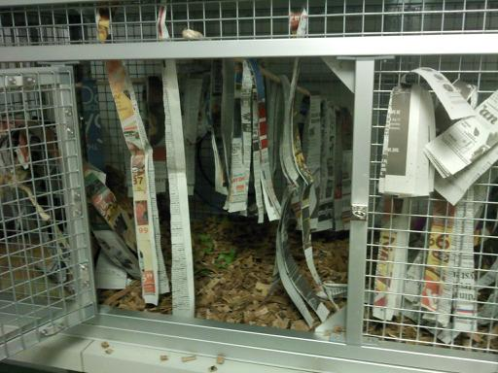
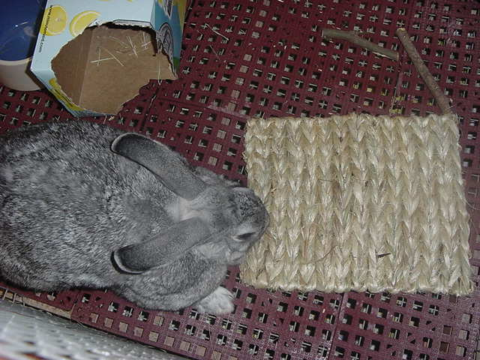
IT’S NOT ABOUT SPACE, IT’S HOW YOU USE IT! IMPROVING AVAILABLE SPACE WITH ENRICHMENT AT PHOENIX ZOO
Hilda Tresz
Behavioral Enrichment & International Animal Welfare Coordinator
Adaptation of article originally published..
Notes:
Photo by: ……….. and Crystal Chaves

Slide 2
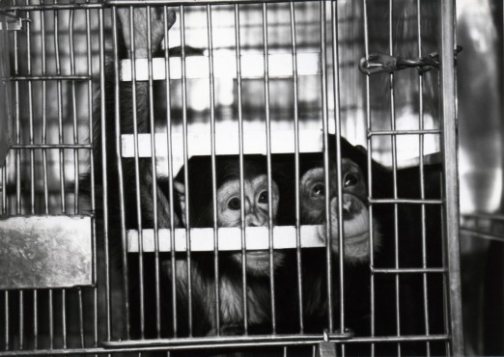
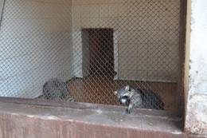
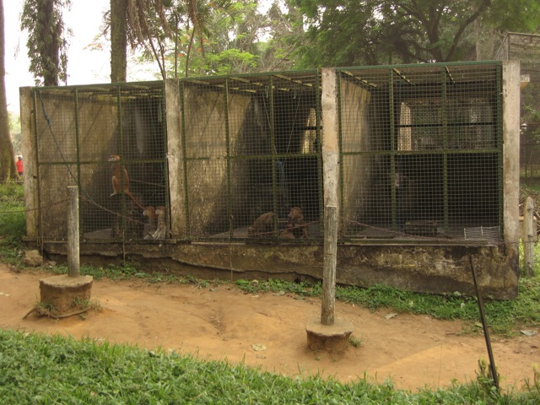
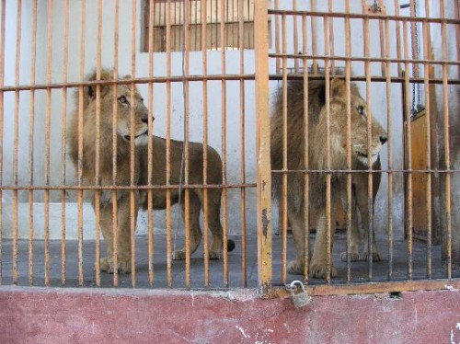
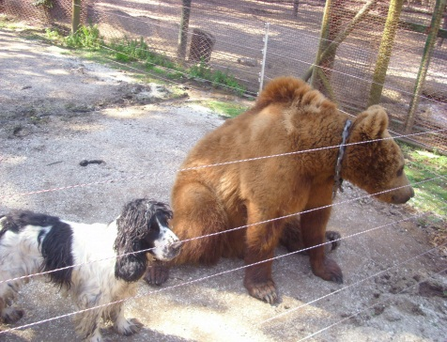
Why Talk About It?
It is the 21st century- animal management should be on higher level!
Basic information is not utilized
Inanimate, basic cages composed of a concrete floor with mesh or bars, a food and water dish and some room on the floor for the animal to move around.
Situation is amplified when only limited space is available (roadside zoos, “old fashioned” zoos, off exhibit areas, hospital cages, etc.)
Notes:
Photo by: Hilda Tresz, Paula Carranza, Balazs Buzas
Photo credit:http://www.google.com/imgres?imgurl=http://www.worldtourismplace.com/wp-content/uploads/2010/11/rare-animal-lion-in-giza-zoo.jpg&imgrefurl=http://www.worldtourismplace.com/giza-zoo-home-for-rare-animal-species-in-egypt/&usg=__pxkTFybTKx-xkDz7qkJhWrPGobE=&h=412&w=550&sz=55&hl=en&start=41&zoom=1&itbs=1&tbnid=voVlD_g75C_GnM:&tbnh=100&tbnw=133&prev=/search%3Fq%3Dold%2BEgyptian%2Bzoo%2Bphotos%26start%3D40%26hl%3Den%26sa%3DN%26ndsp%3D20%26biw%3D1004%26bih%3D637%26tbm%3Disch%26prmd%3Divns&ei=1DHVTd-yMo7egQfl6ImaDA
https://www.google.com/search?q=laboratory+chimps&bav=on.2,or.r_qf.&bvm=bv.50165853,d.cGE,pv.xjs.s.en_US.seW1cfrvSKg.O&biw=1280&bih=929&wrapid=tlif137547717424810&um=1&ie=UTF-8&hl=en&tbm=isch&source=og&sa=N&tab=wi&ei=ER78Ud7mLe6aigLchYHQAQ#facrc=_&imgdii=_&imgrc=GHiBpwbTdpfomM%3A%3BNkh6-R9j62m5uM%3Bhttp%253A%252F%252Fwww.peta2.com%252Fwp-content%252Fuploads%252F2013%252F04%252Fpcases_sema_1_chimps_023-522x370.jpg%3Bhttp%253A%252F%252Fwww.peta2.com%252Fblog%252Fvictory-harvard-primate-lab-closing%252F%3B522%3B370

Slide 3
Enrichment Is A Must In Captivity!
Enrichment can be required on several levels:
By law U.S. Department of Agriculture (USDA). 1985-First U.S. federal regulation in the Animal Welfare Act requiring ‘exercise for dogs, and environmental enhancement to promote the psychological well-being of nonhuman primates. Since 1985, these mandates have become associated with the term ‘‘environmental enrichment’’(Kulpa-Eddy et al., 2005).
By regulations and guidelines Association of Zoos and Aquariums (AZA, founded in 1924). In order to be AZA accredited: it is now a requirement that ‘institutions must have a formal written enrichment program that promotes species appropriate behavioral opportunities’ and ‘have a specific staff member(s) or committee assigned for enrichment program oversight, implementation, training, and interdepartmental coordination of enrichment efforts’ (AZA, 2010).
By institutional policies (Phoenix Zoo). “The Phoenix Zoo considers as its priority to create stimulating, quality captive environments built around the behaviors and biological needs of the species in its care” (Tresz, 2003).
Zoo enrichment programs are no longer novelty. They are becoming an accepted enforced practice.
Phoenix Zoo staff makes it a priority to provide the highest level of enrichment possible.

Slide 4
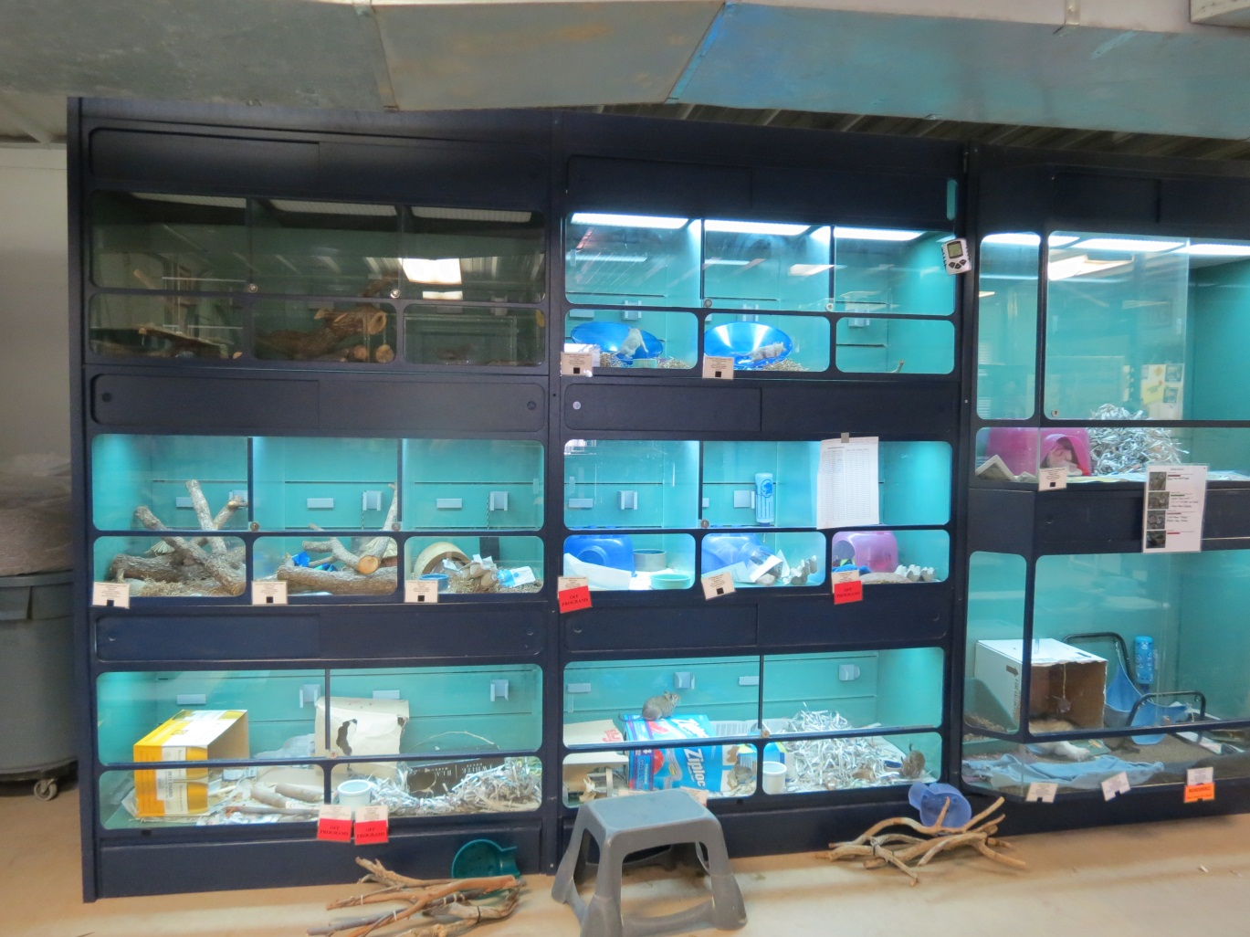
Not An Easy Task!
Animals kept in limited space due special circumstances:
Overly aggressive animals
Sick animals
Show animals
Education program animals
Etc.
Animals are housed solitarily and/or in small areas.
Their need for enrichment is magnified!

Slide 5
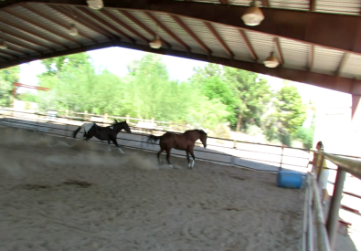
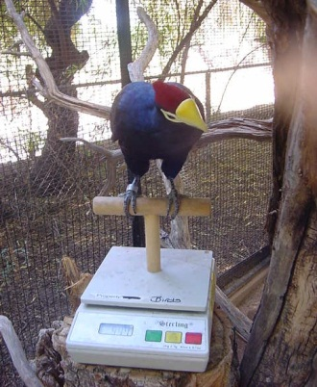
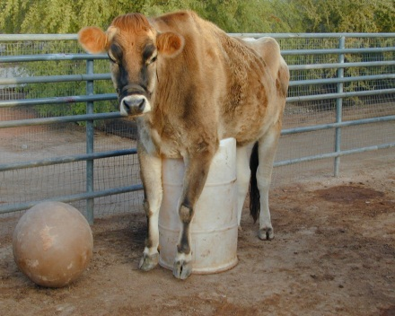
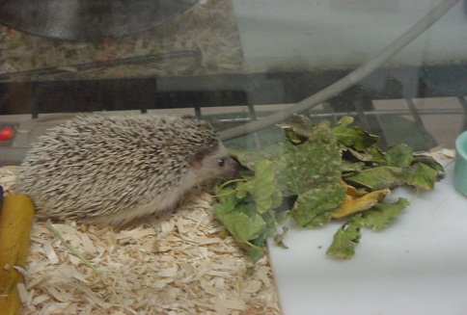
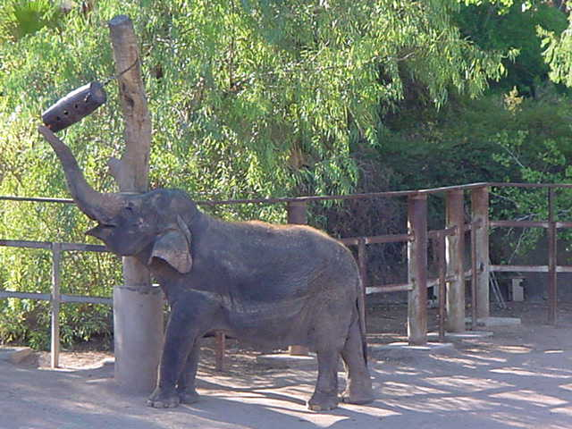
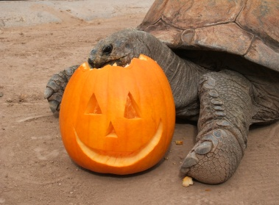
Same Principles – Different Challenges
Same 6 enrichment categories (Phoenix Zoo)
Under different circumstances
Social
Structure/Substrate. Most useful in limited space scenario. The basic component of the inanimate environment is the structure (its size, shape, and design) and the substrate within it.
3. Foraging
4. Manipulanda
5. Sensory
6. Training
Notes:
Social enrichment by conspecifics and none-­conspecifics (physical contact such as grooming, petting, verbal communication, etc.)
Structure/Substrate. The most basic component of the inanimate environment is the structure (its size, shape, and design) and the substrate within it.
Structure -temporary furnishings (perches and shelves, swings, ropes, ledges, nest boxes, tunnels, waterfalls, branches and logs, hammocks ,etc.)
‘Substrate’ –(flooring, artificial and natural turf, sand, gravel, mud, shredded paper, woodchip, leaves, hay, straw, etc.)
3. Foraging enrichment. Contra freeloading - ‘working for food’
4. Manipulanda. Objects that can be moved, used or altered, manipulated (plastic and wooden toys , logs, tires, etc.)
5. Sensory - 5 senses -visual, tactile, auditory, gustatory and olfactory (perfumes, spices, radio, TV, etc.)
6. Training -classical and operant conditioning (gating, stepping on a scale, allowing blood draw, X-ray or ultrasound, entertaining visitors during shows, etc.)

Slide 6
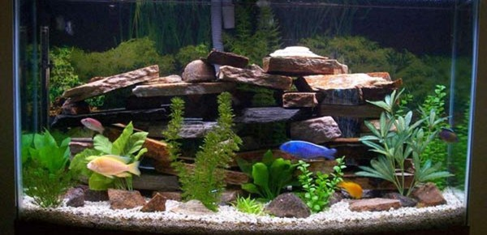
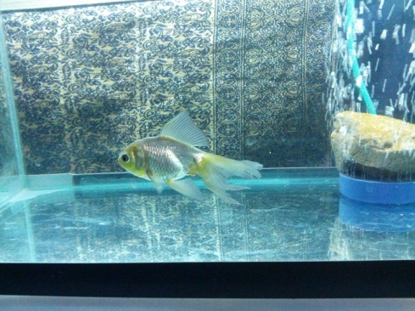
Legal Cage Size ≠ Adequate Space
‘In order to accommodate species-appropriate behavior, the enclosure must have adequate space. Use of legal cage size will not always meet an animal’s behavioral requirements’ (National Research Council Institute for Laboratory Animal Research, 1998).
Adequate space is not just a question of numeric dimensions or total volume, but also one of shape and design.
Structured space means:
Usable
Species-appropriate
Has increased floor space
Has increased vertical space
Notes:
NRC/ILAR (1998): Nonhuman Primates: Standards and Guidelines for the Breeding, Care and Management of Laboratory Animals, a Report. (National Research Council Institute for Laboratory Animal Research.) National Academy Press, Washington, D.C.
https://www.google.com/search?q=fish+in+empty+tank&tbm=isch&tbo=u&source=univ&sa=X&ei=gon6UYHyOKaWigL-o4GIAw&ved=0CC0QsAQ&biw=1280&bih=929#facrc=_&imgdii=_&imgrc=G_icy6t5jjmjcM%3A%3BNwEvDk52rcT6vM%3Bhttp%253A%252F%252Fi.imgur.com%252FPECJJj6.jpg%3Bhttp%253A%252F%252Fwww.irishfishkeepers.com%252Findex.php%252Fforum%252F1-coldwater-fish%252F130866-best-place-to-buy-fancy-goldfish-innear-dublin%3B2332%3B1749
http://www.designarthouse.com/interior-and-designs/good-fish-tank-decoration-ideas/

Slide 7
How To Increase Space?

Slide 8
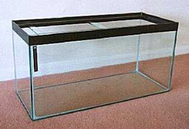
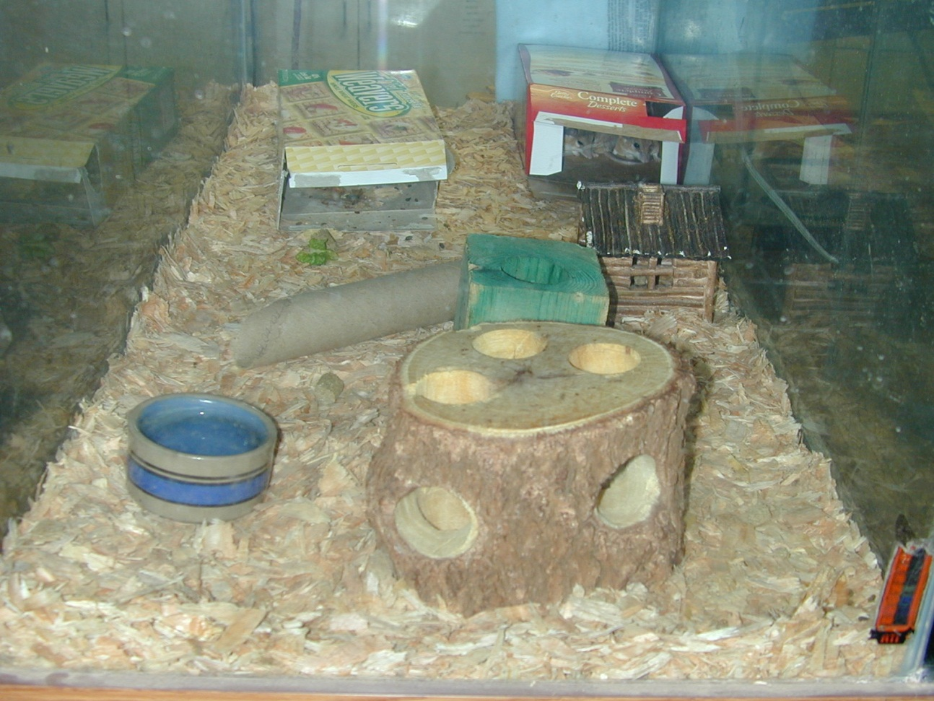
Increased Floor Space Very simple! Anything, that is hollowed + deep substrate
Items:
Boxes
Logs
PVC pipes
Paper tubes
Balls
Buckets
Igloos
Etc.
Providing:
Hiding places
Visual barriers
Escape routes
Digging
Play
Chewing materials
Extended foraging time
Tunneling/climbing
Etc.

Slide 9
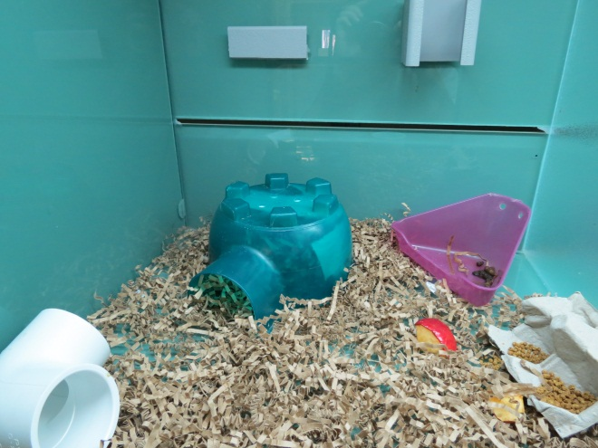
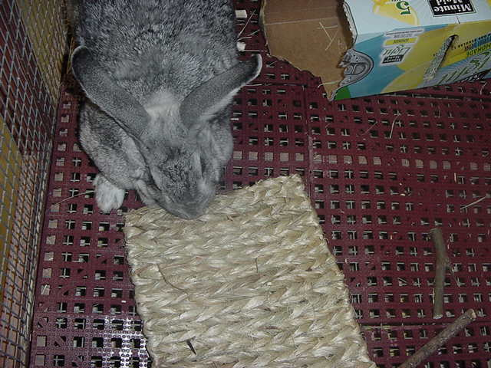
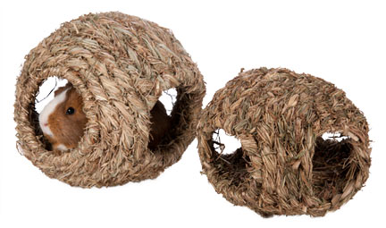
Edible vs. Permanent Furniture
One of the most brilliant enrichments!
Do not take space. Hay mats are flat and hay igloos are hollow
Extends foraging time without requiring larger square footage
Permanent
Edible
Edible
Notes:
https://www.google.com/search?q=fish+tank&source=lnms&tbm=isch&sa=X&ei=pJT6UZuEC8qpigKX0oHIBA&ved=0CAcQ_AUoAQ&biw=1280&bih=929#tbm=isch&sa=1&q=hay+igloo&oq=hay+igloo&gs_l=img.12...2199.4699.5.7044.10.10.0.0.0.0.90.663.10.10.0....0...1c.1.23.img..9.1.71.JSyxsMw86tA&bav=on.2,or.r_qf.&bvm=bv.50165853,d.cGE&fp=6e4bf708f1ad77e0&biw=1280&bih=929&facrc=_&imgdii=_&imgrc=FJV6hRjo6SCe2M%3A%3BNn9HwgMWVkEl6M%3Bhttp%253A%252F%252Fwww.ccac.ca%252Fimages%252FETC%252Fmodule7%252Fmouse-igloo.jpg%3Bhttp%253A%252F%252Fwww.ccac.ca%252Fen_%252Feducation%252Fniaut%252Fvivaria%252Fenrichment%3B400%3B327

Slide 10
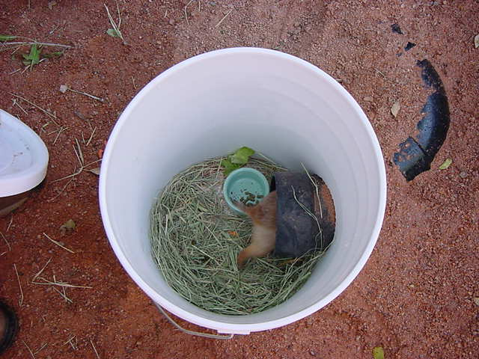
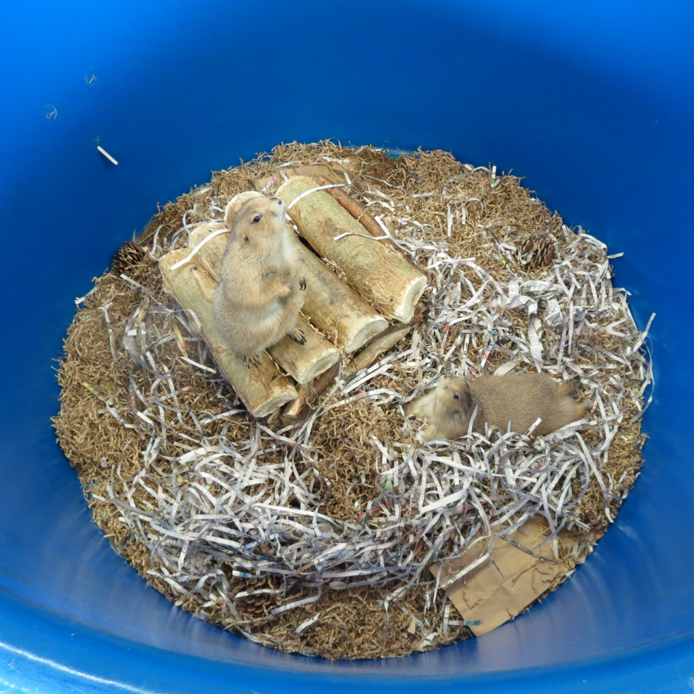
Chewable vs. Unyielding furniture
Extends manipulation time without requiring larger square footage
Permanent
Chewable
Notes:
Photo by: Hilda Tresz

Slide 11
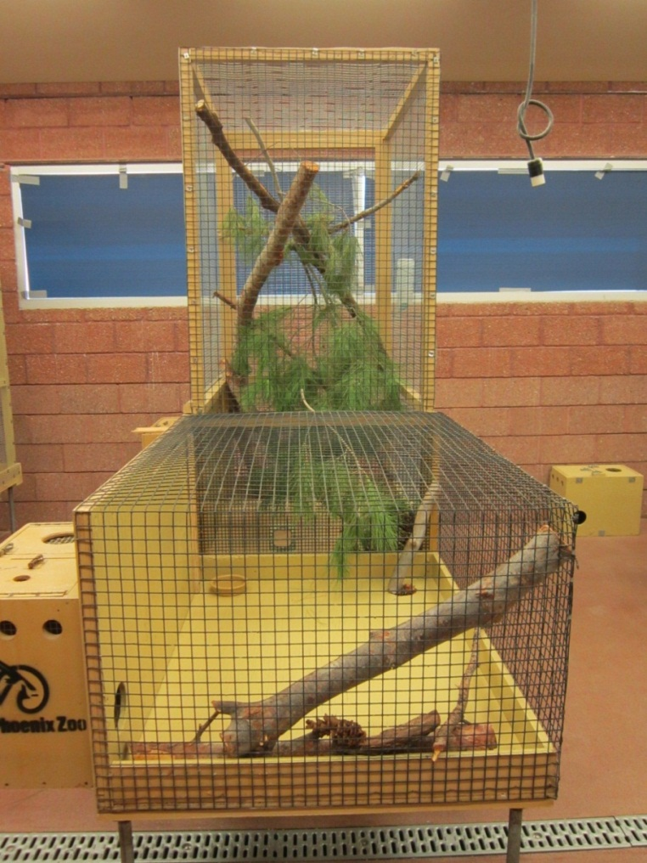
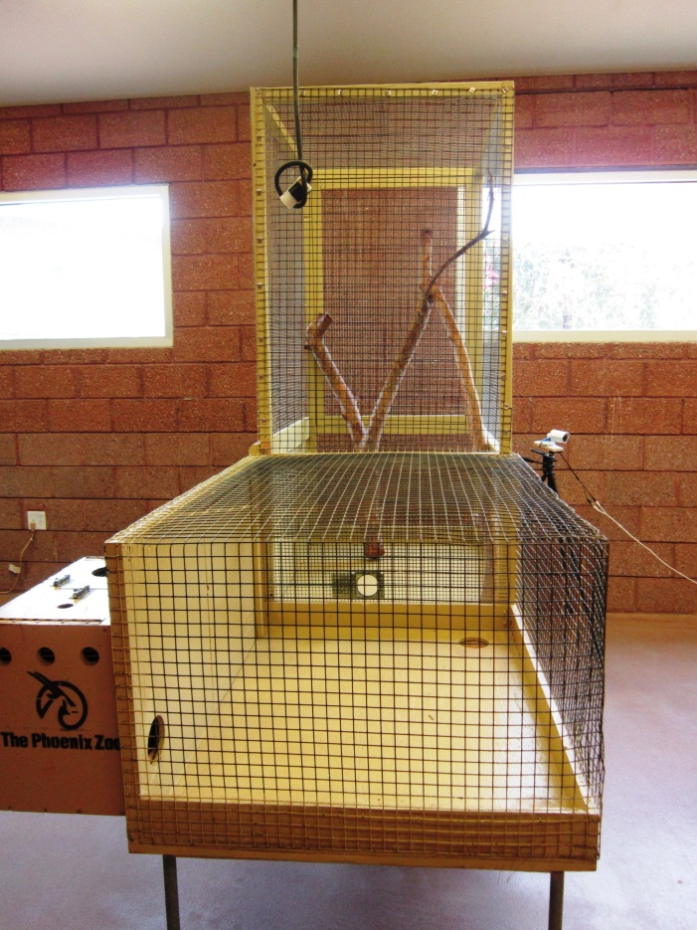
Increased Vertical Space Inflexible, Continuous Structure
Items:
Wooden branches
Benches
Ledges
Metal baskets
Etc.

Slide 12
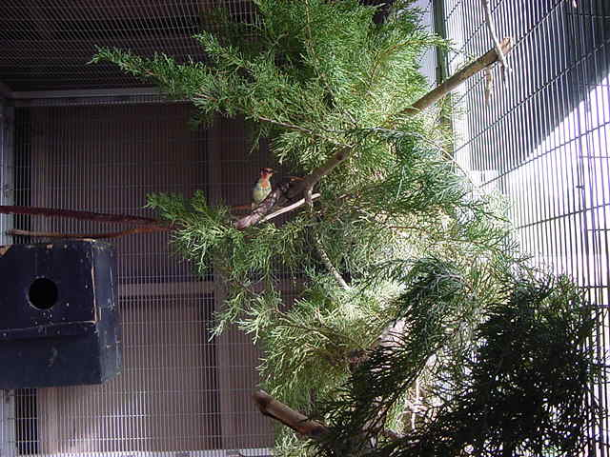
Increased Vertical Space Flexible, Interrupted Structure Animals living in homogeneous enclosures with large, inflexible, continuous supports exhibit different patterns of locomotion than those in more naturalistic and complex environments with smaller, interrupted, flexible supports.(USDA, 1999).
Items:
Perching
Ropes
Chains
Hammocks Ladders
Hung items
Live plants
Etc.
Animals need both inflexible and flexible furniture to develop proper motor skills.
Neither is better then the other!

Slide 13
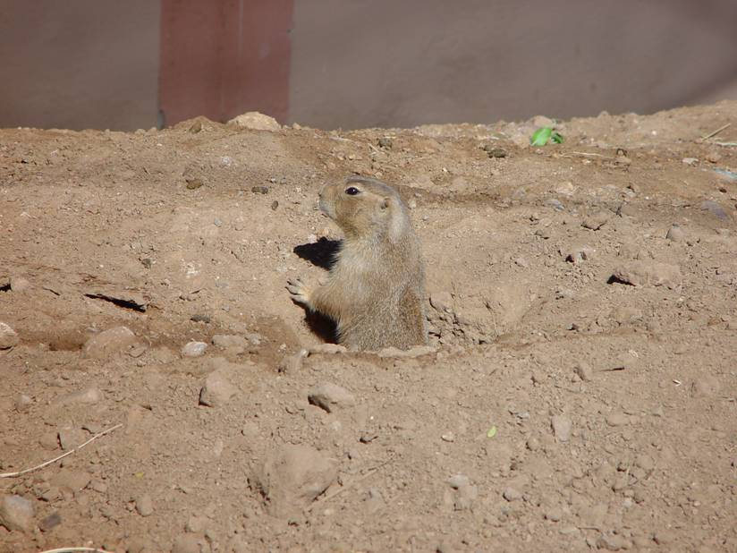
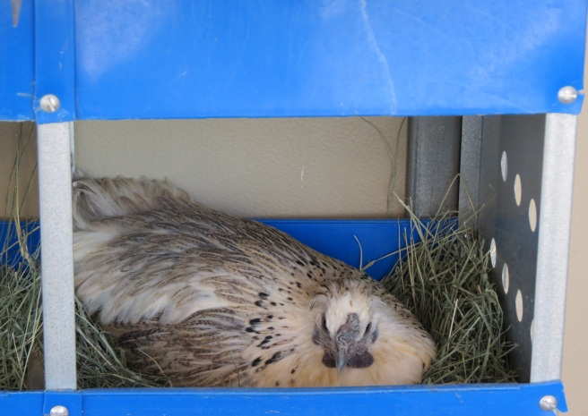
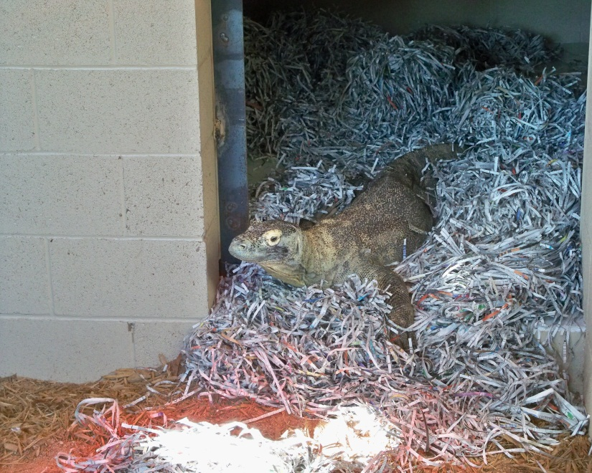
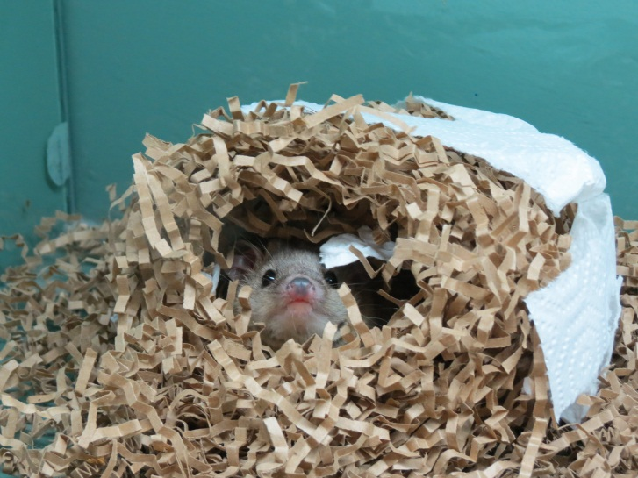
Magical Substrate!
Adding materials as floor coverings can affect space utilization (McKenzie et al., 1986) by aiding other enrichment categories while not taking up additional space.
Providing:
Play behaviors
Nest building
Digging
Hiding
Breeding
Foraging
Etc.

Slide 14
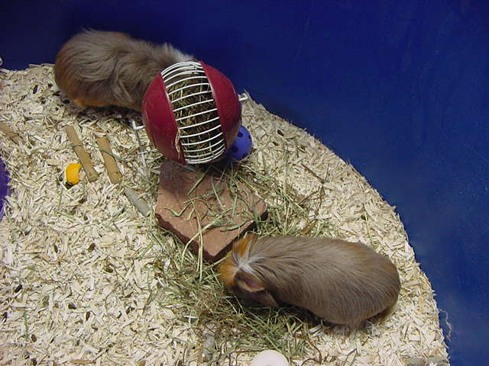
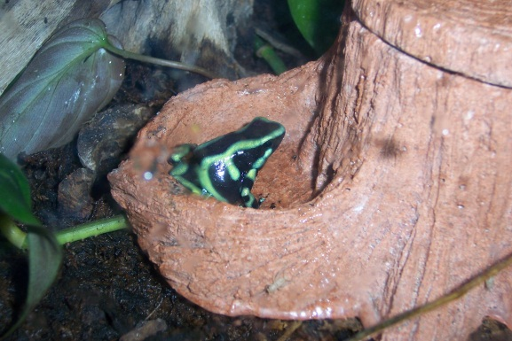
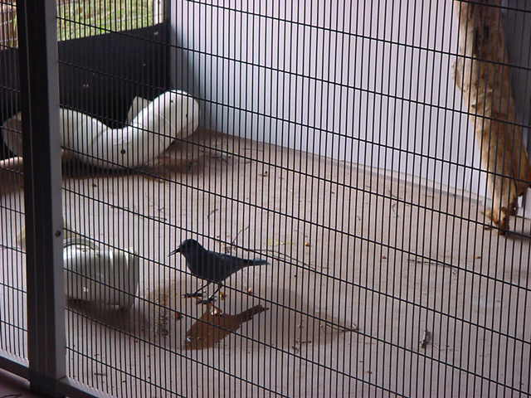
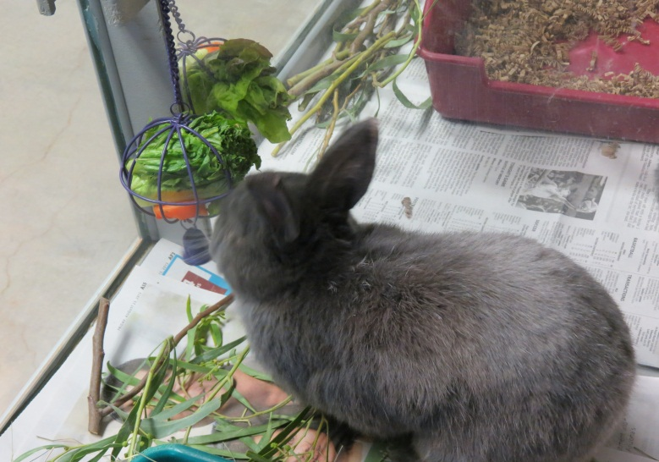
Permanent Foraging Devices Inside of Enclosure

Slide 15
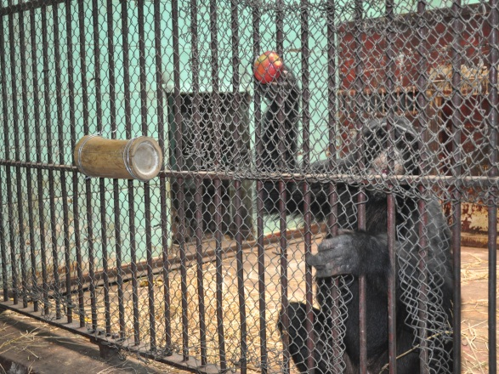
Permanent Foraging Devices Outside Of Enclosure
Further increasing space!
Giza Zoo, Egypt
Notes:
Photo by: Hilda Tresz

Slide 16
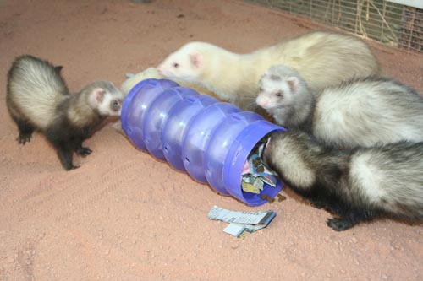
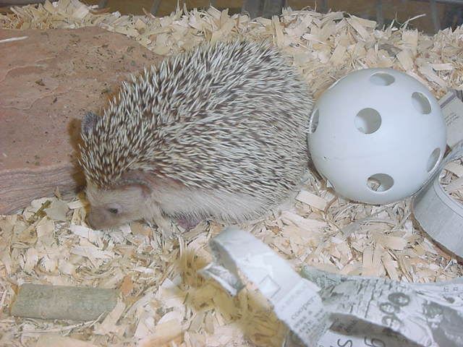
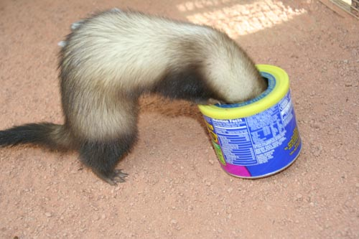
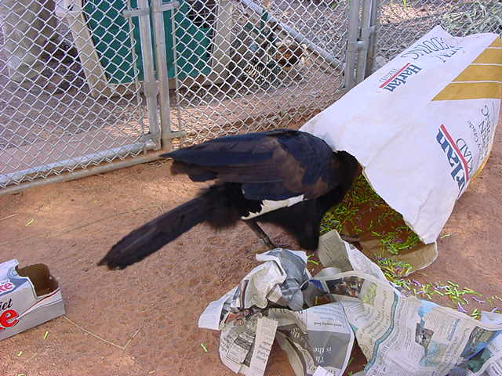
Free-Style Foraging Devices
Video:
Notes:
Video by: Sarah Cooper, Hilda Tresz, A. E.

Slide 17
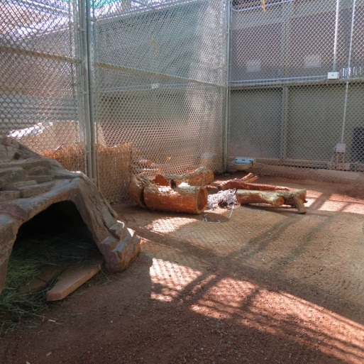
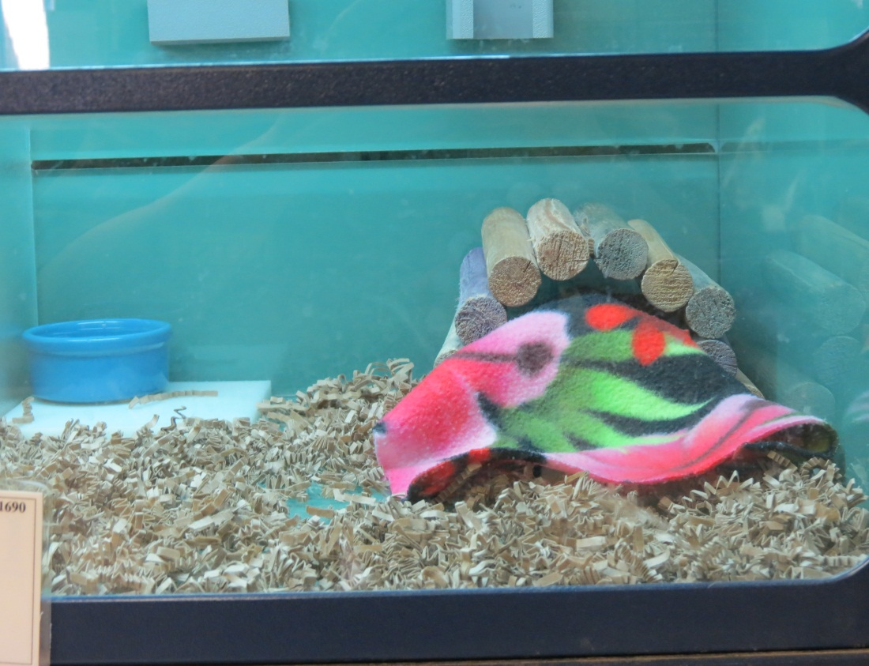
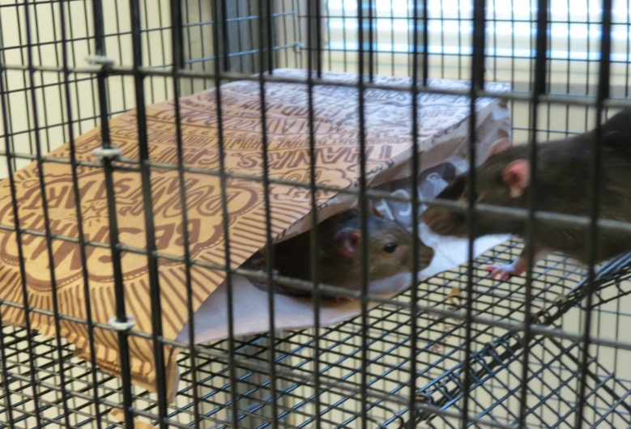
Destroyable Manipulative Items
Common, recyclable household products and vegetation
Logs
Phone books
Boxes
Bags
Paper tubes
Clothing
Etc.

Slide 18
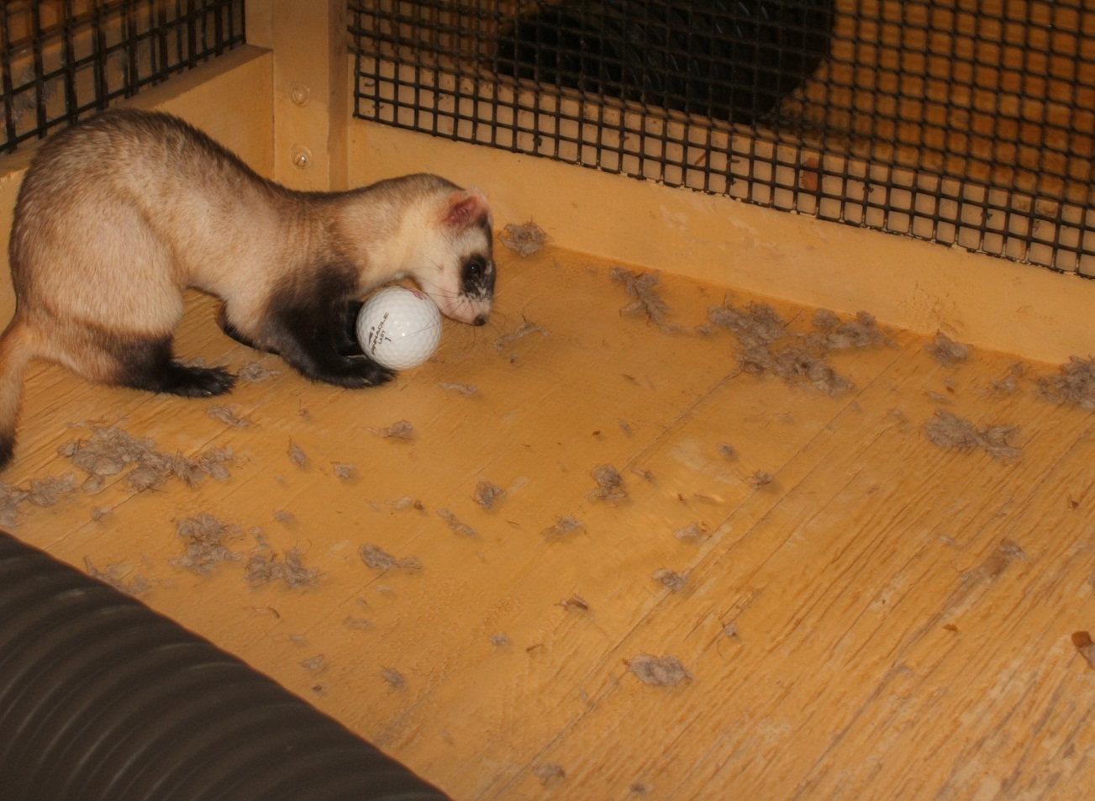
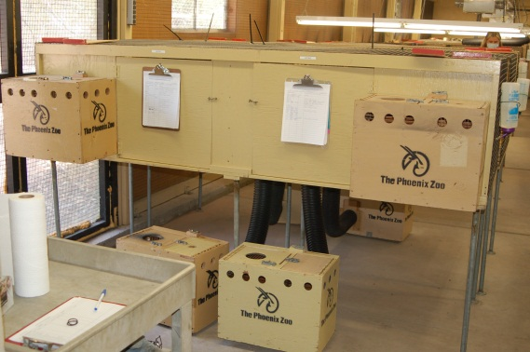
Non-destroyable, Small Manipulative Items
A golf ball goes a long way!
Black-footed ferret exhibiting playing, imitating hunting- stalking, catching, retrieving and chasing down into burrows behaviors via golf ball
Notes:
Photo by Tara Sprankle

Slide 19
Olfactory and Auditory Enrichment
Scents are to be administered on removable items only!
Animals have no way of getting away!
Video:

Slide 20
Exercising in small space
Videos

Slide 21
Perfect example of 3D use

Slide 22
The following slides illustrate some of our animals using enrichment in minimal space at the Phoenix Zoo

Slide 23
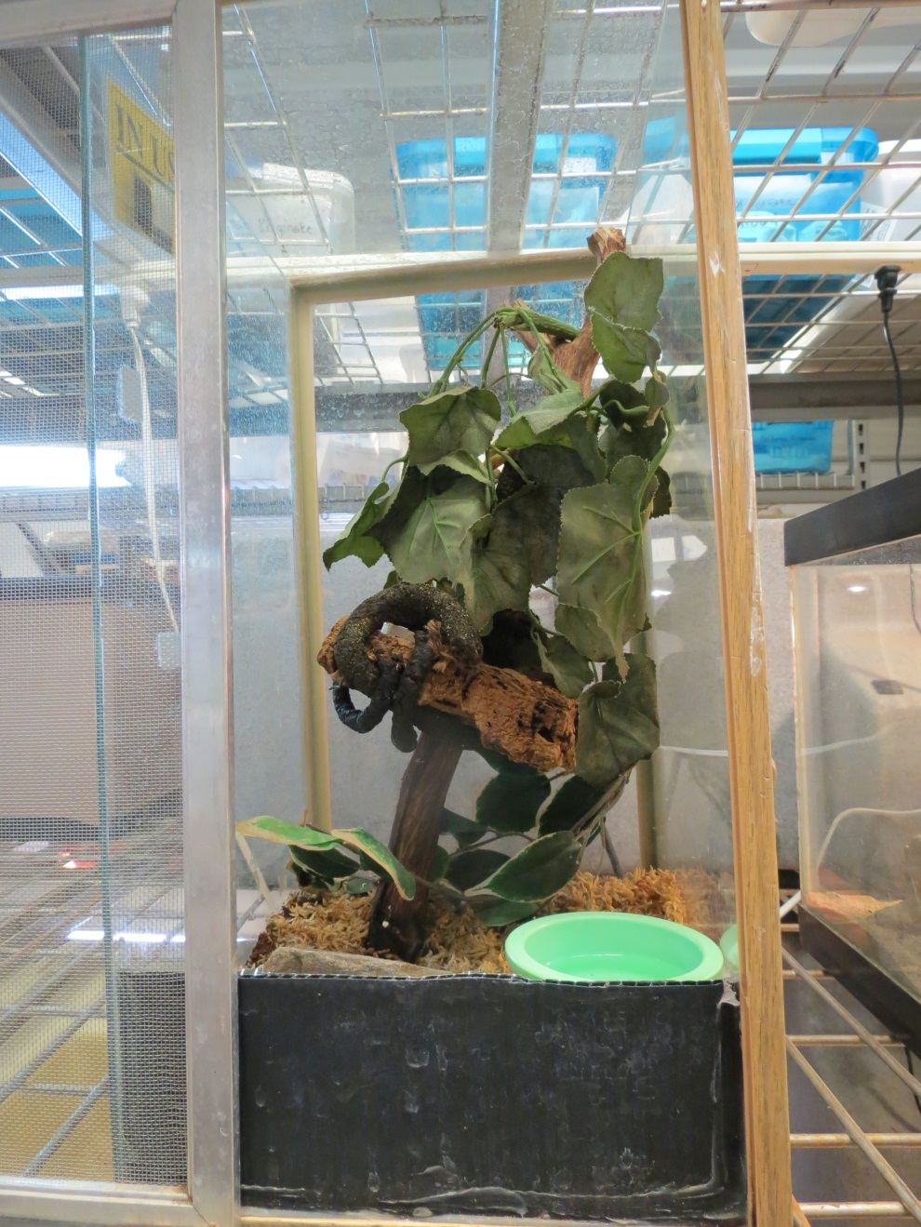
Artificial plants

Slide 24
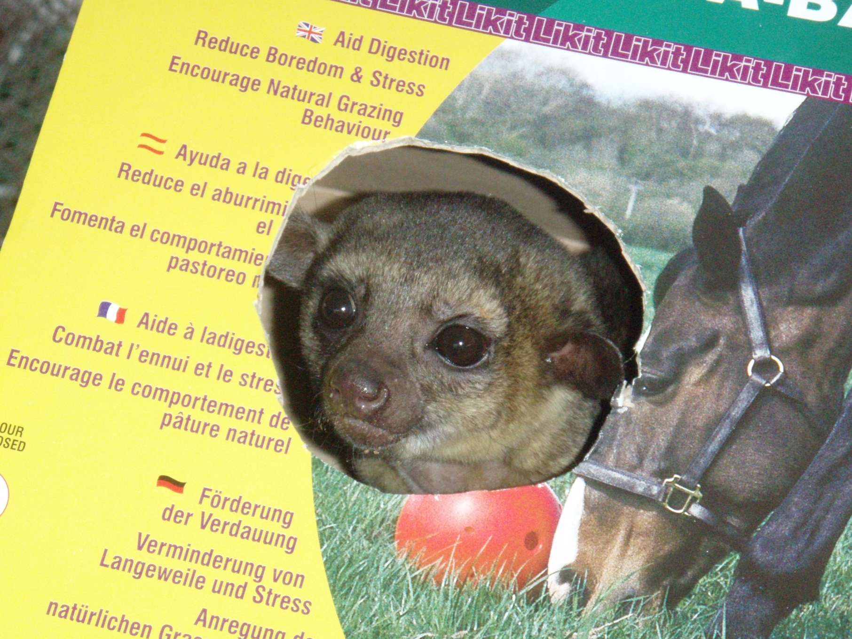
Paper Boxes

Slide 25
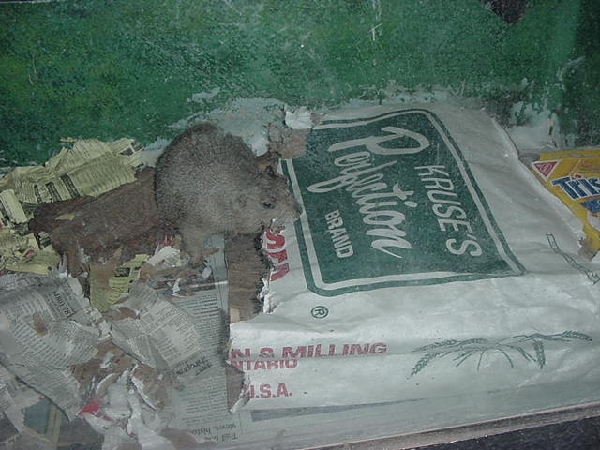
Feed Bags

Slide 26
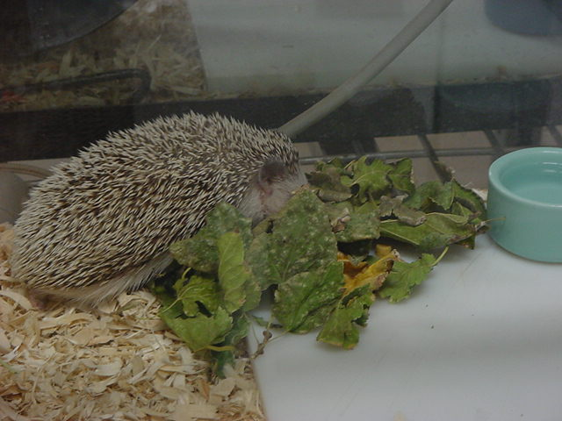
Dry Leaves

Slide 27
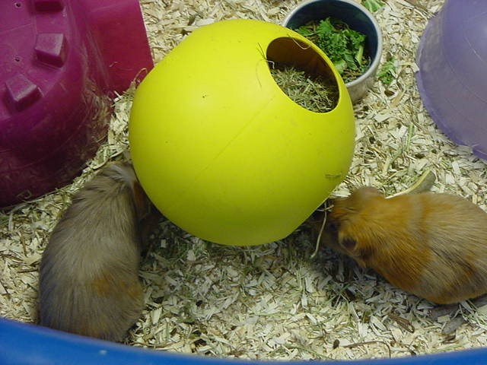
Boomer Ball Feeders

Slide 28
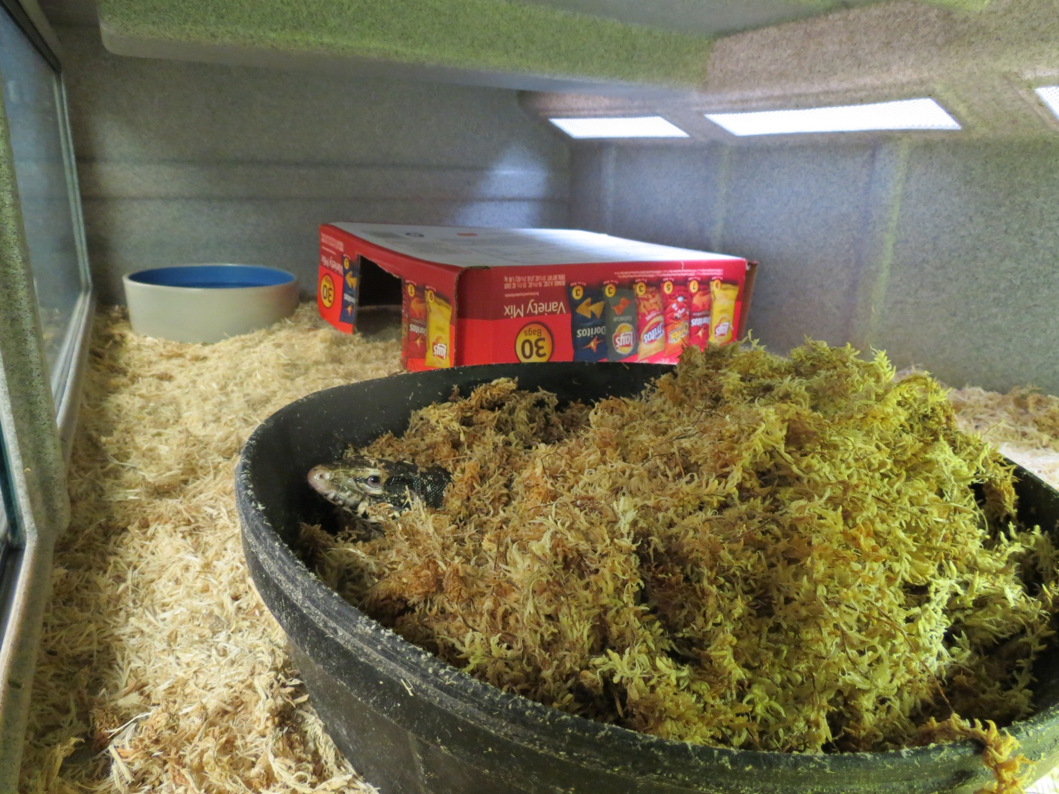
Moss

Slide 29
Paper Roll Feeders

Slide 30
Chew Sticks

Slide 31
Paper Boxes

Slide 32
Plastic balls

Slide 33
Paper bags
Brown Lunch Bags

Slide 34
Plastic Balls

Slide 35
Wooden Branches

Slide 36
Plastic Tunnels

Slide 37
PVC Pipes

Slide 38
Giant PVC Pipes

Slide 39
Paper Boxes

Slide 40
Paper Boxes

Slide 41
Ball Feeders

Slide 42
Paper Boxes

Slide 43
Ropes

Slide 44
Paper Boxes

Slide 45
Shredded Paper

Slide 46
Edible Igloos

Slide 47
Hollow Logs

Slide 48
Wooden Branches

Slide 49
Newspaper

Slide 50
Package Peanuts

Slide 51
Acknowledgement
Special thanks for all Phoenix Zoo staff who pays so much attention on an every day basis to enrich our animals. It is quite a task!
Music by Mitchel Browse
Saint-Saëns Carnival of the Animals (Le carnaval des animaux)
All pictures are credited to the Phoenix Zoo unless otherwise stated

Slide 52
References
Association of Zoos and Aquariums (2010): Accreditation Standards and Related Policies (2010
edition), pp. 7–8.
Bennettt, C.L., and Davis, R.T. (1989): Long term animal studies. In Housing, Care and Psychological Well-being of Captive and Laboratory Primates (ed. E.F. Segal), pp. 213–234. Noyes Publications, Park Ridge, New Jersey.
Dunbar, D. (1989): Locomotor behavior of rhesus macaques on Cayo Santiago. Puerto Rican Health Science Journal 8 (1): 79–85.
Good-fish-tank-decoration-ideas- http://www.designarthouse.com/interior-and-designs/good-fish-tank-decoration-ideas
Kreger, M.D. (1999): Environmental Enrichment for Nonhuman Primates Resource Guide. Animal Welfare Information Center, Beltsville, Maryland.
Kulpa-Eddy, J.A., Taylor, S., and Adams, K.M. (2005): USDA perspective on environmental enrichment for animals. ILAR Journal (Institute for Laboratory Animal Research) 46 (2), 83–94.
McKenzie, S.M., Chamove, A.S., and Feistner, A.T.C. (1986): Floor-coverings and hanging screens alter arboreal monkey behavior. Zoo Biology 5 (4): 339–348.
NRC/ILAR (1998): Nonhuman Primates: Standards and Guidelines for the Breeding, Care and Management of Laboratory Animals, a Report. (National Research Council Institute for Laboratory Animal Research.) National Academy Press, Washington, D.C.
USDA (1999): Final Report on Environmental Enhancement to Promote the Psychological Well­being of Nonhuman Primates. U.S. Department of Agriculture, Animal and Plant Health Inspection Service, Riverdale, Maryland.

