Slide 1
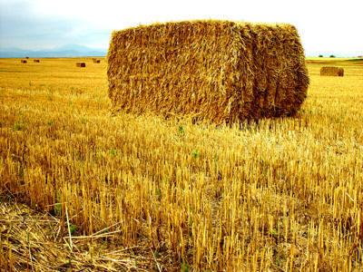
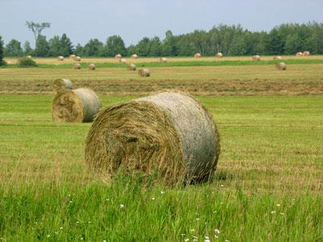
Lack of substrate use in zoos
Hilda Tresz
Behavioral Manager
Phoenix Zoo
ICEE 2011

Slide 2
What is this presentation about?
The number of zoos and other facilities that continue to house their animals on bare surfaces is alarming
Empty cages with solitary animals
Health problems
Lack of stimuli
This presentation will discuss:
The many negative effects of lack of substrate
The simplicity of providing of providing substrate
The numerous positive effects providing substrate can have on animals.
Notes:
http://www.google.com/imgres?imgurl=http://www.payvand.com/news/10/mar/Tehran-Zoo2.jpg&imgrefurl=http://www.payvand.com/news/10/mar/1240.html&usg=__v0HTHvvZus4eLdqIlqgjKQNz8sc=&h=387&w=595&sz=76&hl=en&start=42&zoom=1&um=1&itbs=1&tbnid=vVdg6aILkszseM:&tbnh=88&tbnw=135&prev=/images%3Fq%3Dold%2Bzoo%2Bphotos%26start%3D40%26um%3D1%26hl%3Den%26sa%3DN%26ndsp%3D20%26tbm%3Disch&ei=ghGiTeWZHobUgAeWkvDaBQ

Slide 3
For more than 2000 years zoos have been keeping animals in captivity yet at some degree the picture today could be the same 1870 and 1906
Notes:
http://www.zslprints.com/historic_photography/photo/3425.html?pn=1&so=1&sci=1305752214&gid=3425

Slide 4
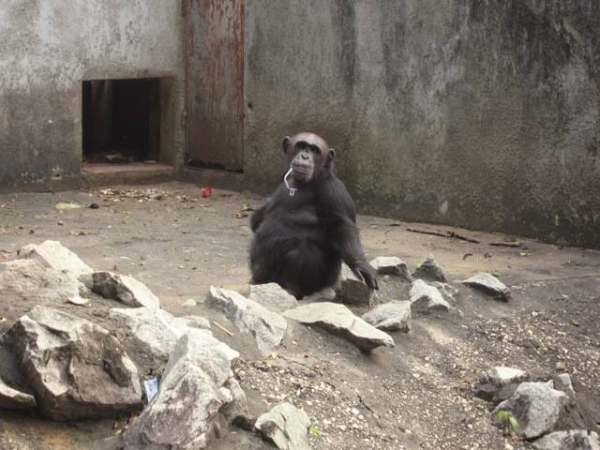
Today
Photo by Balazs Buzas
Notes:
Photo by Balazs Buzas

Slide 5
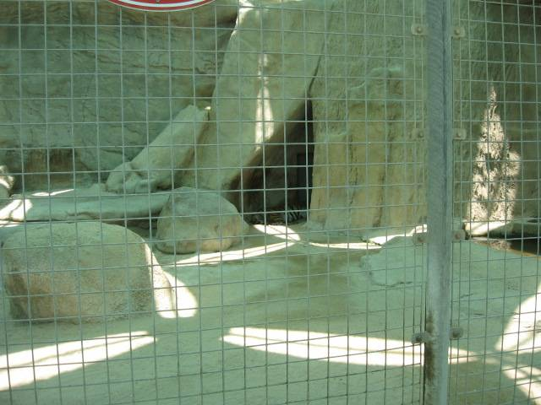
Photo by Hilda Tresz
Notes:
Photo by Hilda Tresz

Slide 6
Photo by Zofia and Stan Kurylowicz
Notes:
Photo by Zofia and Stan Kurylowicz

Slide 7
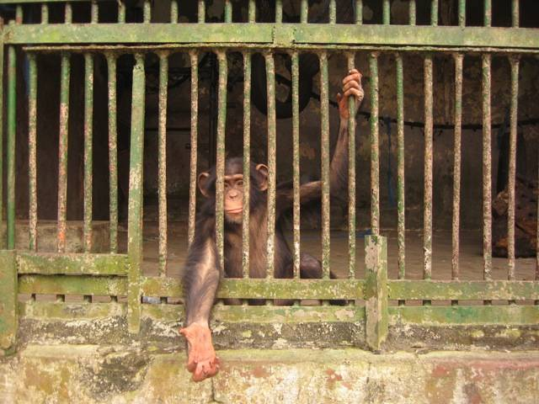
Photo by Balazs Buzas
Notes:
Photo by Balazs Buzas

Slide 8
As a result of inappropriate housing and the lack of mental stimuli, animals can develop physical or psychological illnesses, behavioral changes and abnormal behaviors.

Slide 9
Feeding Disorders
Animals in zoos with inadequate enclosures have been seen to repeatedly regurgitate and ingest food to relieve boredom.
Notes:
Joe, the gorilla at Twycross Zoo
http://www.oozemagazine.co.uk/caps1.htm

Slide 10
Pacing
Repetitive ambulatory movement - transversing the same pathway at least twice (Mellen, Haye, Shepherdson, 1998).
Notes:
Visitors watch as a polar bear cub paces at the San Diego Zoo.
Photo:http://seattlepi.nwsource.com/getaways/090596/pace05_top.html

Slide 11
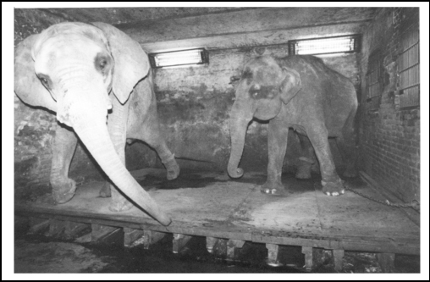
Swaying
Move slowly or rhythmically backward and forward or from side to side.
Courtesy of Alan Roocroft
Notes:
Courtesy of Alan Roocroft

Slide 12
Auto-mutilation
Some individuals turn a normal grooming behavior into an excessive cleaning behavior. This behavior, an exaggerated licking, gnawing and scratching at parts of the body, which may cause serious wounds (Meyer-Holzapfel, 1968).
Photo by Lisa Knowles, Wisconsin Regional Primate Research Center

Slide 13
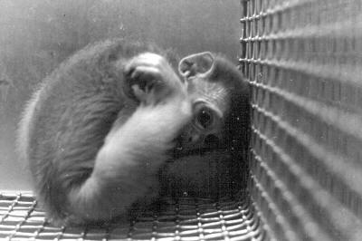
Apathy
Separation from a mate or companion to which an animal is strongly attached can evoke a state of apathy comparable to depression and mourning of man (Mayer-Holzapfel, 1968).
Notes:
Sakol, 1993

Slide 14
Over grooming Over addiction to care and attention to the body surface
Notes:
http://www.fotosearch.com/NGF003/72252258/

Slide 15
Hypothermia A potentially fatal condition, occurs when body temperature falls below 95°F (35°C).
Notes:
http://www.guzooforever.com/theanimals.html

Slide 16
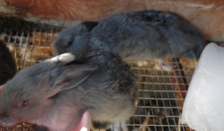
Hyperthermia
Hyperthermia is an elevated body temperature due to failed thermoregulation.
Notes:
http://pluckandfeather.com/wp-content/uploads/2010/09/overheat.jpg
http://www.google.com/imgres?imgurl=http://www.missionfarrierschool.com/images/july/school_264.jpg&imgrefurl=http://www.missionfarrierschool.com/Beau.htm&h=300&w=400&sz=59&tbnid=N2iW8To9sMMqZM:&tbnh=93&tbnw=124&prev=/search%3Fq%3Dlaminitis%2Bin%2Bhorses%26tbm%3Disch%26tbo%3Du&zoom=1&q=laminitis+in+horses&hl=en&usg=__LljAFn4x_iCrzqMf7oGCU4pXrV4=&sa=X&ei=guX4TdCuBuWw0AGptfHXDQ&ved=0CDQQ9QEwAw

Slide 17
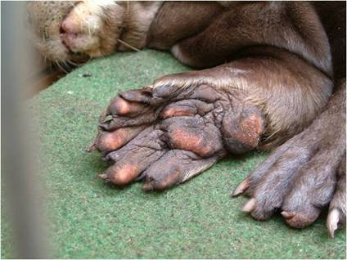
Laminitis and other foot problems
Giant Otter pododermatitis excessive pad wear and inflamation
Inflammation of sensitive layers of tissue (laminae) inside the hoof in horses and other animals.
Pho by Volker Gatz
Notes:
Photo by Volker Gatz
http://www.google.com/imgres?imgurl=http://www.missionfarrierschool.com/images/july/school_264.jpg&imgrefurl=http://www.missionfarrierschool.com/Beau.htm&h=300&w=400&sz=59&tbnid=N2iW8To9sMMqZM:&tbnh=93&tbnw=124&prev=/search%3Fq%3Dlaminitis%2Bin%2Bhorses%26tbm%3Disch%26tbo%3Du&zoom=1&q=laminitis+in+horses&hl=en&usg=__LljAFn4x_iCrzqMf7oGCU4pXrV4=&sa=X&ei=guX4TdCuBuWw0AGptfHXDQ&ved=0CDQQ9QEwAw

Slide 18
Dry skin, pressure sores, calluses and sinus growth
Notes:
Courtesy of Alan Roocroft

Slide 19
Arthritis, face and hips problems and joint swelling!!!!!!!!!!!!
Courtesy of Alan Roocroft
Notes:
Courtesy of Alan Roocroft

Slide 20
The magical effect of substrates!!

Slide 21
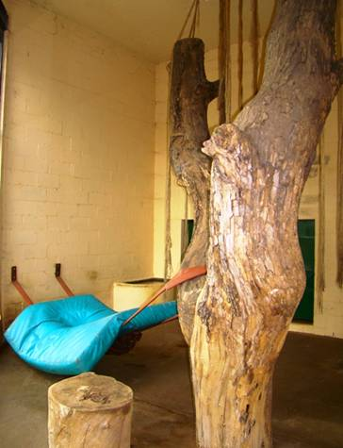
Animals are immediately off of the hot/cold/wet/dry unyielding surface
Photo by Santiago Ricci
Notes:
Enclosure without and with substrate at the Buenos Aires Zoo Photo by Santiago Ricci

Slide 22
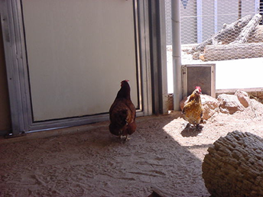
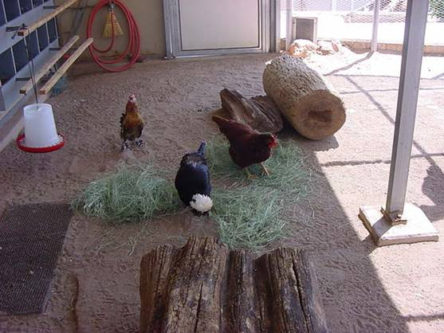
Increased activity
Inactive vs. active animals
Phoenix Zoo, Photo by Hilda Tresz
Notes:
Phoenix Zoo, Photo by Hilda Tresz

Slide 23
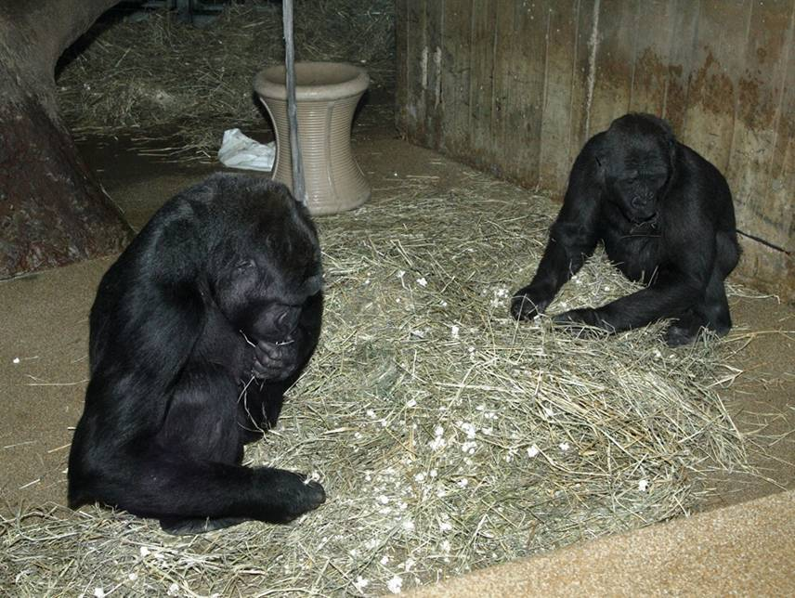
Extended foraging time
Hay, courtesy of Smithsonian’s National Zoo
Notes:
Hay, courtesy of Smithsonian’s National Zoo

Slide 24
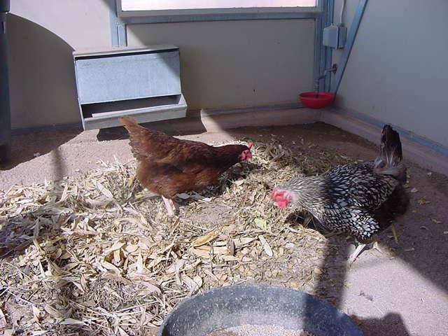
Improved diet consumption (less desirable items are being consumed again)
Phoenix Zoo, Photo by Hilda Tresz
Notes:
Phoenix Zoo, Photo by Hilda Tresz

Slide 25
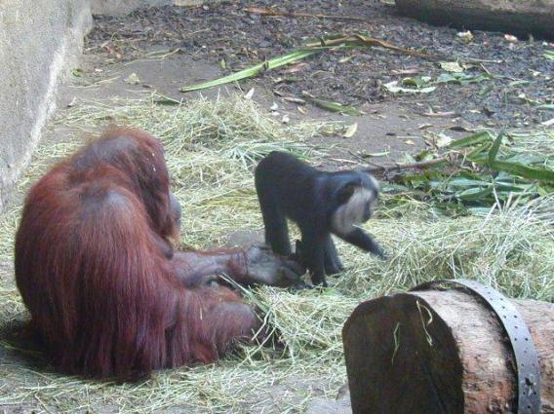
Increased manipulation, locomotion and social contact [Tripp, 1985]
Manipulative objects (substrate) increase activity level more than:
Enclosure size
Surface size of floor
Frequency of feeding
After extended exposure the animals still continued substrate manipulation, indicating that novelty is not essential to elicit interest.
Notes:
Allwetterzoo Münster , photo by Martin Schuchert
1st study of 43 groups of gorillas and 68 groups of orangutans in 42 European zoos Wilson [1982].

Slide 26
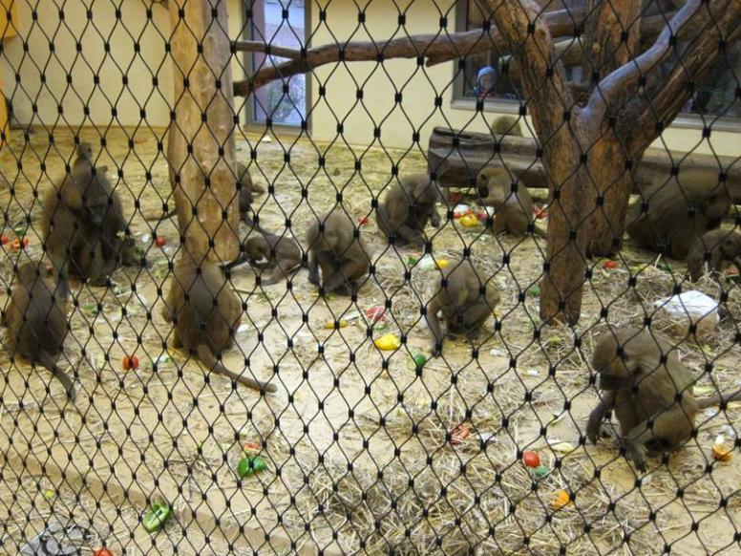
Decreased competition and social proximity
[Lutz, Novak, 2005]
Nürnberg Zoo, photo by Martin Schuchert
Notes:
Nürnberg Zoo, photo by Martin Schuchert

Slide 27
Decreased self-directed behaviors (self grooming, isolated play, and masturbation) [Tripp, 1985]
Notes:
http://upload.wikimedia.org/wikipedia/en/5/5e/Female_Orangutan_Auckland_Zoo.JPG
http://www.google.com/imgres?imgurl=http://us.cdn4.123rf.com/168nwm/jonnysek/jonnysek0908/jonnysek090800119/5342082-very-nice-orangutan-from-the-zoo-prague.jpg&imgrefurl=http://www.123rf.com/photo_5338400_very-nice-orangutan-from-the-zoo-prague.html&usg=__qPmd8eBs7J8VFBMH-5qyWjDlG1c=&h=168&w=113&sz=7&hl=en&start=143&zoom=1&um=1&itbs=1&tbnid=dLfXDKhNJ1wtqM:&tbnh=99&tbnw=67&prev=/search%3Fq%3Dorangutan%2Bzoo%26start%3D140%26um%3D1%26hl%3Den%26sa%3DN%26biw%3D1004%26bih%3D637%26ndsp%3D20%26tbm%3Disch&ei=Jib6TYfKDIHt0gHtxqmLAw

Slide 28
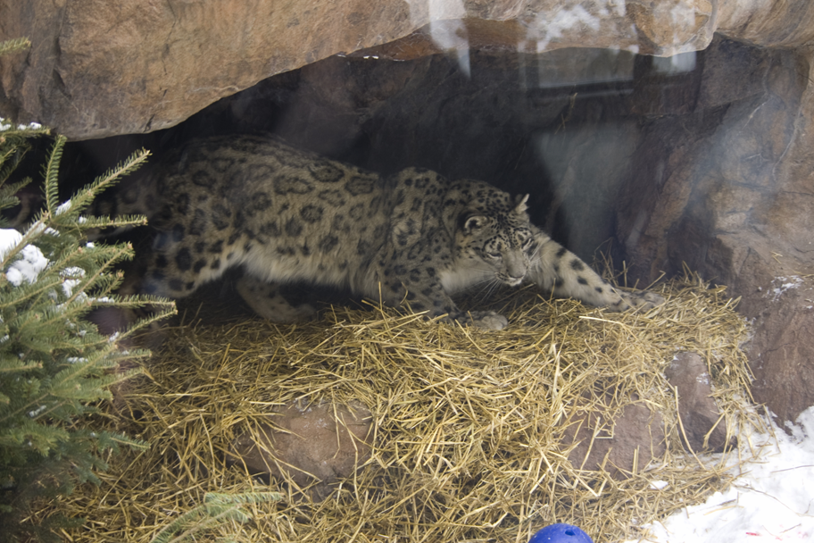
Encouraged nest building
Notes:
Straw, Como Zoo, Photo by Allison Jungheim

Slide 29
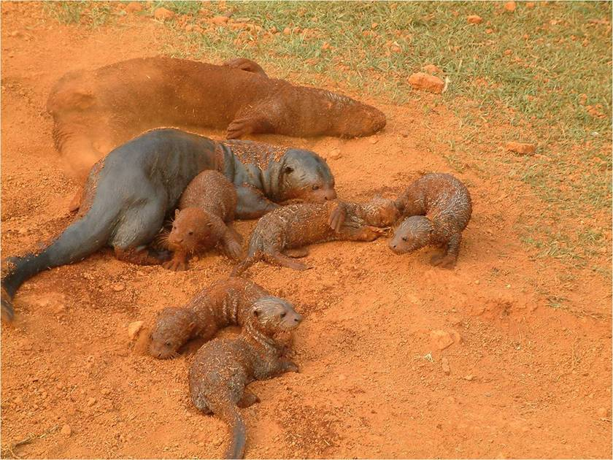
Encouraged breeding success
Red laterit sand Brasilia Zoo, Photo by Volker Gatz
Notes:
Red laterit sand Brasilia Zoo, Photo by Volker Gatz

Slide 30
Induced egg laying [Hughes, 1976]
Six out of eight hens preferred litter to battery flooring and 88% of eggs were laid on litter.
Notes:
http://www.google.com/imgres?imgurl=http://www.spca.org.hk/welfare/images/campaigns/Chicken%2520in%2520cage%2520RSPCA.jpg&imgrefurl=http://www.spca.org.hk/welfare/eng/chicken_welfare.html&usg=__6CYiwtsD_3Nug7hDPJRGdUuJ5xw=&h=424&w=640&sz=84&hl=en&start=16&zoom=1&um=1&itbs=1&tbnid=z2UTzhKjhdRK3M:&tbnh=91&tbnw=137&prev=/search%3Fq%3Dbattery%2Bflooring%2Bfor%2Bchickens%26um%3D1%26hl%3Den%26sa%3DN%26biw%3D1004%26bih%3D637%26tbm%3Disch&ei=yVI5TsPaLcnUgQfR0rnPBg

Slide 31
Birthing aid
Notes:
http://plingpling.files.wordpress.com/2009/04/baby-elephant-raya.jpg

Slide 32
Stress reduced by adding escape routes and hiding places
DirtPhoenix Zoo, Photo by Jim Hughes
Notes:
DirtPhoenix Zoo, Photo by Jim Hughes

Slide 33
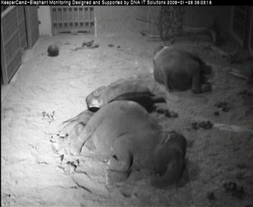
Sleeping habit improvements/Tusk wear preventions
Dublin Zoo, Photo by Gerry Creighton, Alan Roocroft-
Notes:
Dublin Zoo, Photo by Gerry Creighton
Alan Roocroft-”Tusk wear on concrete flooring has been a big problem for elephants in zoos for many years. Some zoos have even resorted to capping or metal banding the tusks so that tusk contact with the concrete is avoided”.

Slide 34
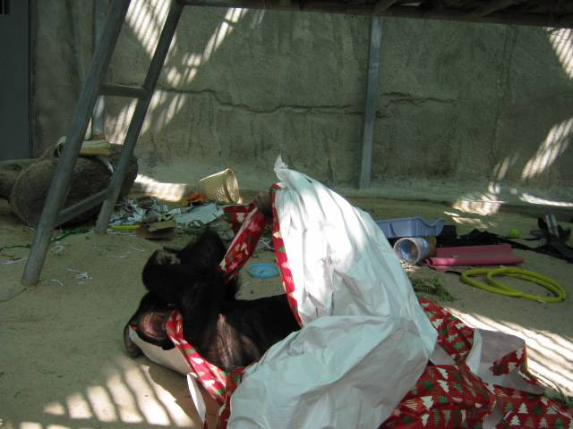
Playing materials
Phoenix Zoo, Photo by Hilda Tresz
Notes:
Phoenix Zoo, Photo by Hilda Tresz

Slide 35
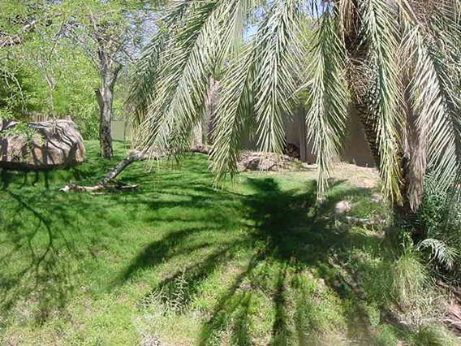
Aesthetic/Naturalistic exhibits
Grass at the Phoenix Zoo, photo by Hilda Tresz
Notes:
http://zoodesign.files.wordpress.com/2008/08/brookfield-tiger.jpg and Grass at the Phoenix Zoo, photo by Hilda Tresz

Slide 36
Keeper enrichment- cleaning is so easy, anybody can do it!
Reduced bad odor
Less cleaning (spot cleaning vs. every day hosing)
Pedro raking, courtesy of Phoenix Zoo
Notes:
Pedro raking, courtesy of Phoenix Zoo

Slide 37
List of substrates
Straw (barley, oats, rice, rye, and wheat)
Hay (rye, timothy, brome, fescue, Bermuda, orchard, alfalfa, clovers, forbs, etc.)
Excelsior (Wood wool)
Paper (shredded , newspaper, phone book, wrapping paper, etc.)
Clothing
Packing peanuts (edible)
Burlap bag
Dry leaves
Browse
Corncob
Mulch
Garden peat
Woodchips
Wood shaving
Sawdust
Ground coco
Grass/Sod
Rubber mat
Rubber floor
Dust
Sand
Clay
Soil/Dirt/Gravel
Biofloor
And many more…….

Slide 38
I know (I know!) you have your concerns!
I have some answers!!!!!!!!

Slide 39
Maintaining cleanliness and drainage problem?! Create natural flooring
12” of crushed stone for drainage
18”of sand on top
Sand is being cleaned daily, urine spots are soaked that washes through the rock layer
Air and sprinkler system
Sand is switched every 6-9 months
Notes:
Lisa Ruggiero, Roger Williams Park Zoo, Rhode Island, USA Elephant facility

Slide 40
Maintaining cleanness and drainage problem Sand box for birthing
Lumber around the perimeter of the stall to maintain a depth of 4-6 inches.
Spot clean, avoid hosing. Sweep, use leaf blowers before hosing.
Secondary traps installed in drains to catch smaller particles or pits that multiple drains go into that have larger traps
Como Zoo , photo by Allison Jungheim
Notes:
Como Zoo , photo by Allison Jungheim

Slide 41
Solutions for drain problems Pool rings
Metal or plastic rings over pool drains. 10cm (3.9”) high and about 15cm (5.9”) in diameter
Overflows with extra mesh wire over the top
Drains on land covered with steel plates with ~1/2 cm (0.6”) holes drilled throughout the plate.
Drains with standardized plastic baskets
Volker Gatz , Zoo Dortmund
Notes:
Volker Gatz , Zoo Dortmund

Slide 42
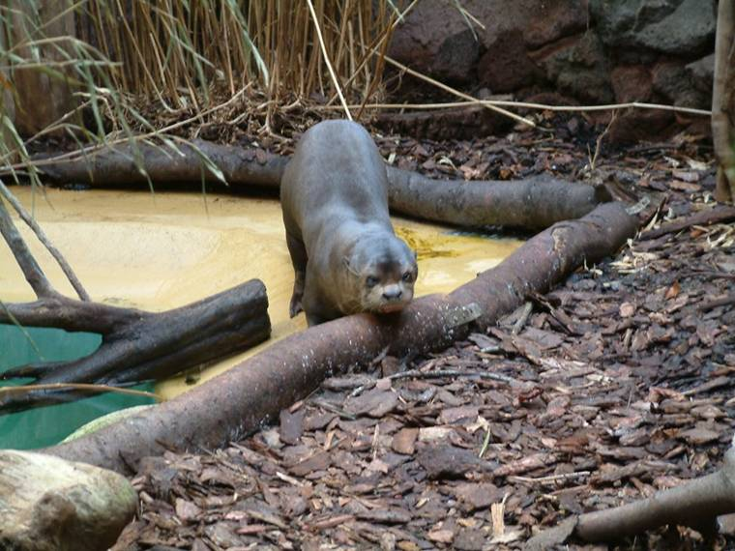
Solutions for drain problems Log borders
Volker Gatz , Zoo Dortmund
Notes:
Volker Gatz , Zoo Dortmund

Slide 43
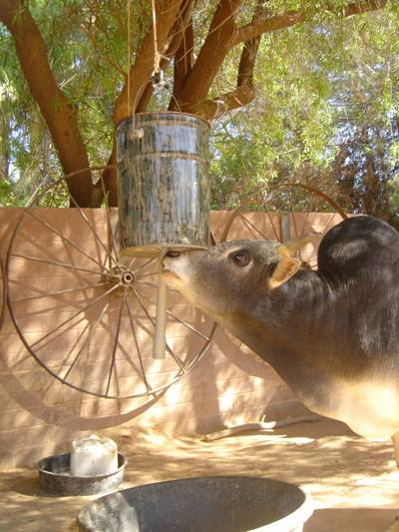
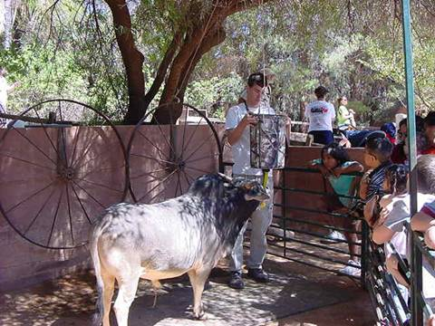
Preventing ingestion of substrate Rubber tubs and mats
Regular fecal check
Offering diet in tubs or placing mats under feeders
Notes:
Photo by Hilda Tresz

Slide 44
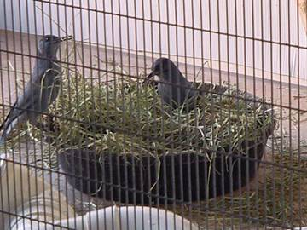
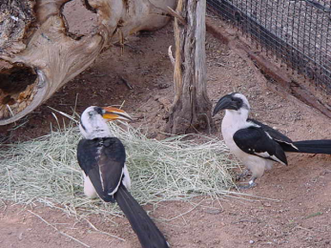
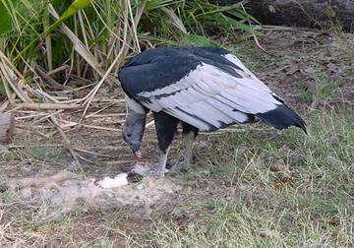
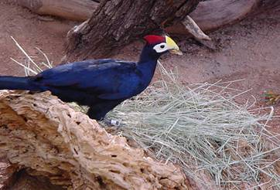
Unnecessary for tree dwelling animals, they won’t come down to the ground.
Really?
Phoenix Zoo, Photo by Hilda Tresz
Notes:
Phoenix Zoo, Photo by Hilda Tresz

Slide 45
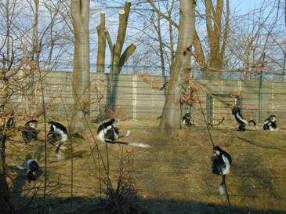
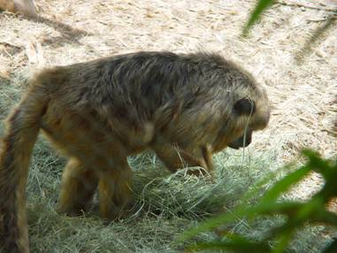
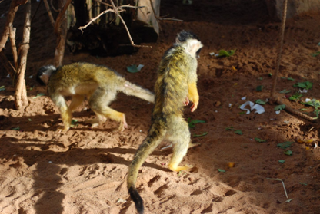
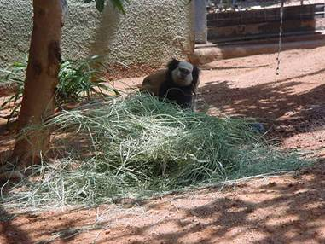
Are you still sure?
Allwetter Zoo, Nunberg Zoo, Photo by Martin Schuchert
Phoenix Zoo, Photo by Shawna Brown and unknown
Notes:
Allwetter Zoo, Nunberg Zoo, Photo by Martin Schuchert
Phoenix Zoo, Photo by Shawna Brown and unknown

Slide 46
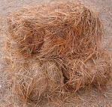
Allergies
Do not discontinue-switch substrate
“N. A. River Otter had an adverse allergic type of reaction (runny eyes, itchy skin) to pine straw. Now the animals are bed with yellow straw (horse straw).
On the opposite hand, young mountain lion cubs kept on with yellow straw had runny, goopy eyes with small, dusty particles in the corners of the eyes. The cougars went on a pine straw bed with pine shavings for their litter box. This has been a successful combination for them”.
Allison Ballentine, Western North Carolina Nature Center
Notes:
Allison Ballentine, Western North Carolina Nature Center

Slide 47
Pest control
“Combat MaxForce gel bait can be strategically applied safely into inaccessible areas (crevices, etc.) of the exhibit.
Reduced hosing of exhibits everyday decreases humidity...which the roaches possibly thrive in.”
Scorpion hunts can be organized as needed by zoo staff
Notes:
Dawn Neptune, Utah's Hogle Zoo
Phoenix Zoo

Slide 48
Who has time for extra cleaning?
Farmers whose livelihood depends on efficiency and time management use substrate daily
Notes:
http://www.travelandtransitions.com/stories_photos/images/ottawa_agriculture_museum1.jpg

Slide 49
Conclusion
“ What I am suggesting is not science, but merely common sense and animal health & comfort.”
Alan Roocroft (2005)

Slide 50
The following slides will show animals from all around the world exhibiting species-appropriate behaviors by using substrates.

Slide 51
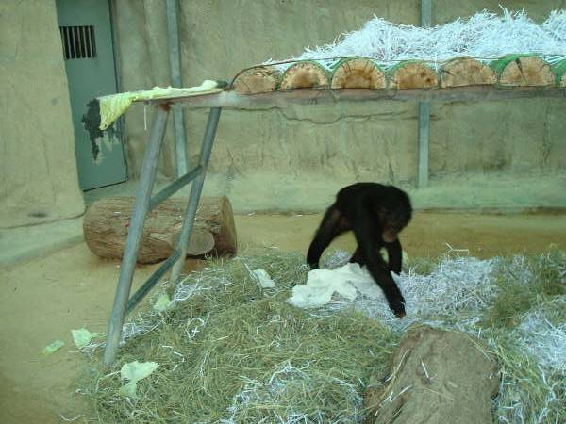
Shredded paper/Hay Doha Zoo, Photo by Hilda Tresz

Slide 52
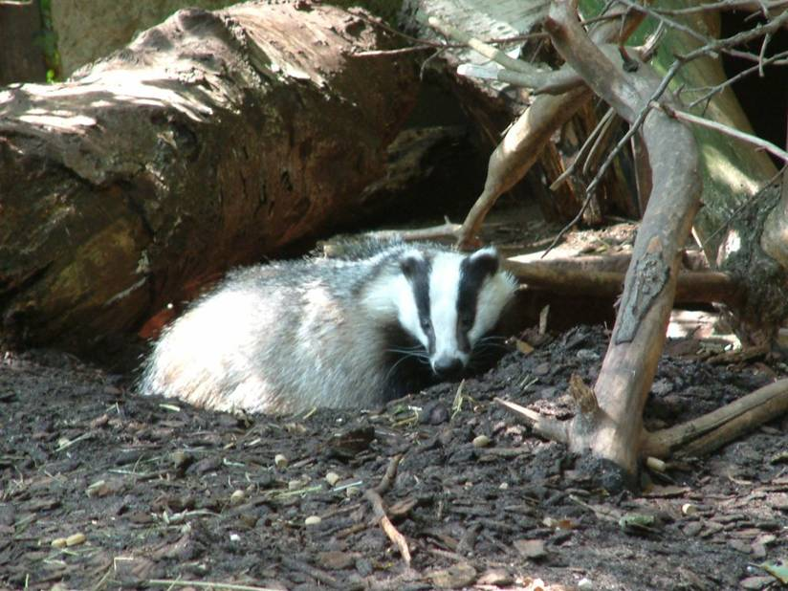
Mulch Zoo Dortmund, Photo by Volker Gatz

Slide 53
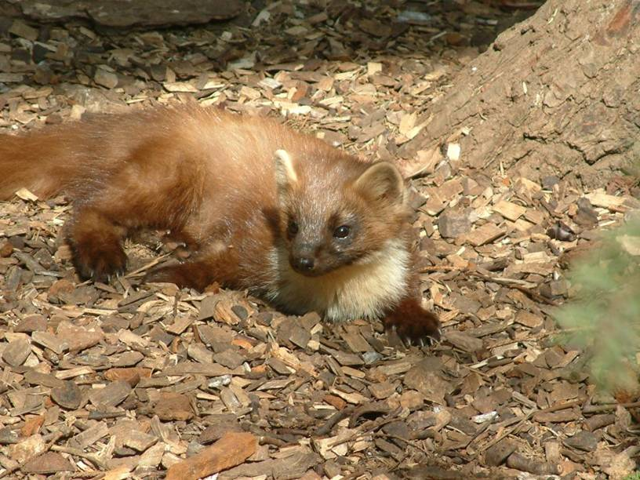
Pine chips Zoo Dortmund, Photo by Volker Gatz

Slide 54
Leaves Phoenix Zoo, Photo by Hilda Tresz

Slide 55
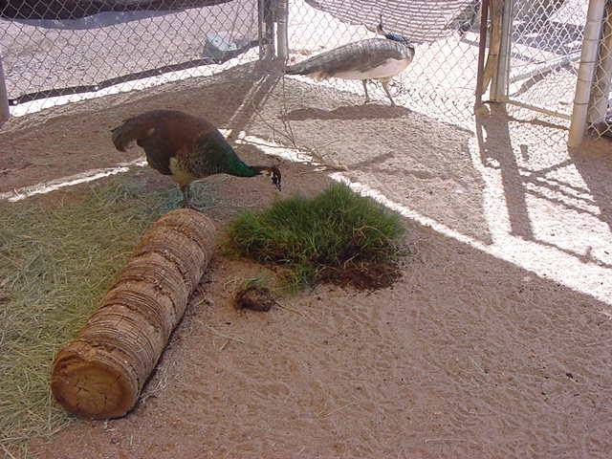
Hay/Grass Phoenix Zoo Photo by: Laura Love

Slide 56
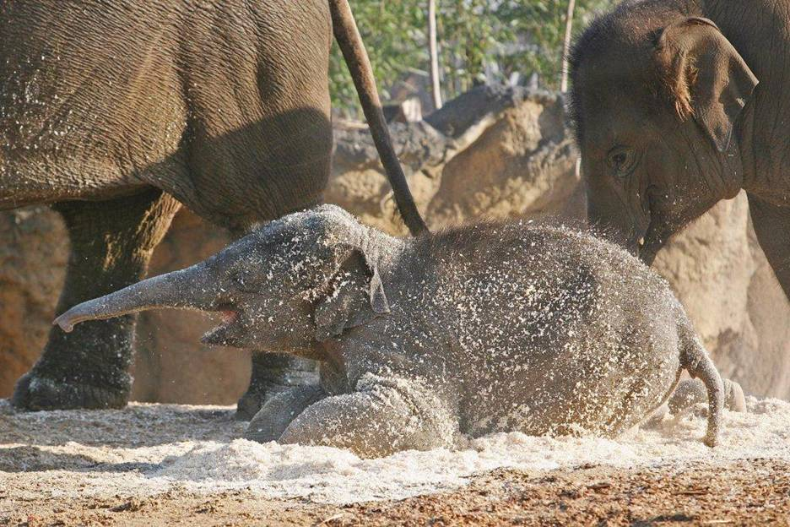
Pine shaving Dublin Zoo Photo by Gerry Creighton

Slide 57
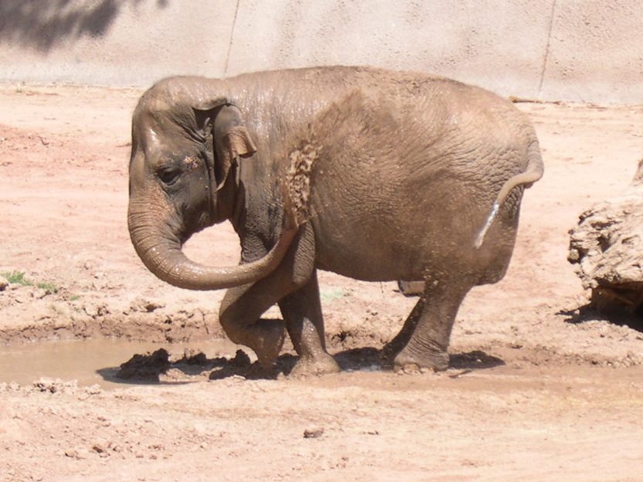
Wallow Phoenix Zoo, Photo by Hilda Tresz

Slide 58
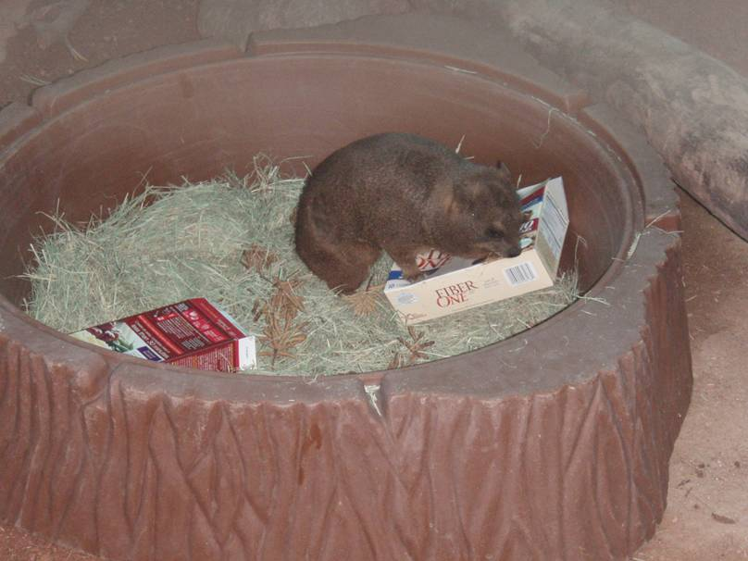
Hay Courtesy of Phoenix Zoo

Slide 59
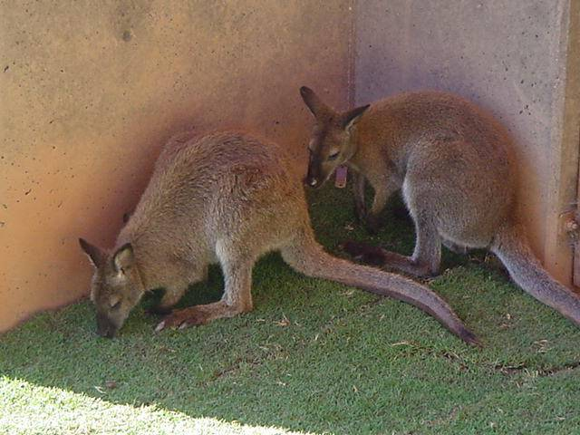
Sod Phoenix Zoo, Photo by Hilda Tresz

Slide 60
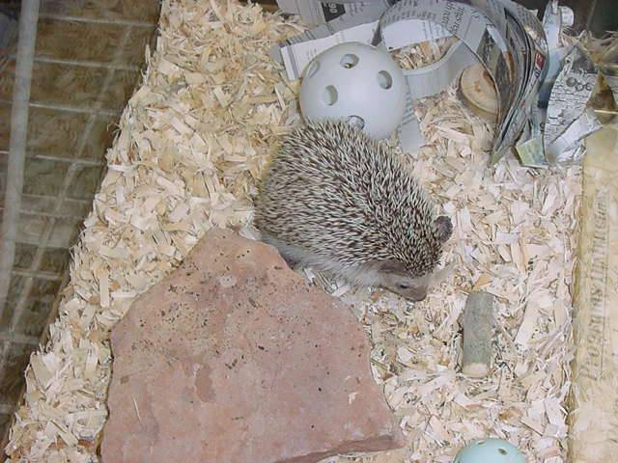
Shaving and newspaper Phoenix zoo, Photo by Hilda Tresz

Slide 61
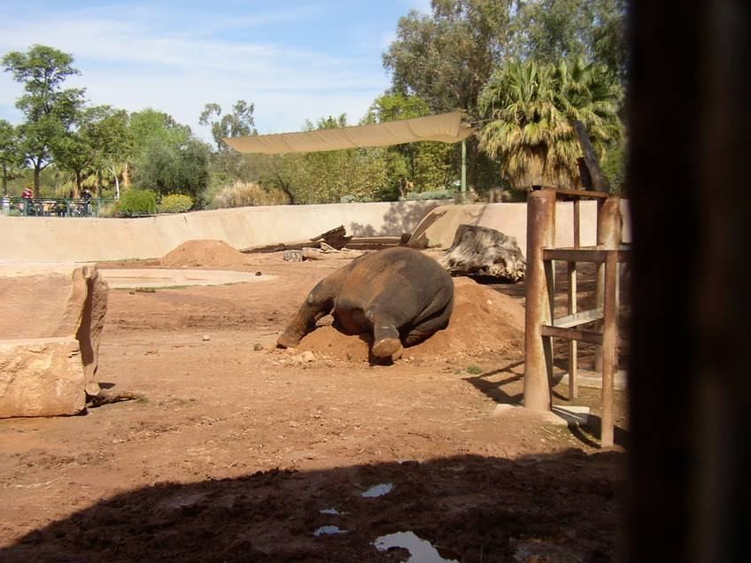
Dirt Phoenix Zoo, Photo by Steve Koyle

Slide 62
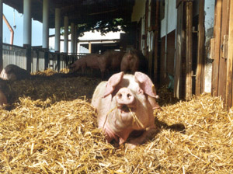
Straw
http://www.google.com/imgres?imgurl=http://www.domaene-mechtildshausen.de/images/content/MUTTERSA.jpg&imgrefurl=http://www.domaene-mechtildshausen.de/seiten/english/schweine.php&usg=__zsWXs0rMO3l-LrhO11ufOuy_QyE=&h=198&w=300&sz=41&hl=en&start=353&zoom=1&um=1&itbs=1&tbnid=Ve7sJFnWisBr3M:&tbnh=77&tbnw=116&prev=/search%3Fq%3Dpigsties%26start%3D340%26um%3D1%26hl%3Den%26sa%3DN%26biw%3D1004%26bih%3D637%26ndsp%3D20%26tbm%3Disch&ei=9H32Taj6IMPYgQe3qOyuDQ

Slide 63
Sod Phoenix Zoo, Photo by Amanda Donagi

Slide 64
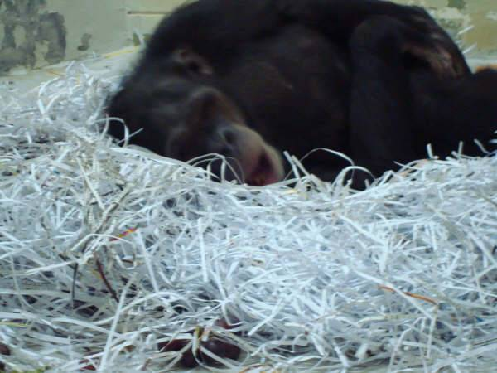
Shredded paper Doha Zoo, Photo by Hilda Tresz

Slide 65
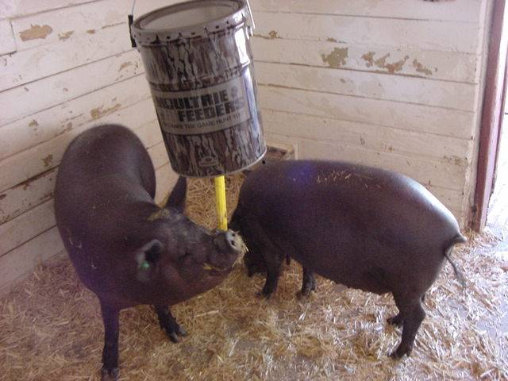
Straw Phoenix Zoo, Photo by Hilda Tresz

Slide 66
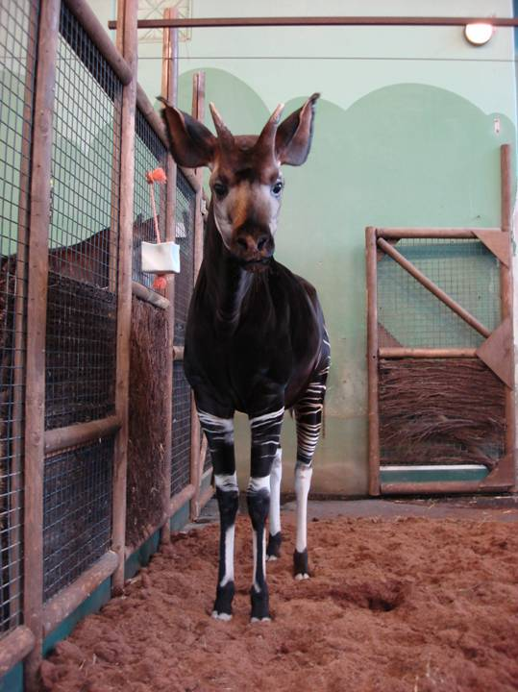
Ground coco Blijdorp Zoo, Photo by Rob von Loon

Slide 67
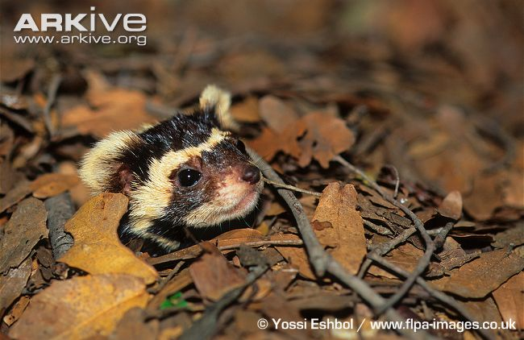
Leaves

Slide 68
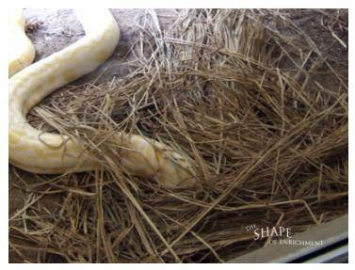
Hay (Courtesy of The Shape of Enrichment)

Slide 69
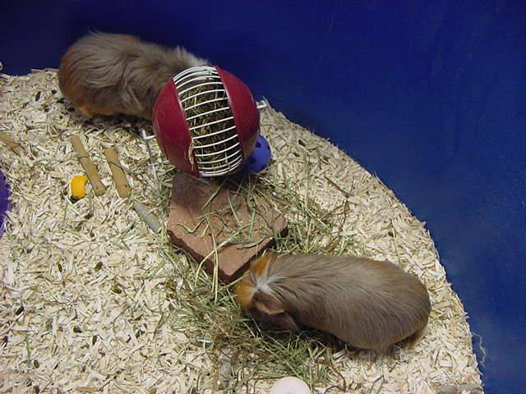
Shavings Phoenix Zoo, Photo by Hilda Tresz

Slide 70
Mulch Doue Lafontaine, Photo by Volker Gatz

Slide 71
Hay Phoenix Zoo, Photo by Hilda Tresz

Slide 72
Shredded paper Phoenix Zoo, Photo by Amanda Knight

Slide 73
Feed bag Phoenix Zoo, photo by Niki Ciezki

Slide 74
Soil
http://c.photoshelter.com/img-get/I0000Oa0CxY2XKO4/s/500/DK-19099-Gevlekte-bunzing-Vormela-peregusna.jpg

Slide 75
Moss
http://www.biaza.org.uk/public/images/campaigns/ecoWildCat.jpg

Slide 76
Dust Phoenix Zoo, photo by Hilda Tresz

Slide 77
Wrapping paper Doha Zoo, Photo by Hilda Tresz

Slide 78
Hay courtesy of Smithsonian’s National Zoo

Slide 79
Straw Bronx Zoo, Photo by Ann Littlewood

Slide 80
Shredded paper Calgary Zoo, Photo by Garth Irvine

Slide 81
Edible packaging peanuts Phoenix Zoo, Photo by Hilda Tresz

Slide 82
Leaves Phoenix Zoo, Photo by Hilda Tresz

Slide 83
Phone book Phoenix Zoo, photo by Hilda Tresz

Slide 84
Clothing Phoenix Zoo, courtesy of Phoenix Zoo

Slide 85
Excelsior Phoenix Zoo, photo by Christina Goulart

Slide 86
Hay Phoenix Zoo, Photo by Hilda Tresz

Slide 87
Browse Phoenix Zoo, Photo by Christina Goulart and Jim Hughes

Slide 88
Mulch Dublin Zoo, Photo by Gerry Creighton

Slide 89
Hay (Courtesy of Smithsonian’s National Zoo)

Slide 90
Shredded paper Phoenix Zoo, Photo by Amanda Knight

Slide 91
Straw Franklin Park Zoo, Photo by Ann Littlewood

Slide 92
Sand Zoo Dortmund, Photo by Volker Gatz

Slide 93
Hay (Courtesy of Smithsonian’s National Zoo)

Slide 94
Excelsior Monkey World, Photo by http://www.flickr.com/photos/80625872@N00/21361795

Slide 95
Dry leaves (Courtesy of Smithsonian’s National Zoo)

Slide 96
Browse (Courtesy of Smithsonian’s National Zoo)

Slide 97
Straw Franklin Park Zoo, Photo by Ann Littlewood

Slide 98
Soil (Courtesy of Smithsonian’s National Zoo)

Slide 99
Dry leaves (Courtesy of Smithsonian’s National Zoo)

Slide 100
Dry leaves courtesy of Smithsonian’s National Zoo

Slide 101
Dry leaves courtesy of Smithsonian’s National Zoo

Slide 102
The end! Or, maybe a new beginning?
Dry leaves Courtesy of Smithsonian’s National Zoo

Slide 103
Acknowledgement
Music by Wally Hestermann
Special thanks to the Phoenix Zoo Management and all zoos involved for supporting behavioral enrichment and for all keepers who take time to provide proper enrichment for their animals on a daily basis.

Slide 104
References
Bayne K, Dexter S.L, Mainzer H, McCully C, Campbell G, Yamada F. (1992): The use of artificial turf as a foraging substrate for individually housed rhesus monkeys (Macaca mulatta). Animal Welfare 1, 39-53
Chamove, A. S., Anderson, J. R., Morgan-Jones, Susan C., Jones, Susan P. (1982): Deep woodchip litter: Hygiene, feeding, and behavioral enhancement in eight primate species. International Journal for the Study of Animal Problems, Vol 3(4), 308-318.
Hartshorne. S. (2006): An evolutionary perspective of grooming as an occupation. Journal of Occupational Science, Vol 13, No 2, 126-133
Hughes, B.O. (1976);Preference decisions of domestic hens for wire or litter floors Applied Animal Ethology, Vol 2, Issue 2: 155-165
Ludes, E., Anderson, J.R. (1996): Comparison of the behaviour of captive white-faced capuchin monkeys (Cebus capucinus) in the presence of four kinds of deep litter. Applied Animal Behaviour Science 49, 293-303
Lutz, C. K., Novak, M. A. (1995): Use of foraging racks and shavings as enrichment tools for groups of rhesus monkeys (Macaca mulatta). Zoo Biology Vol. 14, Issue 5: 463-474.

Slide 105
McKenzie, S.M, Chamove, A.S., Feistner, A. T. C. (2005): Floor-coverings and hanging screens alter arboreal monkey behavior. Zoo Biology Vol. 5, Issue 4: 339-348
Meller, C. L, Croney, C.C., Shepherdson, D. (2007):Effects of rubberized flooring on Asian elephant behavior in captivity . Zoo Biology Vol. 26, Issue 1: 51-61.
Neale, D. Egg Laying Hens, Animals Asia Foundation. http://www.google.com/imgres?imgurl=http://www.spca.org.hk/welfare/images/campaigns/Chicken%2520in%2520cage%2520RSPCA.jpg&imgrefurl=http://www.spca.org.hk/welfare/eng/chicken_welfare.html&usg=__6CYiwtsD_3Nug7hDPJRGdUuJ5xw=&h=424&w=640&sz=84&hl=en&start=16&zoom=1&um=1&itbs=1&tbnid=z2UTzhKjhdRK3M:&tbnh=91&tbnw=137&prev=/search%3Fq%3Dbattery%2Bflooring%2Bfor%2Bchickens%26um%3D1%26hl%3Den%26sa%3DN%26biw%3D1004%26bih%3D637%26tbm%3Disch&ei=yVI5TsPaLcnUgQfR0rnPBg
Roocroft, A. (2009): Indoors natural substrates for elephants & medical issues associated with hard surfaces, Special Dedicated Issue of Animal Keepers Forum, April/May, Vol 36:210
Tripp, J.K. (1985): Increasing activity in captive orangutans: Provision of manipulable and edible materials, Zoo Biology Vol. 4, Issue 3: 225-234
Westergaard1, G.C., Fragaszy, D.M. (1985): Effects of manipulatable objects on the activity of captive capuchin monkeys (Cebus apella). Zoo Biology Vol. 4, Issue 4: 317-327.
Wooster, D.S. (1997): Enrichment techniques for small felids at Woodland Park Zoo, Seattle. International Zoo Yb. 35: 208-212

